Slide 1
Industry Solutions
Patrice Dau
15/10/2013

Slide 2
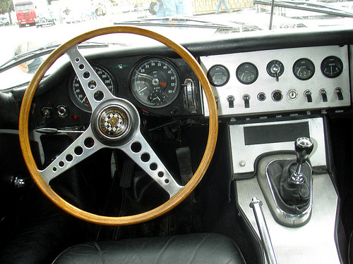
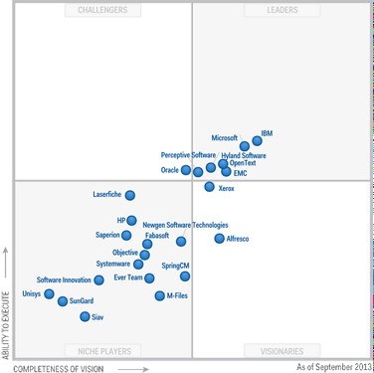
Industry Solutions : Piloter le business
Content Mgt

Slide 3
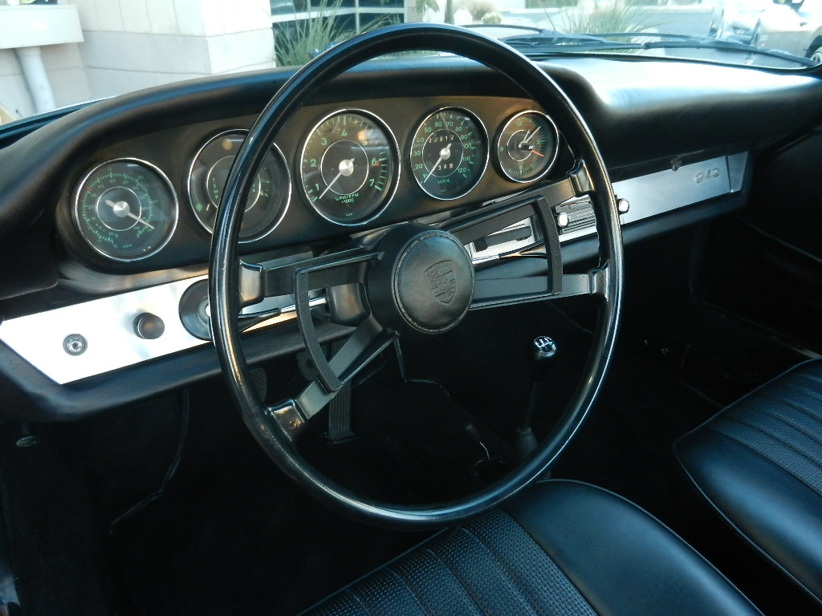
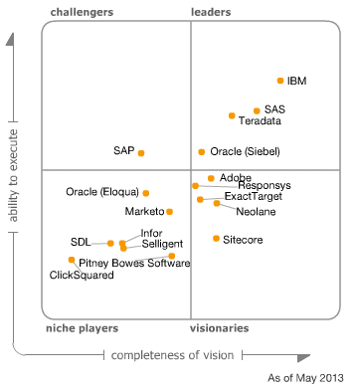
Industry Solutions : Piloter le business
Content Mgt
Marketing

Slide 4
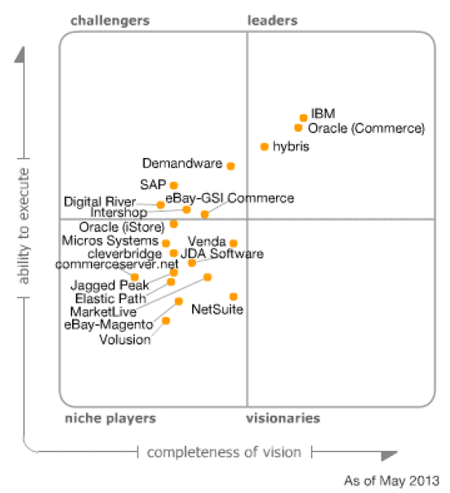
Industry Solutions : Piloter le business
Content Mgt
Marketing
E-Commerce

Slide 5
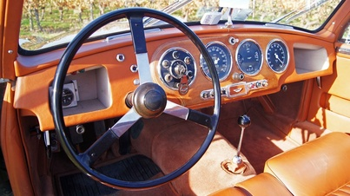
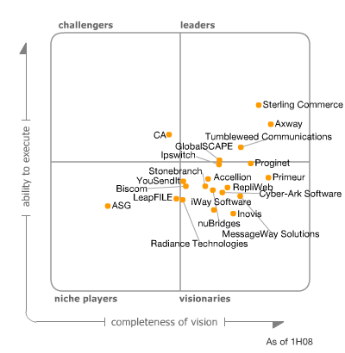
Industry Solutions : Piloter le business
Content Mgt
Marketing
E-Commerce
B2B (Sterling, WTX)

Slide 6
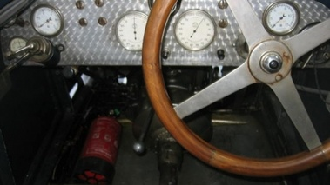
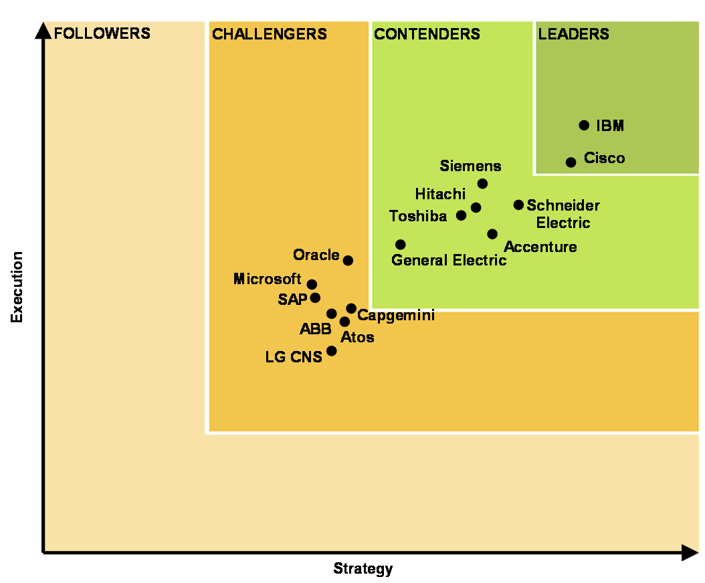
Industry Solutions : Piloter le business
Content Mgt
Marketing
Solutions leader du marché
Forte croissance
Service à forte valeur ajoutée
Part du channel insuffisante
E-Commerce
B2B (Sterling, WTX)
Smarter Cities

Slide 7
L’écurie Industry Solutions
Brand Leader : Patrice Dau
Integrated Accounts : Nicolas Meyerhofer
Large Enterprises, Paris : Salah Ayata
Large Enterprises, Regions : Frederic barbelivien
Smarter Cities : Eric Wolfarth
ECM Segment Leader : Marc Delaveau
EMM Segment Leader : Vincent Tribondeau
B2B Segment Leader : Catherine Jiquel
E-Commerce Segment Leader : Pascale Grabowski
Channel Mgr : Frederic Poupart
Marketing : Sandrine Lebouc, Celou Diallo, Remi Lissajoux

