Slide 1

RATIONAL
Business Partners
Water skiing &
Parasail

Slide 2
Equipes Sales Rational
Marketing Florence Calvez et Sidonie Goussard

Slide 3


A team ready to take off!!

Slide 4

Our expectations: A very high level of Q4

Slide 5

A controlled landing ☺ ☺ ☺

Slide 6
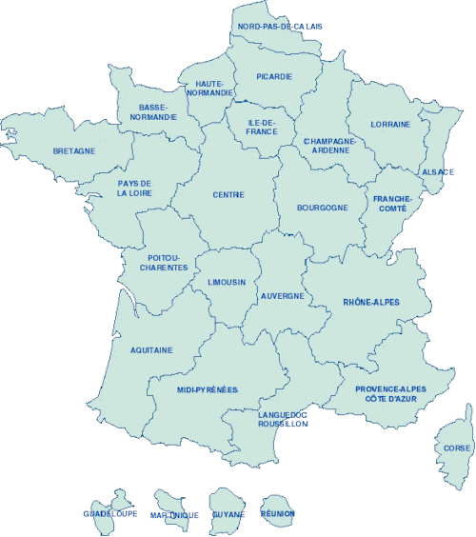


Channel MAP – H1 Results
Tech-AP
2013
Ardent (VMark)
Novalliance
Insight
ADN
Sopra
Recrutement
AxDaNe
SCC
AB Logix
D.FI
Sigma IT
Qualixo
ARCAD
NATEA
2012
2 013
COGENIT
Alteca
H1
H1
D.FI
EGDS
627 277,00 €
803 809,00 €
ASI
Kalimetrix
ASI
Erica
Prometil
ComSoft
28 % Y to Y

Slide 7
Perspective H2, a time tight, decisive timing !!!!!

Slide 8

Forbidden to miss ☹ ☹ ☹

Slide 9

But it can be done! ☺, ☺, ☺

Slide 10

Rational: A state of mind, never giving up anything

Slide 11
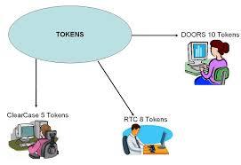
BPs Growth / Q4 Plays & focus
Croissance continue de la part des ventes indirectes dans le Business Rational
YTD -> 15 %
Obj 21 % fin 2013
Obj 35 % -> 2015
Identifier des deals TOKEN
Rational Plays for BPs
Rational Crush HP Jazz Pricing Play
  This play is designed to provide sellers competing against HP with a competitive pricing
  discount structure in the following scenarios where Rational Quality Management and
  Requirements Management products compete against HP’s equivalent products.
Rational GB Whitespace & Invest Account Play
  This promotion is designed to sell net new Rational Standard Offerings into
  accounts where few/no Rational licenses have been sold and/or competitor
  pricing has created a strong barrier to adoption and/or the account has been
  identified as Invest for deeper penetration.
Affinity Pricing Play
  To increase both the percentage of customers owning multiple Rational products
  and the percentage of the Rational portfolio owned by these customers, this play
  discounts specified products when sold in specific combinations as outlined
  below.

Slide 12


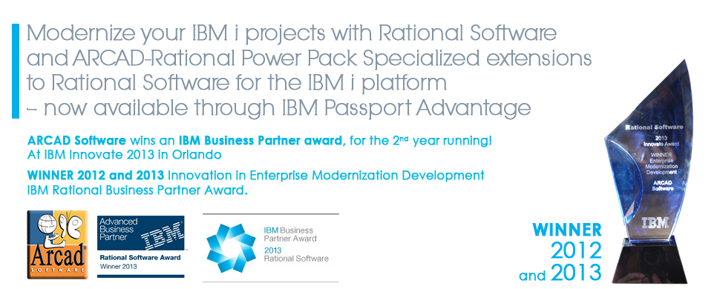












BPs Highlight

Slide 13

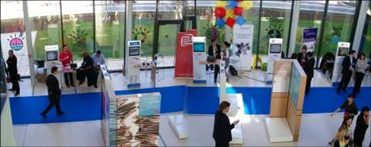

5 bonnes raisons de participer…. Découvrez:
Ce qu’est DevOps et qu'apporte l'acquisition d’UrbanCode à vos clients
Quels bénéfices la collaboration induit au sein du développement Agile
Comment développer et tester efficacement et en continu des apps mobiles
Les dernières nouveautés en matière d'Ingénierie Systèmes
Comment SoftLayer accélère les tests et le développement dans le Cloud
Une session spécifique pour nos partenaires 14h – 14h45
L’offre Arcad Pack for Rational, le nouveau standard en Gestion du Cycle de vie des applications sur IBM i
Et bien d’autres surprises => www.ibm.com/software/fr/rational/technicalsummit
Pour tout renseignement: Sidonie Goussard et Florence Calvez

Slide 14
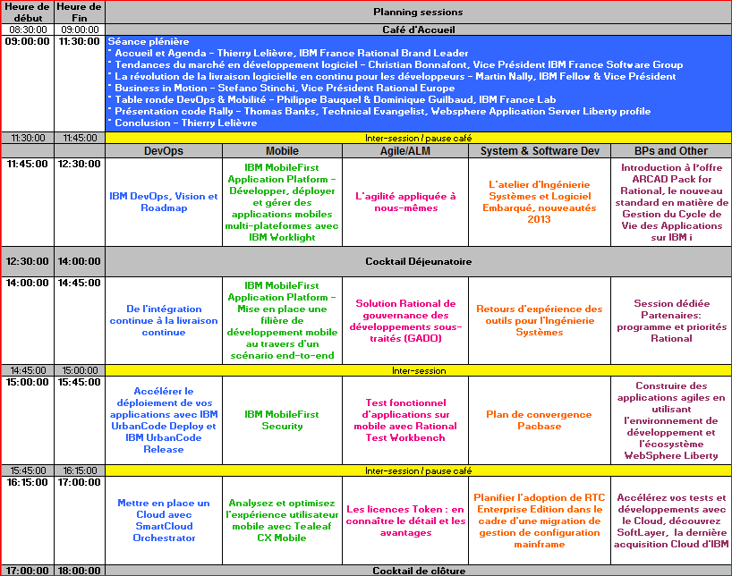
Programme Technical Summit

Slide 15

Do not forget to reach out to thank our BP's ☺

