Slide 1
IBM SPSS Modeler Gold on Cloud Jump Start Service

Slide 2
SPSS Modeler Gold Jump Start Service – Value
Predictive modeling and decision management enabled in a fast and effective manner
Focus on 1st use case with practical business value
Coaching and Mentoring with a dedicated IBM SPSS subject matter expert
Increased internal knowledge and skills
Lower risk
Notes:
Of course, any customer on an older release of Cognos should be encouraged to upgrade to our latest release if it's of value to them. But, customers on Cognos BI v8.4.1 are facing end-of-service which means, effective September 30, 2013 IBM will discontinue technical support for version 8.4.1 including Cognos BI, Mobile, Café, and Metrics Manager among others. The links here will give you the details.
It also means these customers have a compelling event driving them to upgrade. And an upgrade is always an opportunity to introduce new features and possibly upsell or cross-sell new roles and capabilities. In other words, there is both license and services revenue sitting out there in your customer base, ready to be sold.
But as I said, some customers may hesitate. The may be concerned about the risks an upgrade can introduce to their mission critical Cognos applications. They may be unsure about the upgrade process, perhaps because they have not done it before, so they want to understand the process and what approach would be best suited to their unique situation. Or, they might simply be unclear on just what benefits they could take advantage of with our latest version – not just performance improvements but all the other features we have introduced since 8.4.1 was released.
So, let's take a look at what services we have on the truck to help them.

Slide 3
SPSS Modeler Gold Jump Start – Overview
40 hours of remotely-delivered services, provided over a maximum 90 day period
Advice, guidance and assistance helping you with first use-case for SPSS Modeler Gold
Key topics may include:
Understanding and navigating Modeler Gold components in the cloud environment
Business understanding for the target use-case
Basic introduction to building analytic solutions using Modeler Gold (Crisp-DM)
Assistance uploading customer data and connecting to the hosted DB2 database
Assistance managing assets in the analytic repository
Advice on proven practices for data preparation and mining techniques
This offering does not include formal training classes (purchased separately)

Slide 4
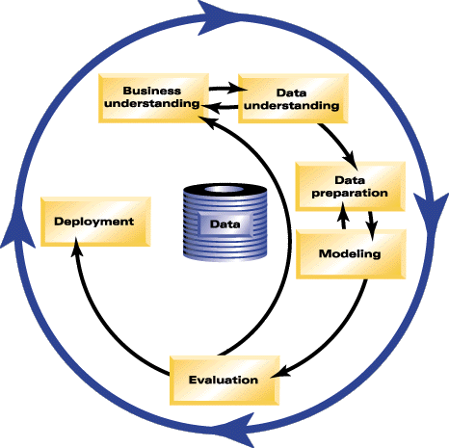
CRISP-DM Solution Implementation Methodology
Gain understanding of CRISP-DM – the Cross-Industry Standard Process for Data Mining
Reflects iterative nature of data mining
Phases include:
Business Understanding
Data Understanding
Data Preparation
Modeling & Business Rules
Evaluation
Deployment
Notes:
SPSS Inc.
Copyright 2003-4, SPSS Inc.
4

Slide 5
SPSS Modeler Gold Jump Start – Modeling
A selection of possible topics related to predictive modeling
Outline | SPSS Modeler Components | Typical Hours
Kickoff meeting | Agreement on use-case and scope of topics within context of 40 hours | 2
Business understanding | Identify / prioritize your challenges and analytic needs related to use-case | 4
Understanding Modeler Gold | Understanding and navigating SPSS Modeler Gold components in cloud environment as related to predictive modeling | 2
Introduction to Crisp-DM | Basic introduction to Crisp-DM for building analytic solutions | 4
Data understanding | Understand data sources and data quality needed to service the use case | 4 - 8
Data Preparation | Assistance uploading customer data and connecting to the hosted DB2 database | 10 - 16
Modeling | Advice on proven practices for mining & modeling techniques relevant to the use case | 4 – 8
Asset management | Assistance managing assets in the analytic repository related to the use case | 4
Engagement summary | Recommended next steps and Go Forward Plan | 2
Additional hours can be purchased separately if needed
Notes:
Module 13 – Upgrading Reports to Cognos 10
IBM CONFIDENTIAL – DO NOT DISTRUBUTE 13-5
Jump Start Service – main focus is on skill development and self sufficiency. Update to reflect Just Jump Start, cut the Quick start information into the speaker notes on how to expand the jumpstart discussion and grow engagement scope.
Quick Start Service – main focus is on coaching & mentoring implementation. Provides further assistance for depth insights and increased results for mid-size & large customers.
5

Slide 6
SPSS Modeler Gold Jump Start – Analytical Decision Management
A selection of possible topics related to decision management
Outline | SPSS Analytical Decision Management | Typical Hours
Kickoff meeting | Agreement on use-case and scope of topics within context of 40 hours | 2
Business understanding | Identify / prioritize challenges and analytic needs related to the business application | 4
Understanding Modeler Gold | Understand and navigate Decision Management and Collaboration and Deployment Services components in the cloud environment | 2
Introduction to Crisp-DM | Introduction to Crisp-DM as it relates to building and deploying analytic solutions | 4
Data understanding | Understand the analytical and operational data sources required for the use case | 4 - 8
Data Preparation | Assistance uploading customer data and connecting to the hosted DB2 database | 10 - 16
Business Rules | Advice on proven practices for developing business rules relevant to the use case based on supplied templates | 4 – 8
Optimization | Advice on proven practices for applying optimization to the use case based on supplied templates | 4 – 8
Asset management | Assistance managing application streams, models, and rules in the analytic repository | 4
Engagement summary | Recommended next steps and Go Forward Plan | 2
Additional hours can be purchased separately if needed
Notes:
Module 13 – Upgrading Reports to Cognos 10
IBM CONFIDENTIAL – DO NOT DISTRUBUTE 13-6
6

Slide 7
Suggested Training (not included in Jump Start)
The following formal IBM SPSS education offerings, taken prior to the Jump Start, may extend the value of the Jump Start service:
Recommended
Introduction to IBM SPSS Modeler & Data Mining – 2 days or self-paced virtual class Advanced Data Preparation – 1 day or self-paced virtual class
Optional
Clustering and Association Models with IBM SPSS Modeler – 1 day or self-paced virtual class
Classifying Customers Using IBM SPSS Modeler – 1 day or self-paced virtual class Predicting Continuous Targets with IBM SPSS Modeler – 1 day or self-paced virtual class
Advanced Predictive Modeling Using IBM SPSS Modeler – 1 day or self-paced virtual class
Notes:
Ensure that your resources are properly prepared to extract the maximum benefit from the SPSS Modeler Service offering.
7

