Slide 1
<Client Name>
IBM OpenPages V7 Upgrade Services
Customer Facing Presentation

Slide 2
Instructions
These slides are intended for IBM OpenPages V7 Upgrade Services only
Use this presentation with customers prior to a formal proposal or contract
Adjust presentation material as needed to help the client understand what upgrade options are appropriate for their organization
This presentation is designed for an 1 hour customer meeting
Ensure you download the latest version of this presentation – improvements may be made on a regular basis
Locate additional BA Lab Services, Guardian Services or Education services slides from the Sales Presentation Builders master deck on the BA Lab Services Portal
Locate any additional product related slides on Software Sellers Workplace | Products
Questions? Contact Don Schafheitlin/Toronto/IBM, Americas Services Executive
******This slide for internal use only – remove from your final customer presentation*****

Slide 3

Upgrade to IBM OpenPages V7
Enhance user experience and support risk-based decision making
Most complete and powerful set of services to maximizing your investment in IBM Software
Expert assistance helps you assess, plan and execute your upgrade to IBM OpenPages V7
Flexible delivery options to help you achieve your goals
Proven practices designed to accelerate your upgrade strategy
Sharpen your team’s skills with our Education Service options
Notes:
IBM CONFIDENTIAL – DO NOT DISTRUBUTE 13-3

Slide 4

Agenda
Considerations for Upgrading to IBM OpenPages V7
Overview of IBM OpenPages V7 Services
  Upgrade Assessment Service
  Upgrade Implementation Service
  Education Service Options
Next Steps

Slide 5
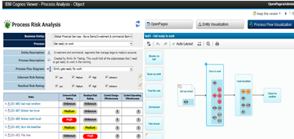
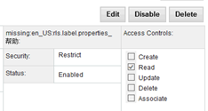
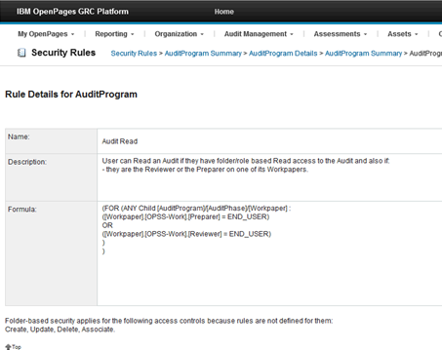
Business Drivers for Upgrade
User Experience
UI modernization: Modern styling and improved usability Task Base UI: Select appropriate view for the data; customize, analyze and make bulk updates in place Visualization: Interactive visualization capabilities integrated into the GRC platform with the ability to analyze and directly interact with the data Create rich visualizations that provide insight into risk data Easily navigate complex relationships and hierarchical data Understand risk and control data in context of business entity and/or business processes
Serviceability
Rule-based Security: Ability to setup granular control over access rights to data Improved API for application extensions and integration Provide significant functional coverage and new features Include better documentation, samples and leverage industry standards Achieve more granular control over access rights to data Enforce segregation of duties across an organization
Notes:
Module 13 – Upgrading Reports to Cognos 10
IBM CONFIDENTIAL – DO NOT DISTRUBUTE 13-5

Slide 6
IT Drivers for Upgrade – Software Specifications
 | 5.X | 6.X | 7.0
Operating System | Windows Server 2003 SP2 | Microsoft® Windows Server™ 2008 R2 / IBM AIX® 6.1 (64-bit) | AIX 6.1; AIX 7.1 - RHEL 6.1 / 6.2 / 6.3 on x64 Intel - Windows 2008 R2; Windows Server 2012
Database Server | BEA WebLogic version 9.1 | Oracle® Database Client 11g R2 (11.2.0.1) | - DB2 ESE 10.5 - Oracle 11g R2
Application Server | BEA WebLogic 9.1 | AIX - IBM WebSphere® Application Server (WAS) 7.0.0.13 Windows - Oracle WebLogic Server 10.3.2 - WAS ND 8.0 / 8.5 / 8.5.5 [supported only in 6.2.1] | AIX - WAS ND 8.0 / 8.5 / 8.5.5 Windows - Weblogic AppServer 10.3.2 (Drop Announcement)* - WAS ND 8.0 / 8.5 / 8.5.5
Reporting Server | Cognos ReportNet 1.1 MR4 | IBM Cognos 8 Business Intelligence Server AIX - Apache HTTP Server™ 2.2.14 or greater Windows - Microsoft Internet Information Services (IIS) 7.0 | Cognos BI 10.2.1 (Bundled/Entitlement for OpenPages use)
Java | JDK1.5 | JDK 1.6 or greater, 64-bit | JDK 1.6 or greater, 64-bit
Browser Version supported | Internet Explorer 6 | Internet Explorer 7 OR 8 in Compatibility view | Internet Explorer 8, 9 in native mode OR 10 in Compatibility view

Slide 7

Upgrade Services At-a-Glance
Service | Description | Work Product
IBM OpenPages V7 Upgrade Assessment Service | Discovery session to gather high-level information about your upgrade, business priorities, complexities, and readiness Assess and develop upgrade scope, approach, level of effort, resources and training that are required for your organization’s upgrade 1 day Implementation Workshop for core team | Assessment Service SOW proposal Perform Upgrade Assessment Upgrade Assessment Summary including custom solutions to be remediated for upgrade High level Project plan and Timeline A training plan with recommendations for the training steps necessary to support a successful upgrade process is also provided
IBM OpenPages V7 Upgrade Implementation Service | Upgrade Hardware needed for OpenPages latest version without impacting current version Upgrade OpenPages application and remediate customization 1 day Core Implementation Workshop OpenPages 7.0 Administration Training* OpenPages 7.0 Report Author Training* End User Adoption – using OpenPages WBT | Upgrade Service SOW Proposal Upgrade deployment plan Upgrade required Hardware needed Upgrade OpenPages Application Remediate Customization
Leverage IBM OpenPages V7 Features | Enhance user experience and support risk-based decision making Public API, Rule Based Security, Pre-Configured ORM in one platform to enhance serviceability | Upgrade Service SOW Proposal customized to your requirements. Blueprint to gather requirements Updated Project Plan Implement new feature for client needs

Slide 8
Upgrade Assessment Service Overview
Overview | Features and Benefits
Pre-upgrade informational service provides you with a comprehensive understanding of the resources and training necessary for your organization’s upgrade A series of subject area interviews with appropriate users and functional area stakeholders to review and discuss your goals, requirements and objectives, all of which help define the scope of your upgrade Detailed plan includes Hardware requirements, assessment on customization Training plan with recommendations for the training steps necessary to support your upgrade process | Upgrade scope and plan adapted to your upgrade Strategy Environment's plan using IBM proven practices Training plan designed to build necessary skills Identify upgrade options and alternatives Provides an introduction to new features and options Accelerate your upgrade with a an implementation plan and scope based on well-documented requirements
Key Activities | Work Products
Working session to review and discuss your goals, requirements and objectives, all of which help define the scope of your upgrade Reviewing the OpenPages modules deployed and in scope for your upgrade Assessing existing OpenPages applications and complexity for your current environment Working with your IT group to conduct an upgrade audit, inventory of your reports, and gather usage information Identifying customization and integration requirements Reviewing your technical systems and developing one or more environment plans Collaborating with your organization to define an upgrade approach that aligns with your business priorities 1 day Core Implementation Workshop | Upgrade services proposal customized to your requirements including Hardware requirements, Remediation plan for Customization Training plan with recommendations for the training steps necessary to support a successful upgrade process Course materials for 1 day Core Implementation Workshop

Slide 9
Upgrade Implementation Service Overview
Overview | Features and Benefits
Documented Upgrade Deployment Plan document, which will include an upgrade services proposal customized to your requirements Perform Hardware and Application upgrade Perform Remediation for Customization | Migration plan for new version Review of Remediation of customization Upgrade environment one by one which allows Users to get familiar with new features before they start using the latest version
Key Activities | Work Products
Hardware upgrade has to be performed by your IT group Upgrade OpenPages Applications in all environment's Working with your IT group to deploy remediated custom solutions Working with your IT group and Users to perform validation in all environment's User acceptance after successful validation Working with your IT group to migrate data from old environment to new environment Turn off old system and have new version to be available for Users 1 Day Core Implementation Workshop for Core Team OpenPages 7.0 Administration Training * OpenPages 7.0 Report author Training* End user Adoption – Using OpenPages WBT | IBM provide an detailed migration Plan document provides timeline Detailed Upgrade Deployment Plan Course materials for all courses provided

Slide 10
Upgrade Process
Upgrade Assessment
A migration assessment is needed to analyze the existing system and determine an upgrade path
Remediation is required for all Custom Components including Reports, Helpers, Notifications for upgrading from 5.x to 7.x
Remediation is required only for Cognos Reports for upgrading from 6.x to 7.x
Migration assessment yields a detailed project plan, timeline chart and a list of custom components that are affected by the upgrade
A migration backup is needed to provide an estimates for remediation of custom components
Upgrade Implementation Steps
Includes upgrade of application, database and reporting servers
Remediation of custom components (helpers/triggers/Cognos reports)
Perform Integration Testing
Deploy application in client environment's
Client validation in Test environment
Upgrade and validate Production
Go Live!

Slide 11
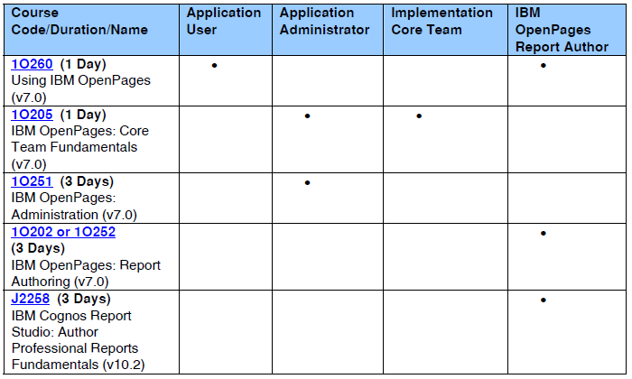
Open Pages Education Offerings Overview
IBM OpenPages Curriculum Fact Sheet
11

Slide 12
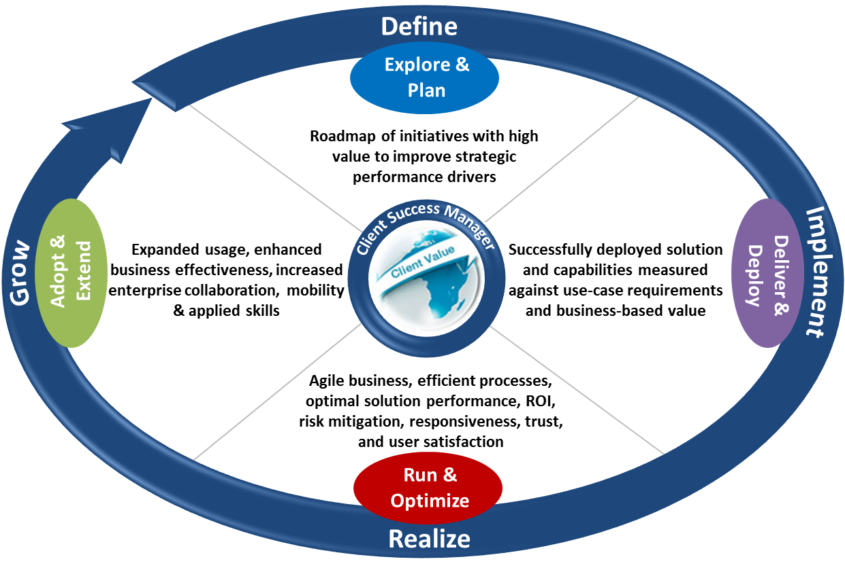
Beyond the Service [Sellers – adjust this slide as you see fit for your particular client situation]
Software Services - Cloud & SaaS Services - Education Services - Client Success Management - Customer Support
Customer Success Lifecycle
Email us: baservices@us.ibm.com
Visit us at IBM.com: Additional IBM Software Services for Business Analytics
Follow us on Twitter: @IBMBAEdu Solution Services
Subscribe to our new BA Education Youtube Channel
12

Slide 13

Questions?
?
?
?

Slide 14
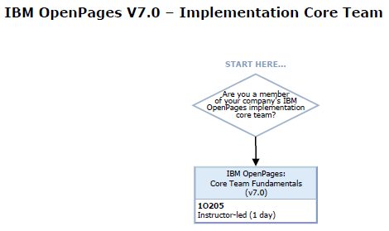
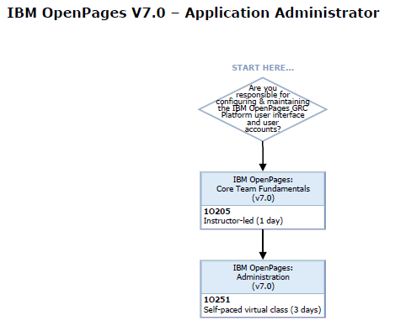
Open Pages Education Offerings Overview
IBM OpenPages Training Paths
14

Slide 15
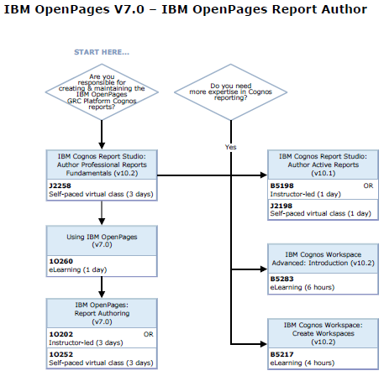
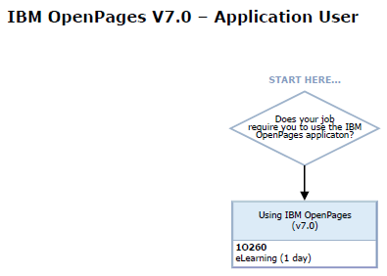
Open Pages Education Offerings Overview
IBM OpenPages Training Paths
IBM Cognos BI Training
15

