Slide 2
Today’s FINTECH Presenters
Active Intelligence
CarIQ
Findability Sciences
KrypC
MRET
Oro Wealth
Primechain Technologies
RapidQube
Signzy
Stelae Technologies

Slide 3
Active Intelligence
AI engagement platform for financial services
Siva Sai N (SVP – Product)

Slide 4






#technology
#alexa
#SIRI
#chat
#AI
Platform
Bank
OMNI CONNECTOR
© 2016 Active Intelligence Pte Ltd. Private and Confidential.
Notes:
Active Intelligence brings the Omni Connector AI platform with Out of the Box solutions from Cloud or On premises for Banks to have “Conversational Banking”

Slide 5
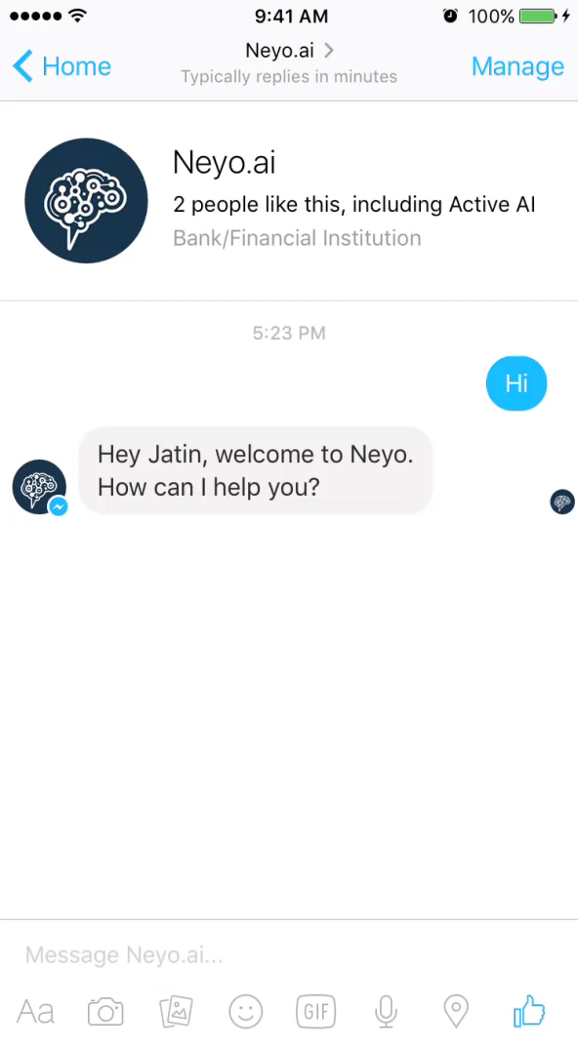
#Demo Video
© 2016 Active Intelligence Pte Ltd. Private and Confidential.
Notes:
Active Intelligence brings the Omni Connector AI platform with Out of the Box solutions from Cloud or On premises for Banks to have “Conversational Banking”

Slide 6
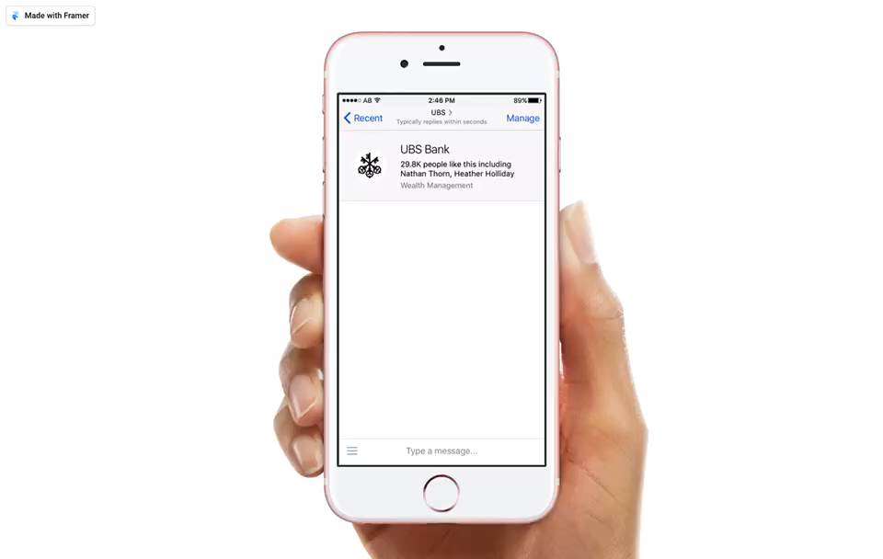
#Demo Video
© 2016 Active Intelligence Pte Ltd. Private and Confidential.
Notes:
Active Intelligence brings the Omni Connector AI platform with Out of the Box solutions from Cloud or On premises for Banks to have “Conversational Banking”

Slide 7

CarIQ
The one app for all your car needs
Sagar Apte (CEO)

Slide 8
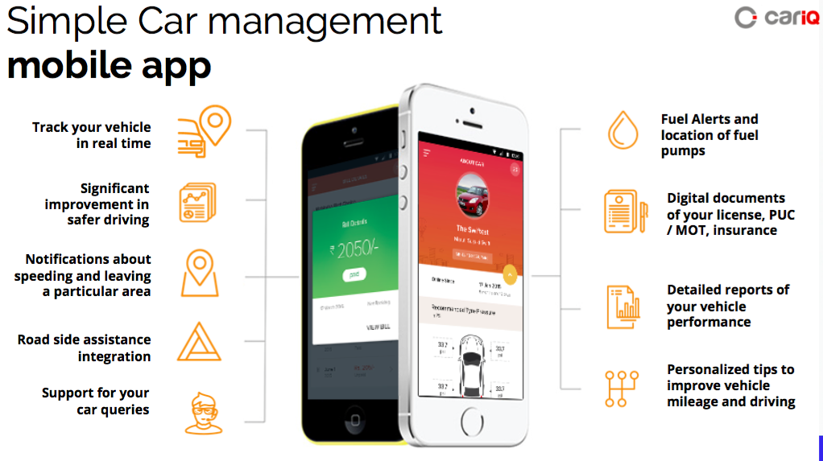

Slide 9
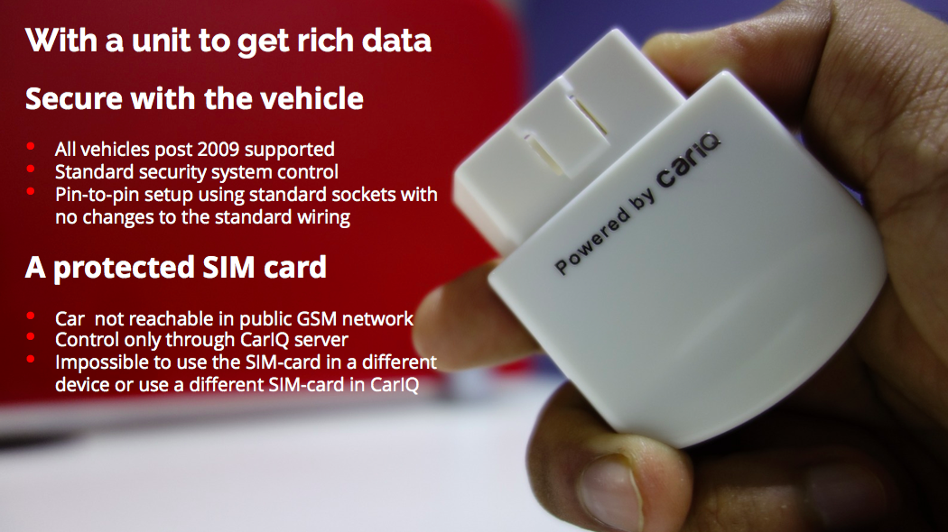

Slide 10
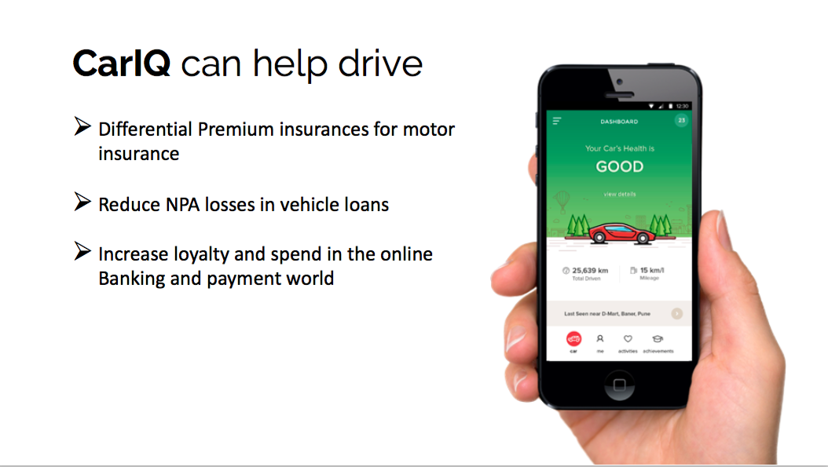

Slide 11
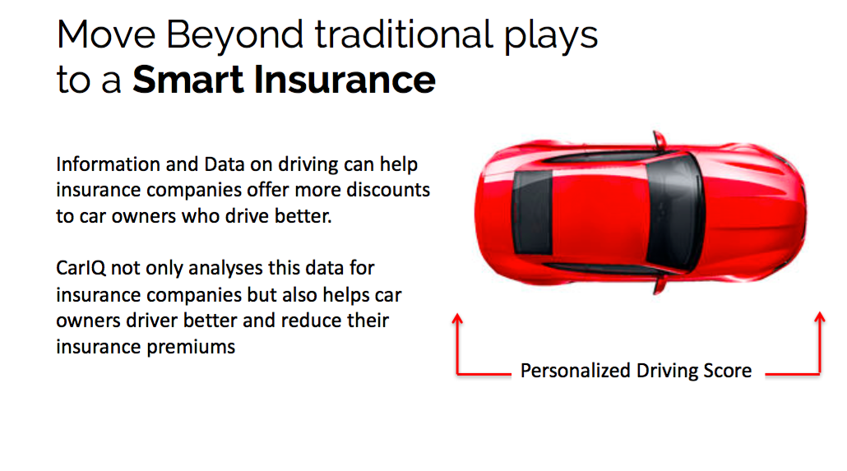

Slide 12
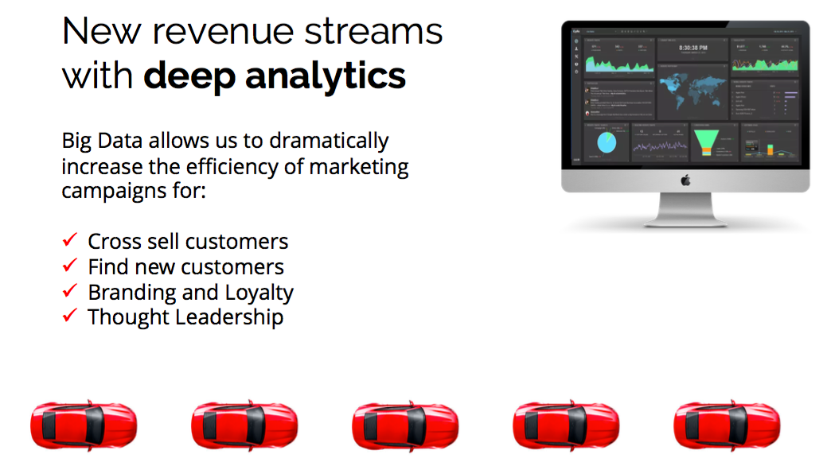

Slide 13

FINDABILITY SCIENCES
Presenter:
Sumit Agarwal
Vice President

Slide 14
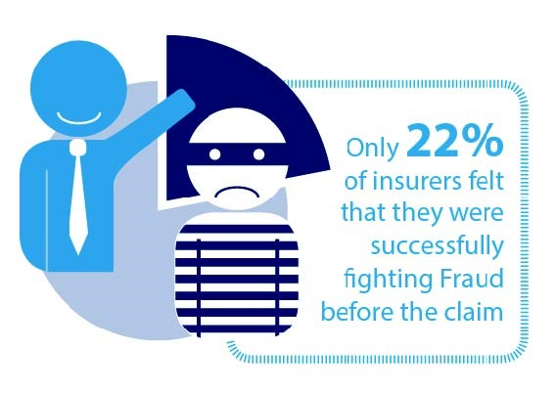













Can data ‘around’ you … ?
Tell about customer personality and purchase reasons
Who will not renew a policy?
Detect frauds as it happens?
Effect of external factors on services
Up sale
Predict diseases and treatment plan
Private and Confidential. © All rights reserved with Findability Sciences Private Ltd.
Notes:
Can this help to answer big questions?
Can we understand customer personality?, predict their behavior – what they need next, what they will buy next? Detect fraud in real time? Retain employees? Or predict the diseases in future? Like who is most likely to have cancer? Which customer will not pay EMI next month?

Slide 15











Internal
Data store
Internal Content
Taxonomy
Statistical Modeling
Using Machine Learning and Artificial Intelligence
Data Validation
Customer Analytics
Public
Data store
Public Content
Data Matching
NLC and Machine Learning
Social Extraction
Predictions using Models
Social Media, news and web data
Customer Persona
Powered By
Digital Body language
Customer Persona
Unified View
Customer segmentation
Insights
Enterprise Search
Natural Language query
Automatic
Multi-Model
Machine Learning
No variable limit
No training limit
Most accurate
Powered By
Private and Confidential. © All rights reserved with Findability Sciences Private Ltd.
Notes:
Our solution, Findability Platform – works in three simple steps
We index and store data from all possible sources. Internal, external. Structured, unstructured. Converted structured content from Stalae solution.
Platform validations the data, relate with each other to find common records. Then extracts social media profiles automatically, feeds, bio, blogs, linkedin profiles and all data to provide digital body language of individual.

Slide 16
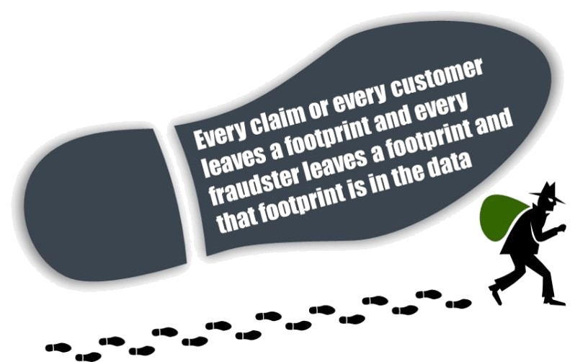
Case Study #1
Credit risk and Fraud detection
Predicting Claim fraud in insurance
Overbilling in insurance amount to 900 million dollar every year. Overbilling can be because of higher diagnosis, procedure, multiple billing, similar procedure, prescriptions, treatment plan etc.
Private and Confidential. © All rights reserved with Findability Sciences Private Ltd.

Slide 17
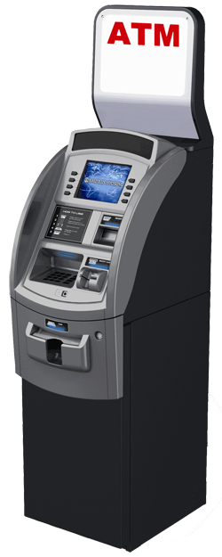

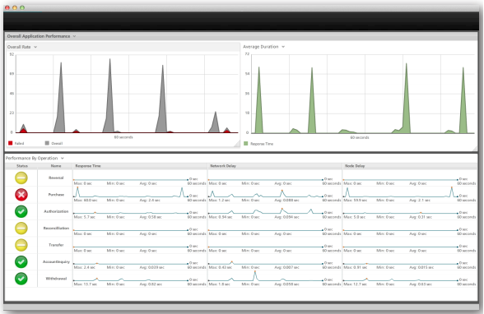
Case Study #2
Banking
Improve customer satisfaction
In new age of technology, does your customer still struggle to connect with you? Or better, can you know their pain before they even realize it? Do you run out of cash at ATM machines? Are they struck at ATM and no one to help?
Are you using their 30 second of undivided attention to offer then something unique, what they need today?
Customer is ONE. Serve as Individual.
Private and Confidential. © All rights reserved with Findability Sciences Private Ltd.

Slide 18

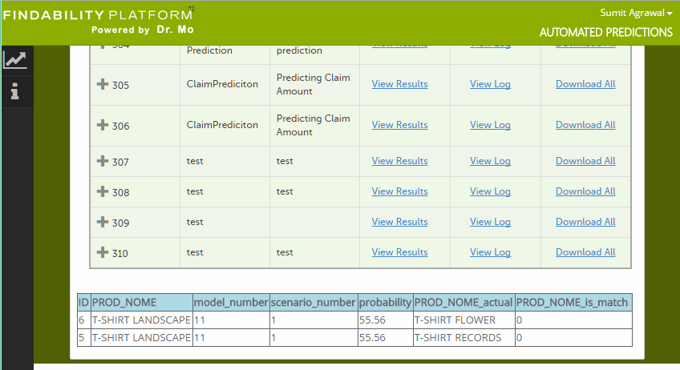


Case Study #3
Purchase motivation and prediction
For Marketing and Up Sale
Predict in real time what you customer will purchase next? Powered by Dr. Mo and IBM Watson, longitudinal prediction is most complex level to predict along with time. So we can say that ‘John Smith’ is most likely to require a personal loan of 1L in next 2 week.
Private and Confidential. © All rights reserved with Findability Sciences Private Ltd.

Slide 19



Case Study #4
Customer Segmentation
For Strategic decision making and growth
Customer segmentation based on their interest, personality, belief, motivation, location, influencer and likes.

Slide 20

KrypC
Help businesses understand, explore and adopt Blockchain
Karthik Balasubramanium (Chief Business Officer)

Slide 21



Problem Statement
Is there a better way to handle micro savings than stuffing it under the mattress?
eGold Platform

Slide 22







KrypC’s Smart Asset Trading Platform
(1) invest less than Rs.10
(3) Sell accumulated eGold
eGold
(2) Purchase micro units of eGold
(4) Reap the benefits of hard earned money
Other Players
Benefits
Gold Vault Service Provider
Auditor
Nodal Officer
Regulator
Special Interest Group appointed audit body
Exchange eGold for physical Gold and vice versa
Store physical gold
Ideally suited for consortium innovation to structure Gold as a savings instrument

Slide 23
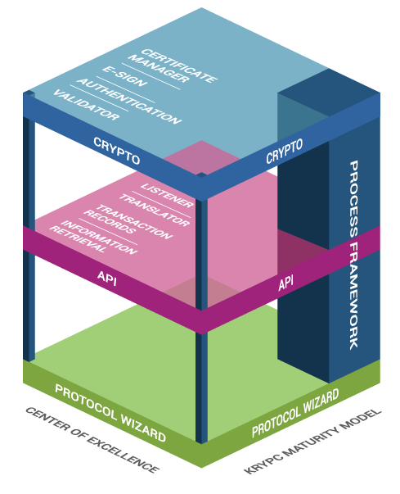
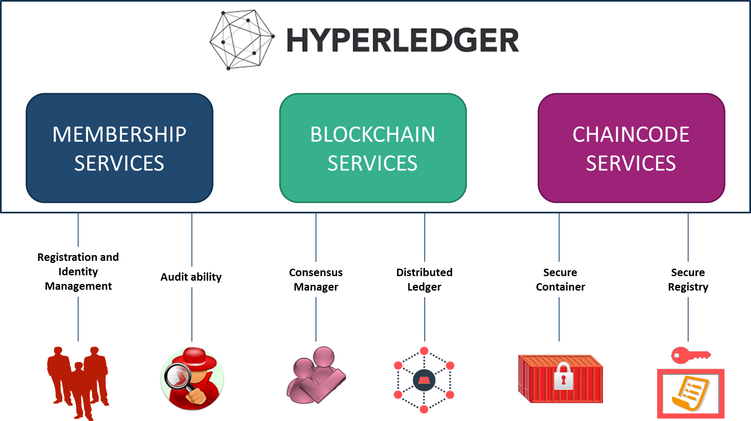
IBM’s HyperLedger + KrypCore
Crypto
Enhances the legal validity of transactions or actions performed in the Block. Module includes Certificate Management, e-Signer Component and Certificate Validator
API
Translates all the messages and actions by various Actors for recording of transactions into Blockchain. Extracts data from Blockchain for reporting and third party API
Protocol Wizard
Enables deployment of Blockchain protocols through user friendly UI driven tool by capturing parameters relating to Nodes, Actors, Block, Assets, Data elements
Process Framework
Enables inclusion of actions, messages, documents relating to transactions in Blockchain by validating access rules, binding rules and business rules defined therein

Slide 24
MRET
Combine collective human and machine intelligence
Rahul Jindal (VP Engineering)

Slide 25


Slide 26
MRET
Microstructure Research & Eng. Tech. LLC (MRET) is a holding company for various ventures involving collective human and machine intelligence
  Alpha Modus Research (AMR) is an asset of MRET
Nearly 10 years of domain expertise in high frequency finance, the market microstructure
Prashant Bhuyan and MRET is training Watson to find alpha in unstructured data.
Alpha is risk adjusted returns in excess of a benchmark. More alpha = faster growth
  Investors should only pay for alpha!

Slide 27
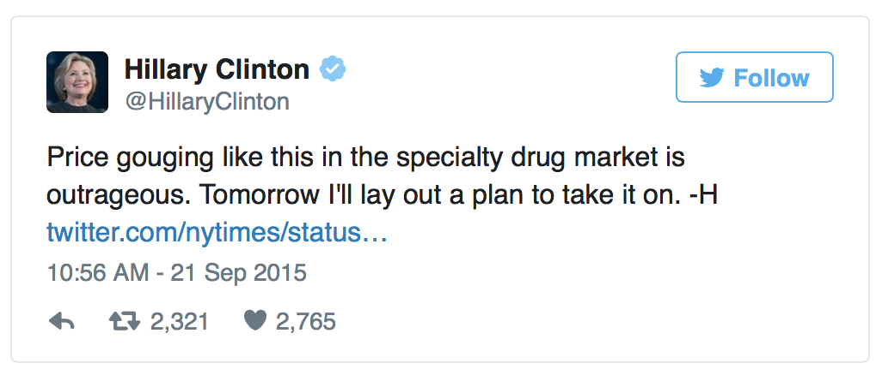
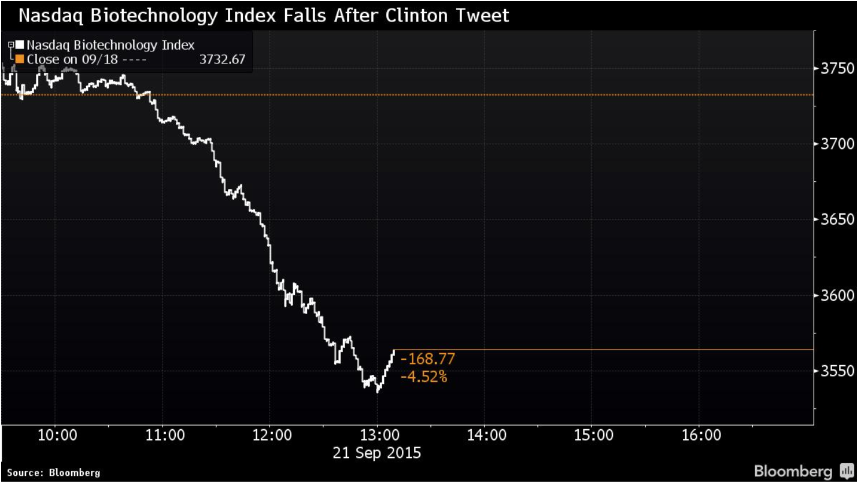
Why is Generating Alpha so difficult?
Too many factors affecting asset prices for the human mind to process
Individual cognitive biases can compound into collective manias
Hillary Clinton can tank the market with a single tweet (e.g. September 21, 2015)
Volatility is the enemy of compounding returns

Slide 28
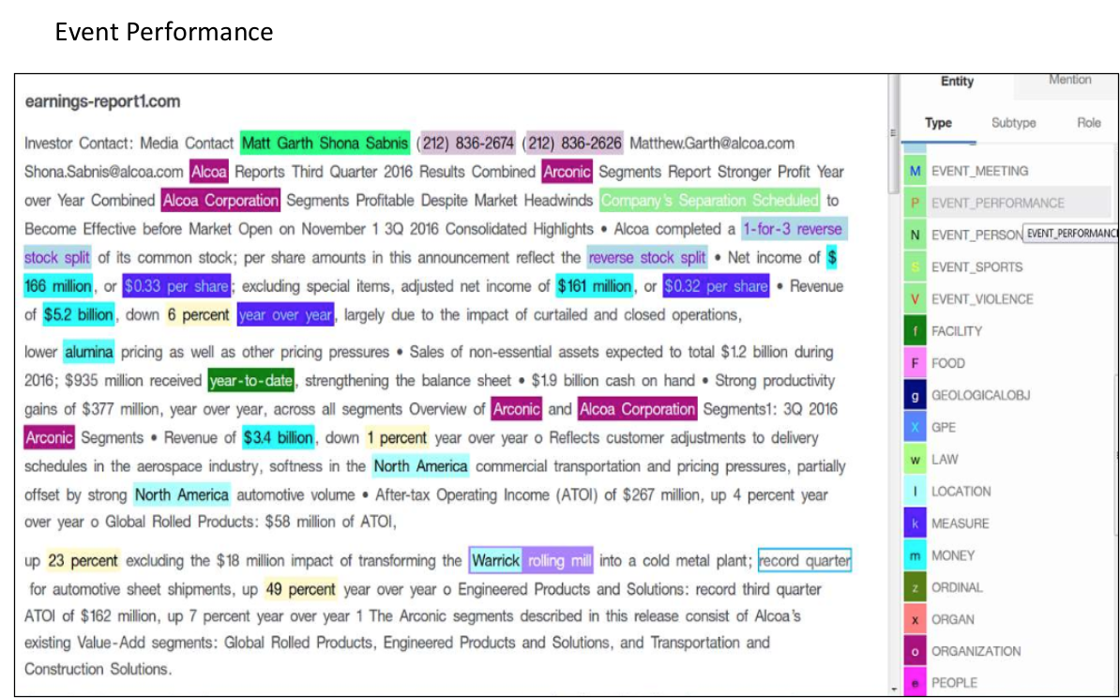
Alpha modus research training a Cognitive System on market microstructure to measure volatility in sentiment, by building custom ontologies
Create a corpus of training data
Give raw info an expert perspective by building a custom ontology
Contextual understanding evolves with over time
MRET provide APIs - embedded learning systems that asset managers can leverage to better compete in markets

Slide 29
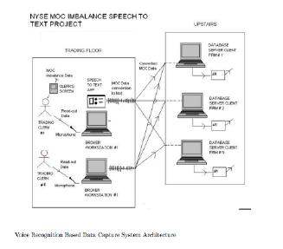
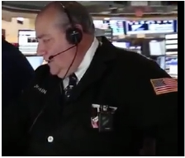
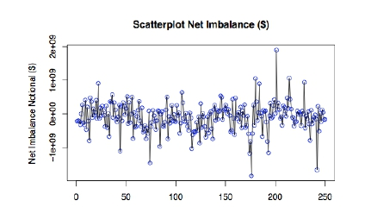
Scaling the Expertise of Floor Brokers with Cognitive Systems
➔
➔
Partnered w/ several floor brokers 5 years ago
Built a voice recognition based data capture system
Collected 2.00pm – 3.45pm EST imbalance indications every day for 5 years
Do imbalance indications predict market direction into the close of trading? (Original question posed ~5 years ago)

Slide 30
ORO WEALTH
Online Wealth Management Platform
Nitin Agarwal (Co-Founder)

Slide 31

Problem Situation
Low penetration of financial products
MF AUM as % of GDP¹
Top reasons for low penetration:
Lack of awareness
Poor distribution economics
Investing is difficult
Top hurdles faced while investing:
Lack of financial knowledge
Poor investment support
2014
2019e²
But a massive opportunity
$7906 bn
$3957 bn
7%
13%
Increase in wealth
Financialization of assets
7%
Household wealth in India
Share of financial assets
1. KPMG report on Indian mutual fund industry (2013); 2. Based on Karvy Wealth Report December 2014; USD/INR rate:65

Slide 32

Opportunity Beckons!
Financial advisors should benefit from this situation but they are plagued with problems
Insufficient reach
Advisors are predominantly offline with lengthy paperwork As a result product awareness has remained low
Poor-quality advice
AMCs rely on 3rd party agents due to poor distribution economics Ensuring quality is a challenge especially outside Tier 1 cities
Mis-selling
For retail, product distributors double up as “advisors” Commissions - based compensation leads to mis-selling
Lack of technology
Wealth will increasingly be with youth who are tech-savvy Traditional intermediaries lack consumer-facing technology

Slide 33

Our Solution
  ORO is an online wealth management platform which enables retail investors and offline intermediaries to access high quality advice and investment services
ORO building blocks
Direct to Consumer Platform
Offers 0-commission products and various financial tools for tracking, analysis and advice
Channel Partnerships
Offers digital financial tools to traditional financial institutions and intermediaries with existing client base
Technology platform
For transactions, advisory and value added services in financial products such as MFs, Stocks, Bonds, Insurance etc.

Slide 34
Market Adoption
Current Status
Direct to consumer platform was launched in January-2016
Channel Partnerships with 2 large financial institutions with an upfront revenue of Rs 20L + AUM-linked fee
NDA signed with a Large Private Bank to evaluate channel partnership
Potential to go global – in talks to partner with a remittance company in Middle East
Exclusive tie up with a top 10 IT company to serve their employees
Selected among the top 10 early stage fintech start ups by IBM SmartCamp in August 2016
Winner, Dell Start-up Challenge in August 2016
3000+ registrations
1200+ transactions
10+ cr worth investments
Top 3 Broker in India
AMC with $2bn Aum

Slide 35

PRIMECHAIN TECHNOLOGIES
Building blockchains for a better world
Rohas Nagpal (Chief Blockchain Architect)

Slide 36
z3
A highly secure blockchain for financial communication.
PBSS-1
Security standards for
private blockchains.

Slide 37

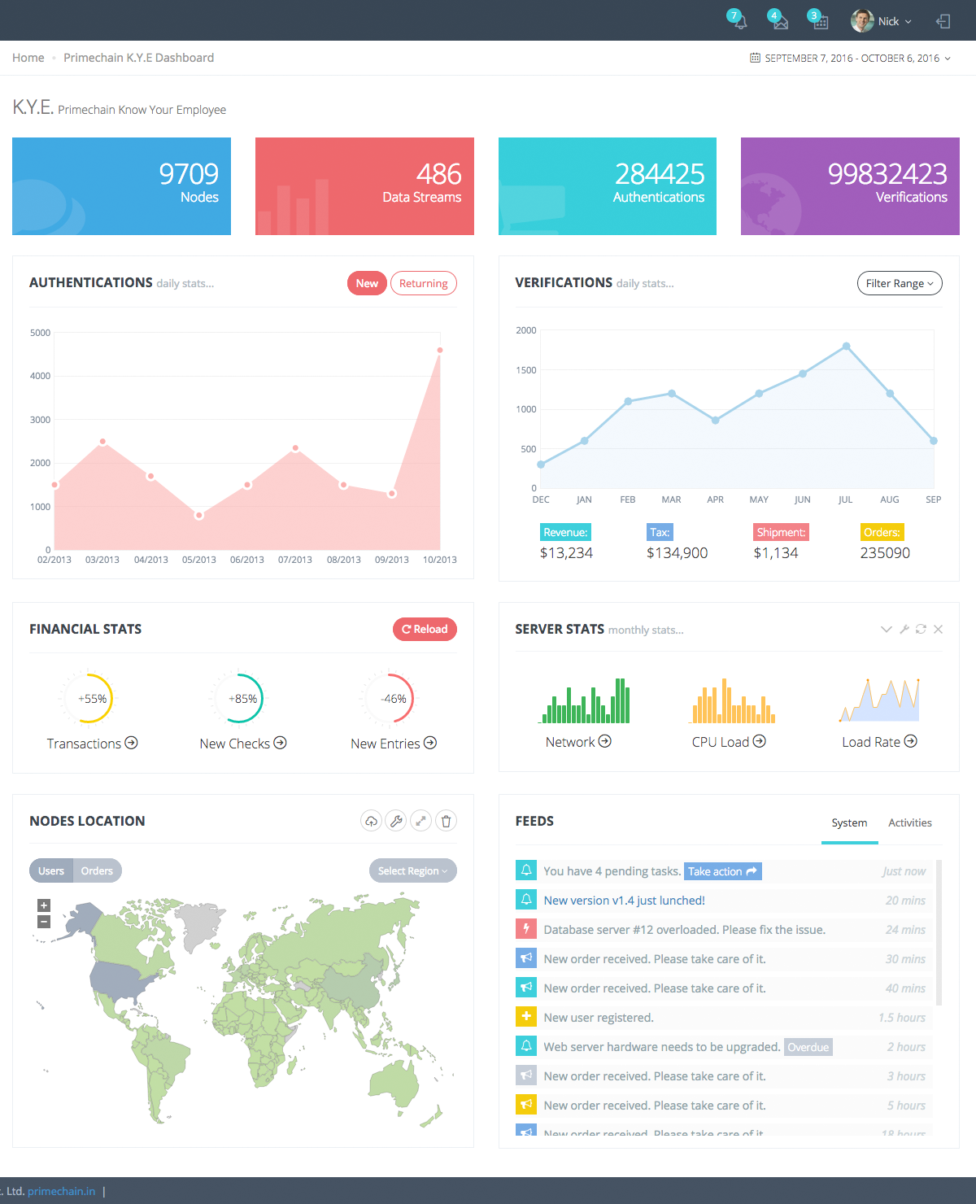
The problem
Money moves slowly
Moving money is costly
High risks of hacking
The solution - z3
Highly secure blockchain:
  Payments
  Securities
  Trade Services
  Cards
  Foreign Exchange
  Virtual Currencies

Slide 38
Industry Problem
1. | There are various security controls and for the technology and payment ecosystem.
2. | There are NO security standards / frameworks / controls or blockchain implementations.
3. | Lack of security controls is the #1 obstacle for widespread blockchain implementation in the BFSI sector.
4. | Primechain Technologies – Blockchain Security Controls (PT-BSC) prescribes security controls and minimum standards.

Slide 39






Primechain Blockchain Security Standard
Blockchain
Development
Ecosystem
External interface
External database
Blockchain fabric
Blockchain instance
Blockchain
connectors
Blockchain
User Ecosystem
Blockchain nodes

Slide 40

RAPIDQUBE
Digital implementation of Smart Contract
Lokesh Reddi (Co-Founder)

Slide 41
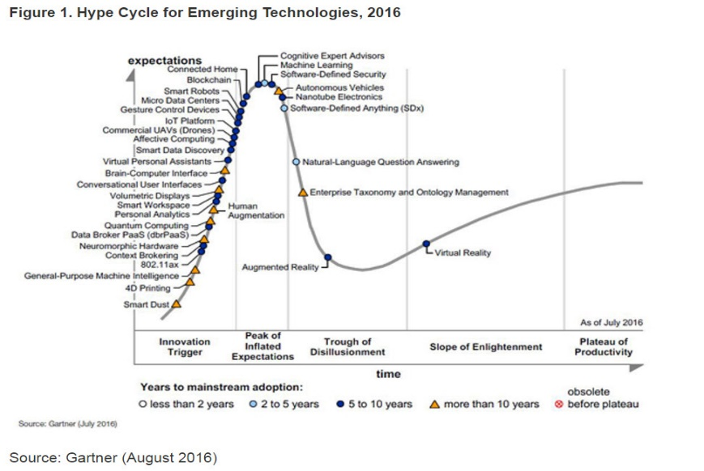
RapidQube with YBL
We @Rapidqube are aimed at
  exploring futuristic and radical innovations
  solve some of the most difficult problems in technology today.
With Block chain, we have developed a vision
  on the evolution of modern commercial transactions
  and the change in fundamentals
Partnered with IBM and YBL have
  designed and built a settlement and clearing system
  enabling YBL to transact through permissioned distributed ledgers

Slide 42
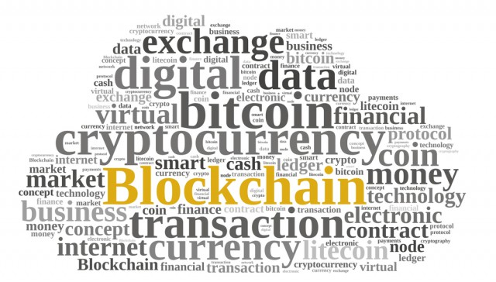
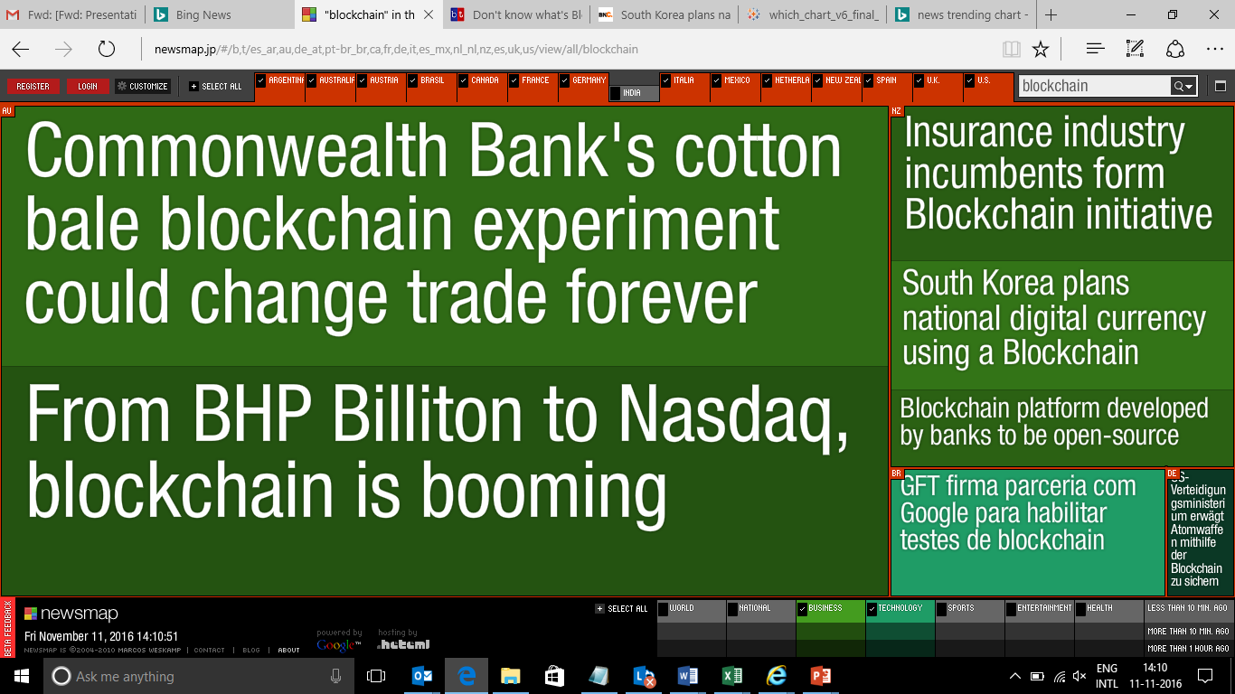
Blockchain – the Future

Slide 43
Blockchain – YBL Solution
Our Solution entails creation of a vendor financing solution using smart contracts and building a shared transaction ledger between Anchor, Vendor and YBL to validate transactions
Validated among separate nodes creates a platform which promises to remedy existing pain points such as:
  Supplant major middle and back-office functions
  Introduce unprecedented cohesion to the internal bookkeeping processes
  Show a record of consensus with a cryptographic audit trail of transactions
  Create near real-time settlement
  Strengthen risk management through stronger auditability and counterparty ties
Anchor
Registers & Agrees
Payment Dept.
Regulator
Anchor Payment Status
Settlement Dept.
Vendor
Smart Contract
YBL Query Settlement
Anchor Payment Pending
Anchor Raises Purchase Order
Vendor Issues Invoice
consensus
Vendor Payment
Program Initiation
Program Closed
Anchor
Accepts Invoice
Payment Initiation
Permissioned & Distributed Ledger

Slide 44
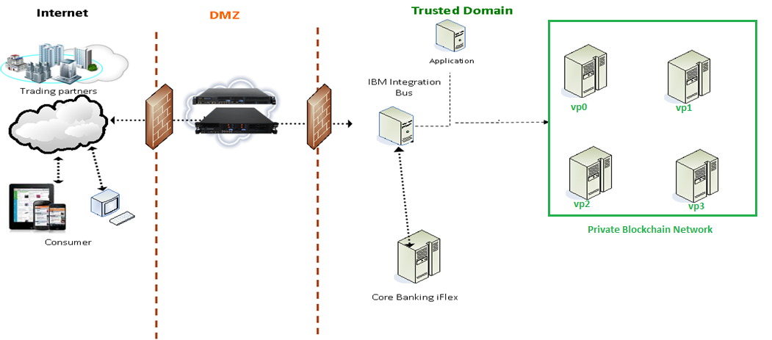





Solution Architecture
  Leverages IBM Hyperledger fabric 0.7.0 version connection in supply chain network -
  IIB for middleware integration
  APIM for the APIs
  IBM Datapower

Slide 45

SIGNZY
Digital KYC and Contracting made easy
Arpit Ratan (Co-Founder)

Slide 46








Trust 1.0 – Offline
Paper based verification is time consuming, costly and frustrating
Paper forms
KYC List
Collect copies of KYC IDs
Address visit by rep
Back-office process
Meeting
Tele-call
New customer finally approved

Slide 47

Trust 2.0 Economy
Signzy’s APIs deliver digital trust ,
wherever identity & background verification is at the core of the transaction.
Winner of RBI’s payments systems Innovation Contest 2016

Slide 48








Signzy APIs simplify digital trust
Improving lending decision using digital data
Eliminating fraud in digital regulatory compliance
Confirmation of employment from verified datasets
ID/Document Verification for PoI and PoA requirements of KYC
Financial history from bank account and other sources
Background due diligence for satisfactorily meeting AML/CFT guidelines
Social media APIs to authenticate education, employment etc.
Secure digital contracts using Aadhar and biometric evidence
Social media APIs help create pshycological profile and customized scores using public posts
Company verification from government records

Slide 49


Overview of technology
Artificial Intelligence
Cryptography
Visual Recognition of ID
Face biometrics
Data extraction from documents
Storage of sensitive documents
Executed transactions audit trail
Secure sharing

Slide 50

Stelae Technologies
Transform your Content using Artificial Intelligence!
Aruna Schwarz (CEO)

Slide 51
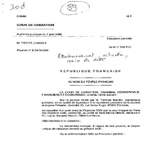
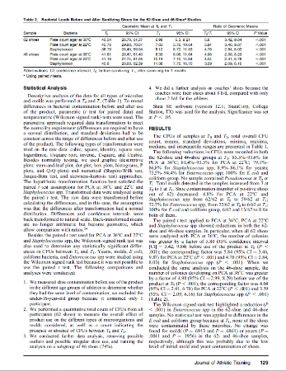
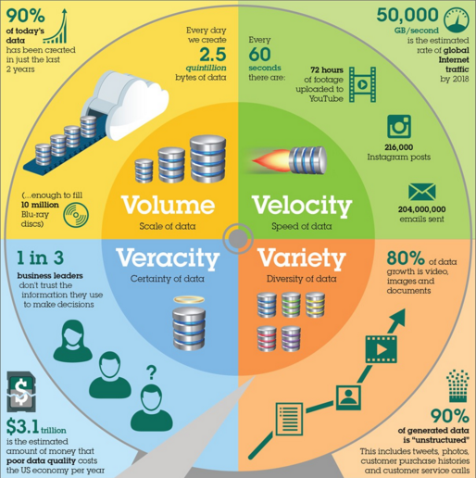
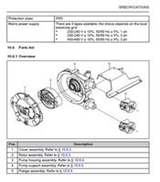
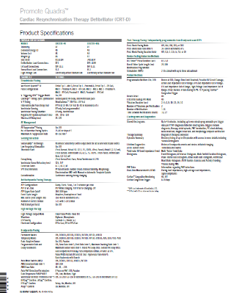
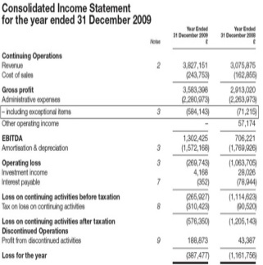
Unstructured Content – the biggest problem in a Data value chain

Slide 52






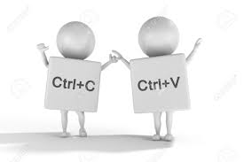





Company Accounts – Inputs for Loan Assessments, Analytics, Statutory Filings
Inputs:
Multi Format/ layout & Multi type (xls, pdf, doc…)
Read: Rules to Interpret Terms
Queries, Clarifications
Finally the document arrives
Time = Money = Cost
Repository/Data Base
Attrition and New Hires

Slide 53


An end to end automated work-flow with Khemeia™
Inputs:
Multi Format/ layout & Multi type (xls, pdf, doc…)
Read: Rules to Interpret Terms
Queries, Clarifications
Finally the document arrives
Repository/Data Bases
Attrition and New Hires

Slide 54
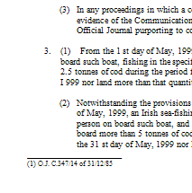
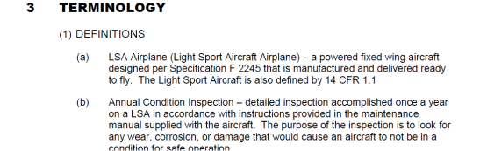
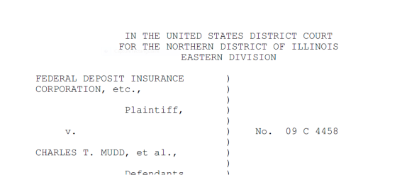
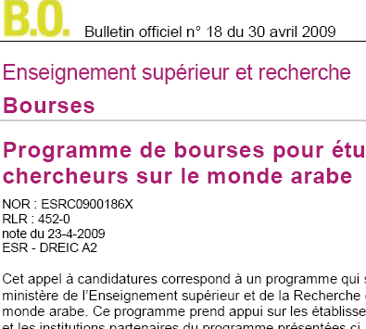
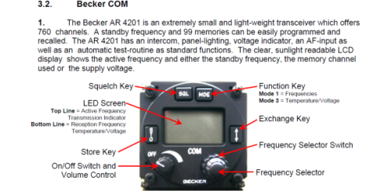
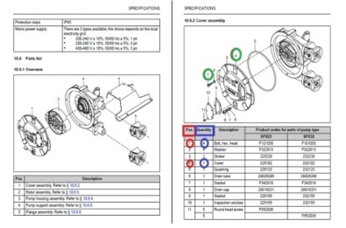
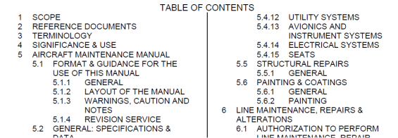
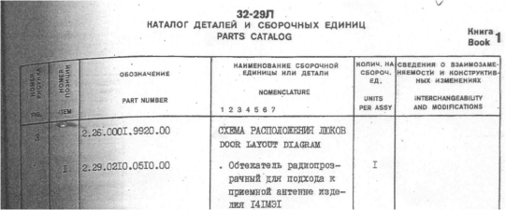

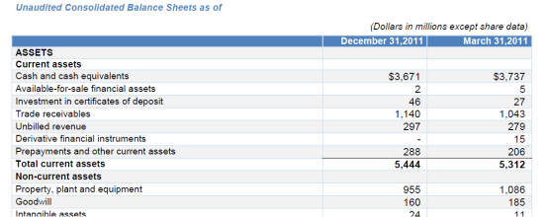
The Technology
70+ Pattern Recognition & Content Analysis Algorithms
Tables, Paragraph,
List Variants
Geometric Positioning
Visual Analysis
Fonts, Colour, Size
Double Column Text
Linking Images to
Captions, Text
Special Characters –
indices, symbols,
and languages (Cyrillic)

Slide 55








Khemeia™ : One platform for Multi Format, Content Type, Language & Outputs
UKI
US
France
India

