Slide 1
Making Blockchain Real for Business Explained
Nitin Gaur ngaur@us.ibm.com
© 2016 IBM Corporation
Notes:
Thanks, pleasure etc.
There is much hype around Blockchain.
Most of this relates to the use of Blockchain to underpin the Bitcoin crypto currency.
Whilst IBM are not interested in Crypto currency, we are very interested in exploring the broader business application of Blockchain technology. This is a transformational opportunity for many of our clients
This touches most all industries – we are making Blockchain REAL for business.

Slide 2
Disruption and Innovation
IBM Blockchain – 2016

Slide 3
Investment Interest in Blockchain
Blockchain has the potential to reduce infrastructure cost by up to $20 billion a year
P2P money Transfer across international borders - segment worth $583 B
Anderseen Horowitz ( VC firm) has invested over USD $100 million into Blockchain technology
All time Public/VC investment into Blockchain startups - > $1.8 B
Over 4000 active fintech startups in the NY area and investment in the sector tripling this year to > $14 billion
Source – LTP,Finextra

Slide 4
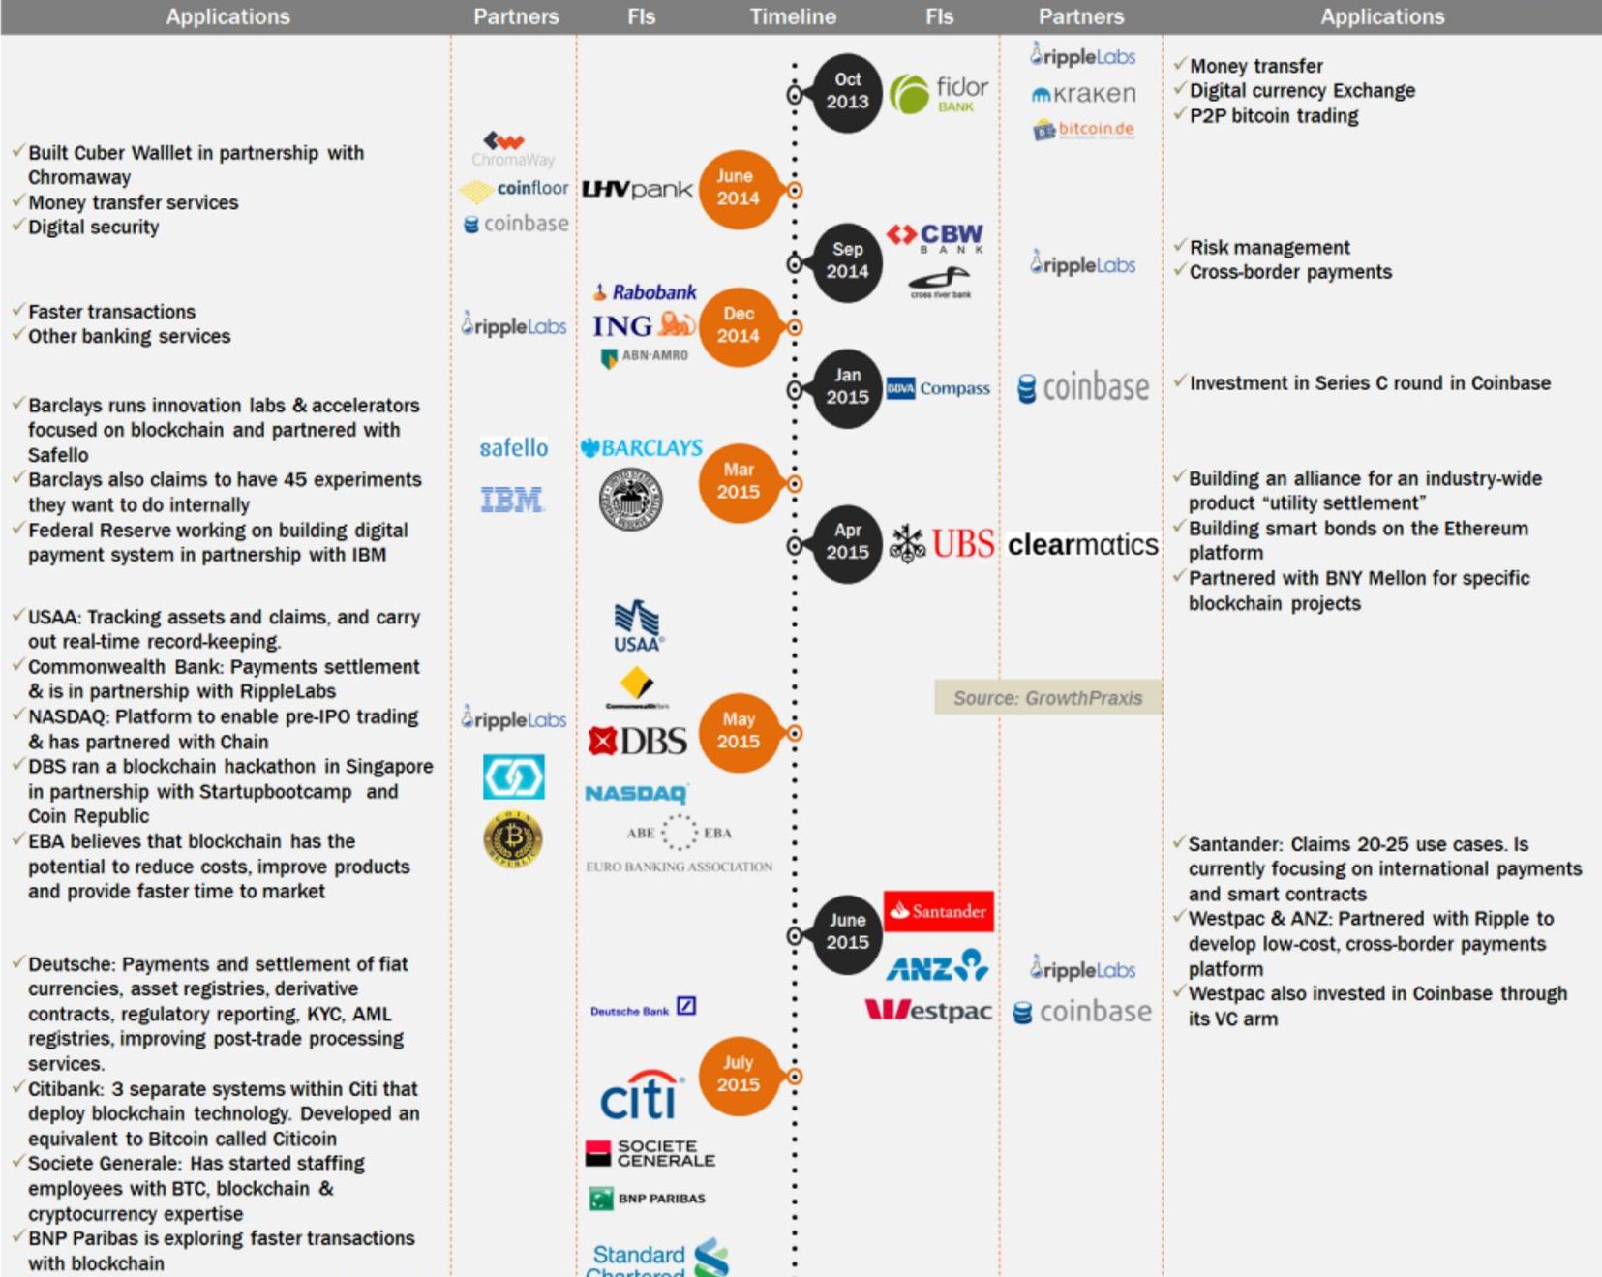
Blockchain Adoption – Understanding the Disruption
Source: Lets talk Payments

Slide 5
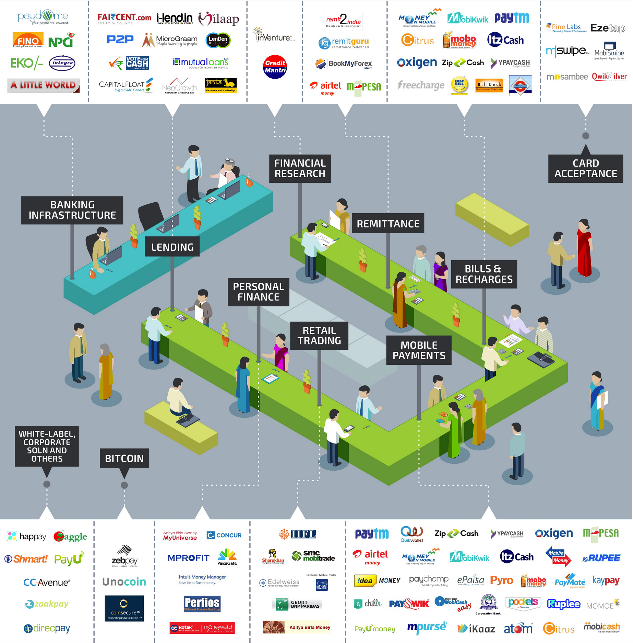
Fintech Ecosystem in India (source:LTP)

Slide 6
are Blockchain technologies?
is it relevant for our business?
can IBM help us apply Blockchain?
Contents
© 2016 IBM Corporation
Page
6
Notes:
Presentation is in three sections addressing the “big” questions for business use of Blockchain.
First section we will give CONTEXT for Blockchain by looking at the BUSINESS NETWORK and how to make this relevant for the 21st Century.
Then consider benefits and use cases for industrial Blockchain.
Finally focus on practical steps to make this new technology real for business.

Slide 7
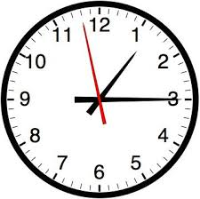
What are We Solving?
Time
Trust
© 2016 IBM Corporation
Page
7
Notes:
Presentation is in three sections addressing the “big” questions for business use of Blockchain.
First section we will give CONTEXT for Blockchain by looking at the BUSINESS NETWORK and how to make this relevant for the 21st Century.
Then consider benefits and use cases for industrial Blockchain.
Finally focus on practical steps to make this new technology real for business.

Slide 8
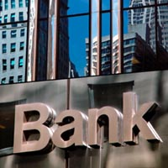
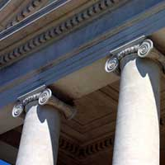
Introducing Blockchain
A shared ledger technology allowing any participant in the business network to see THE system of record (ledger)
© 2016 IBM Corporation
Page
8
Notes:
What’s new here is the SHARED LEDGER – up to this point each participant had their own Ledger
This sharing is the foundation for innovative business solutions,
This introduces an interesting set of technical challenges, including (1) participant identity and privacy & (2) transaction privacy
Let’s look at this in some more detail.

Slide 9
Problem …
Counter-party
records
Party A’s records
Bank records
Party C’s records
Party B’s records
Auditor records
… Inefficient, expensive, vulnerable
Notes:
This is the “BEFORE” picture representing the “status quo” for business networks.
Each participant keeps their own ledger(s) which are updated to represent business transactions as they occur.
This is EXPENSIVE due to duplication of effort and intermediaries adding margin for services.
It is clearly INEFFICIENT, as the business conditions – the contract – is duplicated by every network participant
It is also VULNERABLE because if a central system (e.g. Bank) is compromised due to an incidents this affects the whole business network. Incidents can include fraud, cyber attack or a simple mistake.

Slide 10
Solution …
Counter-party
records
Party A’s records
Bank records
Party C’s records
Party B’s records
Auditor records
… Consensus, provenance, immutability, finality
Notes:
The novel Blockchain architecture give participants the ability to share a ledger which is updated every time a transaction occurs through peer to peer replication.
Cryptography is used to ensure that network participants see only the parts of the ledger that are relevant to them, and that transactions are secure, authenticated and verifiable.
Blockchain also allows the contract for asset transfer to be embedded in the transaction database determining the conditions under which the transaction can occur.
Network participants agree how transactions are verified through consensus or similar mechanisms. Government oversight, compliance & audit can be part of the same network.
Participants SAME AS BEFORE – this is not a disintermediation play
CONSENSUS– means all participants agree that a transaction is valid
PROVENANCE– means participants know where the asset came from and how it’s ownership has changed over time
IMMUTABILITY– means no participant can tamper with a transaction once it’s agreed. If a transaction was in error then a NEW transaction must be used to reverse the error, with both visible
FINALITY– means that there is ONE place to determine the ownership of an asset or completion of a transaction. This is the role of the SHARED LEDGER.

Slide 11
Blockchain for business …
Shared ledger
Smart
contract
Append-only distributed system of record shared across business network
Business terms embedded in transaction database & executed with transactions
Ensuring appropriate visibility; transactions are secure, authenticated & verifiable
All parties agree to network verified transaction
Privacy
Consensus
… Broader participation, lower cost, increased efficiency
Notes:
So Blockchain technology comprises these four main blocks, that can lead to increased efficiencies, and cost reduction across the business network.
We will “unpack” CONSENSUS PRIVACY & SMART CONTRACT in the next couple of slides.
Shared LEDGER has been already covered, and a SMART CONTRACT enables the business rules implied by the contract to be embedded in the Blockchain and executed with the transaction

Slide 12
are Blockchain technologies?
is it relevant for our business?
can IBM help us apply Blockchain?
Contents
© 2016 IBM Corporation
Page
12

Slide 13
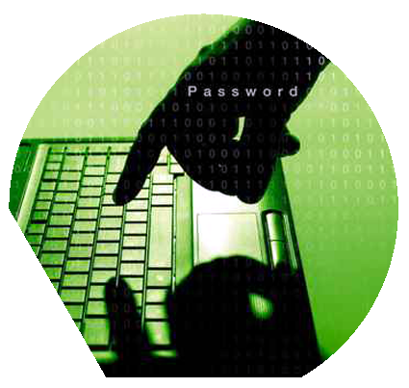
Blockchain benefits
Saves time | Removes cost | Reduces risk | Increases trust
Transaction time from days to near instantaneous | Overheads and cost intermediaries | Tampering, fraud & cyber crime | Through shared processes and recordkeeping
Notes:
Other benefits include :
Improve discoverability
When everyone on an exchange can view the same ledger, it is easy to broadcast an intention (or offer) by appending it. For example, in a trading network, all asks and bids would be visible to every network participant.
Automate trusted processes
Unlike a centralized system where only the network operator can create a generalized solution that fits every user’s needs, Blockchain networks allow each participant to create customized solutions using their own proprietary business logic while running on the same common ledger.
Ensure trusted record-keeping
By design, no one party can modify, delete, or even append any record to the ledger without the consensus from others on the network, making the system useful for ensuring the immutability of contracts and other legal documents.

Slide 14
Other potential use cases
Securities
Post-trade settlement
Derivative contracts
Trade Finance
Bill of Lading
Cross-currency payment
Syndicated Loans
Supply Chain
Retail Banking
Cross border remittances
Mortgage verification & contracts
Public Records
Real estate records
Vehicle registrations
Citizen Identity
Digital Property Management

Slide 15
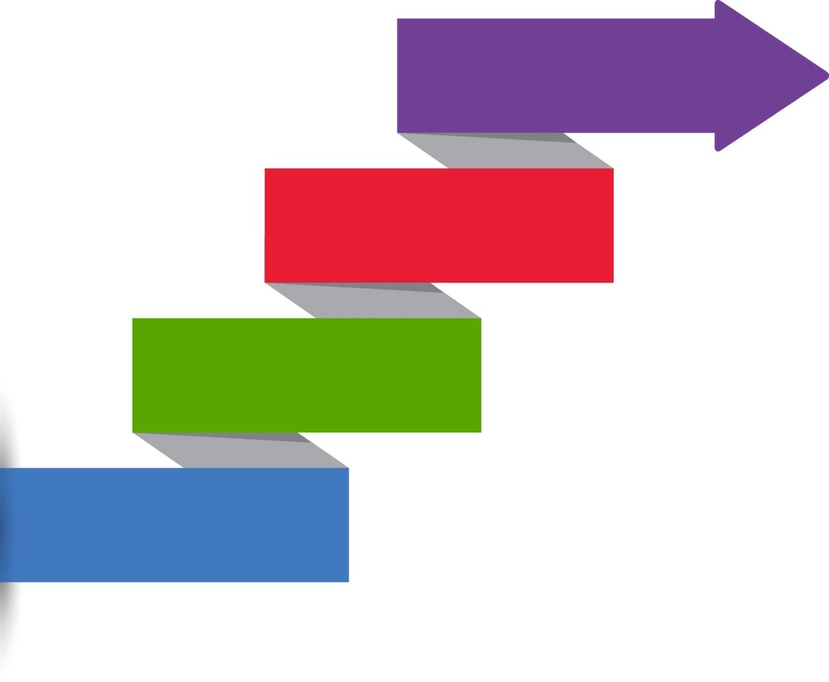
Patterns for customer adoption
HIGH VALUE MARKET
Transfer of high value financial assets
Between many participants in a market
Regulatory timeframes
ASSET EXCHANGE
Sharing of assets (voting, dividend notification)
Assets are information, not financial
Provenance & finality are key
CONSORTIUM SHARED LEDGER
Created by a small set of participants
Share key reference data
Consolidated, consistent real-time view
COMPLIANCE LEDGER
Real-time view of compliance, audit & risk data
Provenance, immutability & finality are key
Transparent access to auditor & regulator
© 2016 IBM Corporation
Page
15

Slide 16
Not for all …
Blockchain is not …
Suited to high performance (millisecond) transactions
For just one participant (no business network)
A replicated database replacement
A messaging solution
A transaction processing replacement
Suited for low value, high volume transactions
Notes:
Blockchain is not right for all classes of business problem
This simple “indicators” chart helps us choose the right set of business problems

Slide 17
Summary
Blockchain …
is a shared, replicated, permissioned ledger technology
can open up business networks by taking out cost, improving efficiencies and increase accessibility
addresses an exciting and topical set of business challenges, which cross every industry
IBM …
supports the Linux Foundation Hyperledger open standard, open source, open governance Blockchain
has an easy to access, proven and incremental engagement model giving customers the confidence to get started NOW

Slide 18
Thank you!
© 2016 IBM Corporation
Page
18

Slide 19
Payment Specific Investment
Largest Investment in Fintech Category - $5.3 billion in funding in the US last year. (BI Intelligence)
Payments and lending captured a combined 79% of fintech investments in the US in 2014 (CB Insight)
Visa invested an undisclosed amount of money in Stripe, valuing the payment gateway at $5 billion (BI Intelligence)
TransferWise, a cross-border transfer company, raised $58 million at a nearly $1 billion valuation, and has since established offices in the US (BI Intelligence)
BAT - Third-party mobile payment platforms like Alipay and Tenpay processed 5.99 trillion Yuan ($936 billion) in gross merchandise volume (GMV) in 2014, marking 391% YoY growth. (BI Intelligence)
Virtualization/Uberization of Services - Startups are leveraging these networks (Visa/MC)to create their own solutions

Slide 20
are Blockchain technologies?
is it relevant for our business?
can IBM help us apply Blockchain?
Contents
© 2016 IBM Corporation
Page
20

Slide 21
Blockchain for Business – Our Point of View
 | Community + Code Linux Hyperledger Project | Open Source Code: Blockchain built from the ground up for business; Permission | Privacy Confidential | Auditable Open Governance – 40 member board
 | Cloud IBM Blockchain | Blockchain value-added managed service on SoftLayer and z Systems; Identity | Consensus | Audit | System Integration | Hardware-assist for Performance & Security IBM Blockchain on Bluemix
 | Clients Blockchain Solutions Blockchain Garage | Blockchain Solutions for Financial Services; Trade Finance | Capital Markets Blockchain Garage NY | London | Singapore | Japan Blockchain GBS Practice

Slide 22
IBM offerings supporting Hyperledger
>
LINUX FOUNDATION
HYPERLEDGER
PROJECT
IBM Blockchain
ON IBM CLOUD
IBM Blockchain
SOLUTIONS
Managed Service on IBM Cloud
Your private Blockchain network in 1-click
Learn with sample applications
Develop your own Smart Contracts
BLUEMIX SERVICE
Blockchain
ibm.com/blockchain/

Slide 23
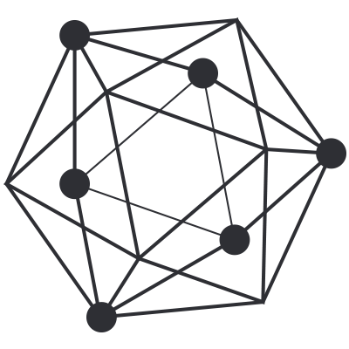
High Level Roadmap
Hyperledger Project
First Incubator:
IBM contributes
44k lines of code.
Others follow from
Intel, DAH, etc.
50 paying members
Fabric v.1
Dynamic add/subtract & sync nodes
ISVs offer solutions based on Fabric
Consolidated codebase & scalable consensus
~100 tps
~15 nodes tested and stable
Hyperledger Project
Launched on
Linux Foundation
Open governance!
Fabric v 0.5
PBFT
Security
~50 tps
4 nodes + CA tested and stable
“Dictator” Networks
2016
Feb
Mar
April
May
July
3Q
4Q
High-security environment plan
Deploy to IBM secure container technology
High security hosting environment
Fast crypto
Targeted Solutions focused on markets, industries, usecases
Blockchain on Bluemix Beta
Integrated Swagger UI
Transaction Dashboard
Chaincode
Blockchain on
Dockerhub Alpha
Blockchain on DockerHub Beta
Import/Export Data with External Systems
IBM Blockchain
Blockchain on Bluemix
Experimental Service
Multitenant starter plan
Developer Dashboard
Fabric v0.5
Blockchain environment plans: GA:
Metered starter plan – multi-tenant
Metered high-security plan — dedicated

Slide 24
Linux Foundation’s Hyperledger Project
Linux Foundation project announced December 17, 2015 with 17 founders, now 40 members
The Hyperledger Project is a collaborative effort to advance Blockchain technology by identifying and addressing important features for a cross-industry open standard for distributed ledgers that can transform the way business transactions are conducted globally
Open source and open standards-based
QUICK FACTS
Chairman: | Blythe Masters/DAH
Executive Director: | Brian Behlendorf
Tech Committee: | Chris Ferris/IBM
Contribution: | 44,000 lines of code in February 2016
Accept: | 2Q IBM Open Code accepted into incubation
Sprint to one codebase with unified thinking: | Target 3Q release
Enable adoption of shared ledger technology at a pace and depth not achievable by any one company or industry
www.Hyperledger.org

Slide 25
As of 13 June 2016
© 2016 IBM Corporation
Page
25

Slide 26
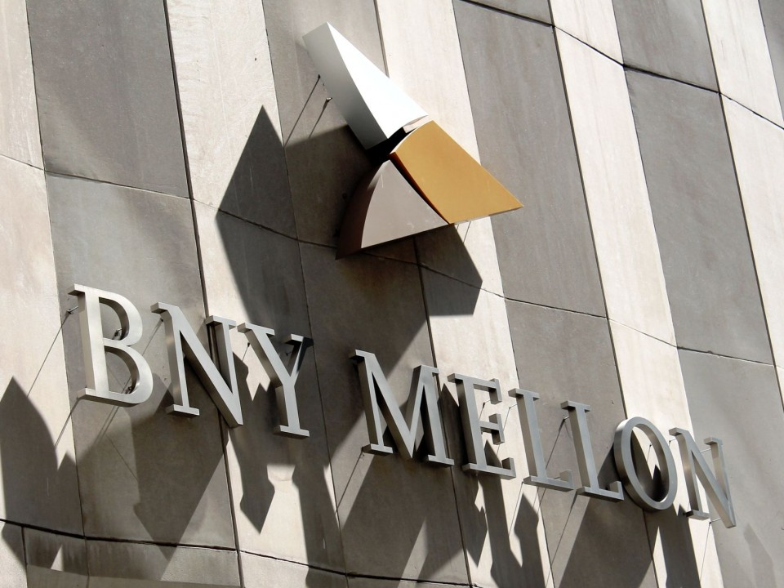
BNY Mellon, New York
To accelerate the design and development of a unique application for securities lending, using a blockchain network to trade and transfer assets
Notes:
With the opening of the IBM Garage this month in New York City, IBM is also working with clients such as BNY Mellon to accelerate the design and development of a unique application for securities lending, using a blockchain network to trade and transfer assets. “At BNY Mellon, we are actively exploring blockchain’s potential to better serve our clients and our company,” said Suresh Kumar, CIO, BNY Mellon. “With this new initiative, IBM is providing an environment that will allow companies like us to collaborate more easily and more securely and in a more standardized way, which is critical to advancing meaningful use cases for blockchain.”

Slide 27
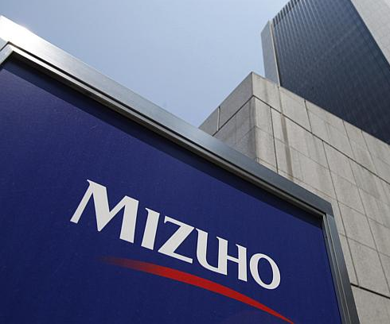
Mizuho Financial
To Test Blockchain Technology for Settlements Using Virtual Currency
Notes:
Mizuho Financial Group and IBM (NYSE: IBM) announced today a test of the potential of blockchain for use in settlements with virtual currency. By incorporating blockchain technology into settlements with virtual currency, Mizuho will explore how payments can be instantaneously swapped, potentially leading to new financial services based on this rapidly evolving technology. The pilot project uses the open source code IBM contributed to theHyperledger Project.
“Mizuho Financial Group has a history of adopting new technologies to continuously improve customer services," said Masahiko Katou, Senior Technical Officer, Mizuho Financial Group. "In an era of technology transformation, Mizuho is testing blockchain, Watson, and other technologies to deliver high quality and more efficient customer services."
Mizuho is working with the newly-opened IBM Bluemix Garage in Tokyo, which offers IBM Blockchain services, including blockchain application development using Bluemix, IBM’s cloud platform, and assessments to determine the best uses for blockchain within the enterprise and across various industries. Based on global insights across various industries and the experience of system development at Mizuho FG, IBM is helping the bank transform the design and development of business applications using blockchain.
“Mizuho Financial Group is a leading financial institution known for adopting advanced technologies such as IBM Watson,” said Masao Sanbe, Managing Director, Industry Sales, IBM Japan. “IBM understands how to use blockchain and IBM Cloud as the technology foundation to transform the way businesses interact with their ecosystem of trading partners. IBM is proud to continue to support Mizuho Financial Group’s important initiatives.”
Mizuho has a long history of promoting projects that create new customer experiences and business value by applying technologies in response to changes in environments inside and outside Japan.
IBM is actively working with hundreds of clients to understand what it takes to make blockchain ready for business. Through its open source contributions and resources for blockchain software developers, IBM is advancing the science of blockchain, helping to remove complexity, and making it more accessible and open. Financial services, supply chains, IoT, risk management, digital rights management and healthcare are some of the areas that are poised for dramatic change using blockchain networks.

Slide 28
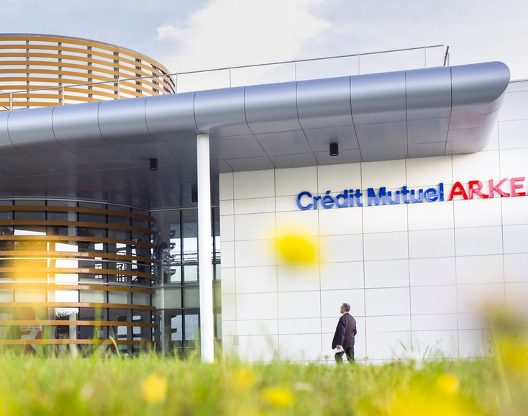
Crédit Mutuel Arkéa
Pioneer the Use of Blockchain to Manage Customer Identity and Improve Customer Satisfaction
Notes:
https://www-03.ibm.com/press/us/en/pressrelease/50087.wss
PARIS and BREST, France - 30 Jun 2016: IBM (NYSE: IBM) and Crédit Mutuel Arkéa announced today the completion of their first blockchain project to improve the bank’s ability to verify customer identity.
The result of this successful pilot is an operational permissioned blockchain network that provides a view of customer identity to enable compliance with Know Your Customer (KYC) requirements. This demonstrates the disruptive capabilities of blockchain technology beyond common transaction-oriented use cases.
"Blockchain is a transformative agent in our operational application, as proven by this project -- the first of its kind in France. This pilot offers a complete view of customers' documents across our distributed network," said Frédéric Laurent, COO Innovation & Operations, Crédit Mutuel Arkéa. "The project helped us to understand and master blockchain for other client uses. Now, we are ready to incorporate this technology in our ecosystem."
With 3.6 million customers and a comprehensive line of banking, financial and insurance services for individuals, businesses or institutional clients, Crédit Mutuel Arkéa expects to use the technology to help improve both customer and advisors experiences. Banks often have a variety of systems that separately manage customer identity for different services provided. As a result of this successful pilot, Crédit Mutuel Arkéa group and IBM are working to federate the different silos of customer data creating a single but cross-businesses KYC platform to inform all of the banks processes, helping to reduce unnecessary duplication of information and requests. The blockchain technology identifies and uses all valid existing evidence already stored in the bank’s multiple systems of record such as from mortgage applications or life insurance enrollment and bank accounts opening. This simplifies administrative processes making them reliable for the bank, which in turn can help improve customer satisfaction.“Crédit Mutuel Arkéa applied IBM Design Thinking and agile development methods to turn a simple idea into a strategic, decentralized platform for collaboration. The availability of IBM Blockchain services and DevOps tools on IBM innovation platform Bluemix was key to accelerate the time-to-value during the development phase,” said Juliette Macret, IBM Financial Services Sector Business Development Director, IBM France. “As the foundation of a robust system of trust, blockchain technology can help businesses create frictionless business transactions that improve customer satisfaction and employee efficiency.”
Crédit Mutuel Arkéa relied on IBM expertise for this project, including:
- IBM Design Thinking methodologies and the IBM Studio in Paris to shape the strategic imperatives of the project, explore the initial ideas and co-design the use case from an end-user viewpoint.
- Bluemix, IBM's cloud platform, to accelerate the development of the project using a complete set of as-a-services components, including Blockchain-as-a-Service and DevOps.
- IBM Global Business Services banking industry insight to guide the project and identify the business transformation opportunity.
Using the open-source Hyperledger Project fabric, the software reinforces consistency, traceability and privacy of the information, which is critical in a highly regulated environment. Ultimately, Crédit Mutuel Arkéa could enable its customers to deliver proof of their identity to third-parties such as local utilities, retailers or regulated service providers.
IBM is actively working with hundreds of clients to understand what it takes to make blockchain ready for business. Through its open source contributions and resources for blockchain software developers, IBM is advancing the science of blockchain, helping to remove complexity, and making it more accessible and open. Financial services, supply chains, IoT, risk management, digital rights management and healthcare are some of the areas that are poised for major changes using blockchain networks.
About Crédit Mutuel Arkéa
Crédit Mutuel Arkéa comprises of the Crédit Mutuel Bretagne, Sud-Ouest and Massif Central federations and some 20 specialized subsidiaries (Fortuneo, Monext, Arkéa Banque Entreprises et Institutionnels, Financo, Federal Finance, Suravenir, etc.). With nearly 9,000 employees, 3,700 directors, 3.6 million banking and insurance customer shareholders and clients and €110 billion in total assets, Crédit Mutuel Arkéa is one of the leading banks headquartered at regional level. For further information go to www.arkea.com

Slide 29
Blockchain vendors – Offer specialization
Each Vendor – Offers Specialization
Variant trust systems – Consensus, Mining, Proof of Work etc.
Lock into single trust system
Purpose built infrastructure components for a specialized use case
Design being field tested in form of POCs.
Crates fragmented blockchain models for enterprise.

Slide 30
How can IBM Blockchain be Different?
How Do we differentiate ?
Open Design
Providing flexibility with pluggable and modular trust system
Open for specialized blockchains e.g. Ripple
Trust Intermediary – a trust system provisioning layer
Enterprise blockchain platform concept
Separate Business domain with technology that supports it.

Slide 31
Blockchain – Transaction Processing vehicle
Enterprise Integration Considerations
Integration with incumbent SoR
Compliance and regulatory requirements
Data formats – ISO20022, EDI 820 etc.
Blockchain to enable transaction processing, and preserve the enterprise SoR systems.
Design Intent
Path of least disruption
Accelerate Enterprise adoption

Slide 32
Linux Foundation’s Hyperledger Project
Linux Foundation project announced December 17, 2015 with 17 founders, now 40 members
The Hyperledger Project is a collaborative effort to advance Blockchain technology by identifying and addressing important features for a cross-industry open standard for distributed ledgers that can transform the way business transactions are conducted globally
Open source and open standards-based
QUICK FACTS
Chairman: | Blythe Masters/DAH
Executive Director: | Brian Behlendorf
Tech Committee: | Chris Ferris/IBM
Contribution: | 44,000 lines of code in February 2016
Accept: | 2Q IBM Open Code accepted into incubation
Sprint to one codebase with unified thinking: | Target 3Q release
Enable adoption of shared ledger technology at a pace and depth not achievable by any one company or industry
www.Hyperledger.org

Slide 33
As of 13 June 2016
© 2016 IBM Corporation
Page
33

Slide 34
IBM Blockchain on Bluemix
Value: Developers can stand up a blockchain test network in under 2 minutes and quickly build & test an application on it. There are two plans — multitenant starter environment and high-security business environment.
Current release:
Multi-tenant starter environment — Beta. 2 nodes on shared softlayer
APIs — write/test smart contracts through chaincode layer, create, transfer and track assets
July:
Multi-tenant starter network — 4 nodes + 1 certificate authority on shared softlayer environment with updated monitors, SDK, upgraded documentation/tutorials
High-security business environment beta — Invitation-only with web signup. 4 nodes + 1 certificate authority on LinuxOne
3Q 2016 GA release:
Multi-tenant starter network will be priced at low cost for community developers and architects
High-security business environment will be priced competitively for companies doing serious security and performance testing of networks in regulated industries

Slide 35
More on High-Security Business Environment Plan
Value: IBM clients can test their 4-node + CA blockchain network in a high-security cloud environment that simulates a production deployment
July Beta release:
Private plan provisioned to client’s Bluemix Org
4 node + CA network, running in a secure service container environment
Site of service: NorthEast USA (no overseas in-country or multi-site deployments at this stage)
Based on Fabric v0.5
3Q 2016 GA release:
Priced plan for Enterprises: 4 node + CA network, running in a secure service container environment
Pre-packaged simulations to test network and enhanced documentation, tutorials, samples
Based on Fabric v1.0
4Q 2016:
Import/Export of data between blockchain and external systems of record
Expand to 15 nodes without significant loss of performance or reliability from 4 node levels
Tested for over 100’s of transactions per second
Roll-out plan forming for additional sites positioned around the world

