Slide 1

OMEGAMON Performance Management Suite
Long Presentation
September 2015

Slide 2
Acknowledgements, Disclaimers and Trademarks
© Copyright IBM Corporation 2014. All rights reserved.
The information contained in this publication is provided for informational purposes only. While efforts were made to verify the completeness and accuracy of the information contained in this publication, it is provided AS IS without warranty of any kind, express or implied. In addition, this information is based on IBM’s current product plans and strategy, which are subject to change by IBM without notice. IBM shall not be responsible for any damages arising out of the use of, or otherwise related to, this publication or any other materials. Nothing contained in this publication is intended to, nor shall have the effect of, creating any warranties or representations from IBM or its suppliers or licensors, or altering the terms and conditions of the applicable license agreement governing the use of IBM software.
References in this publication to IBM products, programs or services do not imply that they will be made available in all countries in which IBM operates. Product release dates and/or capabilities referenced in this presentation may change at any time at IBM’s sole discretion based on market opportunities or other factors, and are not intended to be a commitment to future product or feature availability in any way. Nothing contained in these materials is intended to, nor shall have the effect of, stating or implying that any activities undertaken by you will result in any specific sales, revenue growth, savings or other results. All statements regarding IBM future direction and intent are subject to change or withdrawal without notice, and represent goals and objectives only.
Information concerning non-IBM products and services was obtained from a supplier of those products and services. IBM has not tested these products or services and cannot confirm the accuracy of performance, compatibility, or any other claims related to non-IBM products and services. Questions on the capabilities of non-IBM products and services should be addressed to the supplier of those products and services.
All customer examples cited or described are presented as illustrations of the manner in which some customers have used IBM products and the results they may have achieved. Actual environmental costs and performance characteristics may vary by customer and will vary depending on individual customer configurations and conditions. Nothing contained in these materials is intended to, nor shall have the effect of, stating or implying that any activities undertaken by you will result in any specific sales, revenue growth or other results.
Prices are suggested U.S. list prices and are subject to change without notice. Starting price may not include a hard drive, operating system or other features. Contact your IBM representative or Business Partner for the most current pricing in your geography.
IBM, the IBM logo, ibm.com, Tivoli, the Tivoli logo, Tivoli Enterprise Console, Tivoli Storage Manager FastBack, and other IBM products and services are trademarks or registered trademarks of International Business Machines Corporation in the United States, other countries, or both. If these and other IBM trademarked terms are marked on their first occurrence in this information with a trademark symbol (® or ™), these symbols indicate U.S. registered or common law trademarks owned by IBM at the time this information was published. Such trademarks may also be registered or common law trademarks in other countries. A current list of IBM trademarks is available on the Web at "Copyright and trademark information" at ibm.com/legal/copytrade.shtml

Slide 3
OMEGAMON Performance Management Suite
IBM Tivoli Performance Management Suite for z/OS V5.3 and the IBM Tivoli OMEGAMON z/OS Management Suite V5.3 can help provide cost savings and greater effectiveness while helping you meet your Service Level Agreements by:
• Delivering new Enhanced 3270 User Interface (Enhanced 3270UI) history capability, increased integration, and enhanced install, configuration, and customization
• Offering the ability to quickly identify problem situations.
• Isolating and addressing problems quickly.
• Improving resource utilization to maximize investment.
• Improving personnel interaction for better synergy and efficiency.
• Reducing outages or delays.
• Customizing the enhanced user interface based on the scope and control of your day-to-day job.
• Expanding solution throughout IBM z/OS platform.

Slide 4

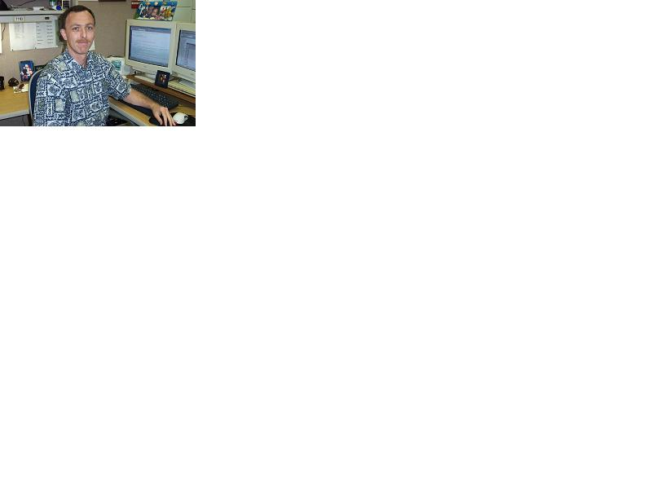


Simplification with OMEGAMON Integrated Suites
OMEGAMON Performance Management Suite
Improved visibility and management for z/OS and subsystems
zOS
DB2
CICS
IMS
MQ
Storage
Networks
WAS
Lower TCO: customization and less resource usage
Optimized architecture built for multiple personas
Better problem analysis with new history alerts
Strategic foundation for zCSI
Jim
Subject Matter Expert
Annette
Operations Analyst
Zach
Senior SysProg
Doug
IT Operations Manager
Notes:
4
Main Point: OMEGAMON Performance Management suite includes all eight OMEGAMON products as well as ITCAM for Application Diagnostic (Web Resources). The Suite simplifies acquiring the entire OMEGAMON family of support for z/OS and associated sub-systems. OMEGAMON products have a single user interface that works seamlessly with all the products for a more integrated zEnterprise monitoring and management environment.
OMEGAMON Performance Management Suite includes the following:
5655-W37 IBM Tivoli OMEGAMON XE for DB2 PE V5.2.0 (5655-R07)*
5698-B23 IBM Tivoli OMEGAMON XE for Messaging V7.1.0 (5608-S83)
5698-T07 IBM Tivoli OMEGAMON XE for CICS on z/OS V5.1.0 (5608-S74)
5698-T02 IBM Tivoli OMEGAMON XE for IMS on z/OS 5.1.0 (5608-S75)
5698-T01 IBM Tivoli OMEGAMON XE on z/OS V5.1.1 (5608-S81)
5698-T03 IBM Tivoli OMEGAMON XE for Mainframe Networks 5.1.1 (5608-S76)
5698-T05 IBM Tivoli OMEGAMON XE for Storage on z/OS 5.2.0 (5608-S77)
5698-T06 IBM Tivoli OMEGAMON DE on z/OS V5.1.0 (5608-S72)
5698-B48 IBM Tivoli Composite Application Manager for Application Diagnostics V7.1.0 (5698-S83)*

Slide 5
Agenda
Observations in z Systems
OMEGAMON Improvements
OMEGAMON Values
New in 3Q15 - OMEGAMONs

Slide 6

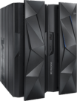













Observations in z Systems
New factors effecting service
Mobil
Cloud
Big Data / Analytics
Social, Mobile, Analytics
Smarter Infrastructure
Systems of
Record
Systems of
Engagement
VISIBILITY
CONTROL
AUTOMATION
In an Enterprise z Delivers
Business Transactions
Quality of Service
Source of data
Command & Control of data (e.g. CICS, DB2, IMS, Messaging, Network, Storage, z/OS
Key needs
Reduce risks and costs
Optimize service and performance
Flexible management
Leverage value of IT operational analytics
Simplify management tools portfolio
Leverage integration across z/OS and cloud
Notes:
6
6
6

Slide 7




What happens at your site when a problem happens?
All sites have different configurations and unique expectations
    How do problems get communicated?
    What type of alerting happens?
    Are all your teams disparate groups?
    Do you have “War Room” meetings?
    How do you Identifying Complex Problems?
    Are your teams challenged to do more with less?
    How do you address these issues?

Slide 8

Business Agility with improved IT visibility now available with OMEGAMON V5.3.x family
Modernized and strengthened OMEGAMON product line for reduced resource usage and faster problem resolution
Increased System Availability with faster problem resolution
Enhanced 3270 User Interface for SMEs
Built-in Problem Solving Scenarios
Improved Productivity with simplified information
Faster Install/Configuration/Maintenance
zEnterprise monitoring across
Reduced Costs with decreased resource usage
Usage of zIIP specialty servers
Simplified OMEGAMON architecture
Individual products include additional capability
8
Notes:
8

Slide 9




OMEGAMON Continues Addressing TCO
Improving OMEGAMON Total Cost of Ownership with each release
Lowering MIPS by collecting data once, leveraging subsystems, and using zIIP offload
Indentifying TCO focus areas with performance analysis for every release of OMEGAMON
V 5.3 Enhanced OMEGAMON Architecture (“New approach”)
Monitoring agents
TEMS
CICS
IMS
z/OS
DB2
Stor
MfN
MSG
…
Single Manager and User Interface across OMEGAMON family
Enhanced
3270 UI
Tivoli OMEGAMON Manager (TOM)
TEP GUI
V 4.x OMEGAMON Architecture (“Old School Approach”)
Classic 3270
IMS
z/OS
CICS
Storage
MfN
DB2
Messaging
Multiple Address Spaces and User Interfaces across each OMEGAMON
Monitoring agents
CUA 3270
TEMS
TEP GUI
Simplification - Reducing the number of address spaces by enhancing the OMEGAMON 3270ui
Notes:
Continuing to make OMEGAMON monitoring solution Total Cost of Ownership improvements
Lowering MIPS by collecting data once, integrating with RMF and subsystems, and using zIIP offload
Indentifying TCO focus areas with performance analysis for OMEGAMON (e.g. TOM, TEMS z/OS, DRA, probe)
Reducing the number of address spaces by enhancing the OMEGAMON 3270ui common component

Slide 10
OMEGAMON already has low TCO and …… is still improving!
Delivering drastic reductions in labor time needed to configurez/OS components:
    “5x improvement, [less time for OM upgrade and configuration] with new PARMGEN tool” IBM Host System Services team member
Leveraging ServerPac’s efficient deployment of binaries for z/OS, subsystems and OMEGAMON
    Consolidates SMP/E tasks (versus CBPDO)
    Customizes ordering of any combination
    Contains all latest maintenance.
Minimizing the manual effort to maintain agents using ITM Self Describing Agents (SDA)
Notes:
Delivering drastic reductions in labor time needed for the configuration and customization of z/OS components:
“5x improvement, [less time for OMEGAMON upgrade and configuration] with new PARMGEN tool” per IBM HSS team member)
Leveraging ServerPac’s efficient deployment of binaries for z/OS, subsystems and OMEGAMON
Consolidates SMP/E tasks (rather than CBPDO) to lower TTV
Allows customized ordering for any combination
Contains all latest maintenance.
Minimizing the manual effort to maintain agents using ITM Self Describing Agents (SDA)

Slide 11

OMEGAMON provides significant cost savings over other vendors’ solutions
Exploiting zIIP offload for years.
  Routines for OMEGAMON (z/OS, DB2, CICS, Storage)
  RMF used as a data collector
IBM’s analysis shows reduced CPU usage, 20%-50%* from v4.2
Identifies address spaces for easy tracking and tuning, typical 1%-3% MIPS* usage
Decreasing overall costs: Customers could see a 48% reduction in CPU usage*, when comparing just the cost of running OMII (CUA) and OMEGAVIEW vs. the cost of running the 3270ui.
* Based on internal testing and running similar scenarios on v 4.2 versus v 5.1. Results at your own shops will vary dependent on OM II (CUA) and OMEGAVIEW deployment

Slide 12
Get the most out of your OMEGAMONs

Slide 13

Situations: What are they?
System z integrated performance monitoring - Visibility
Situations describe a condition or set of conditions you want to examine to determine if a potential problem exists in the systems and resources you are monitoring and will notify operations.
Situations: Why use them?
Proactively monitor the performance of your system,
allowing you to find and resolve problems before
end users report them. You pick which metrics to monitor
out of many hundreds to use and on which systems to run.
Resolve problems automatically using Take Action (reflex automation)
Provide customized expert advice
Situations provide continuous observation of your systems!

Slide 14
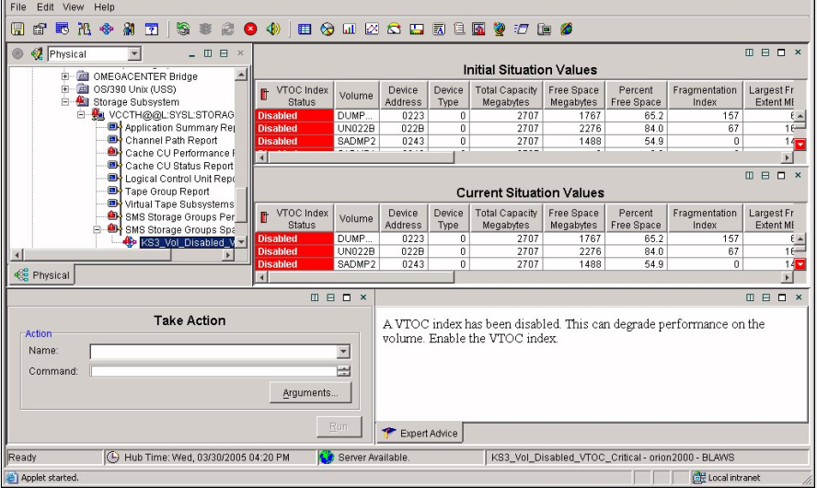
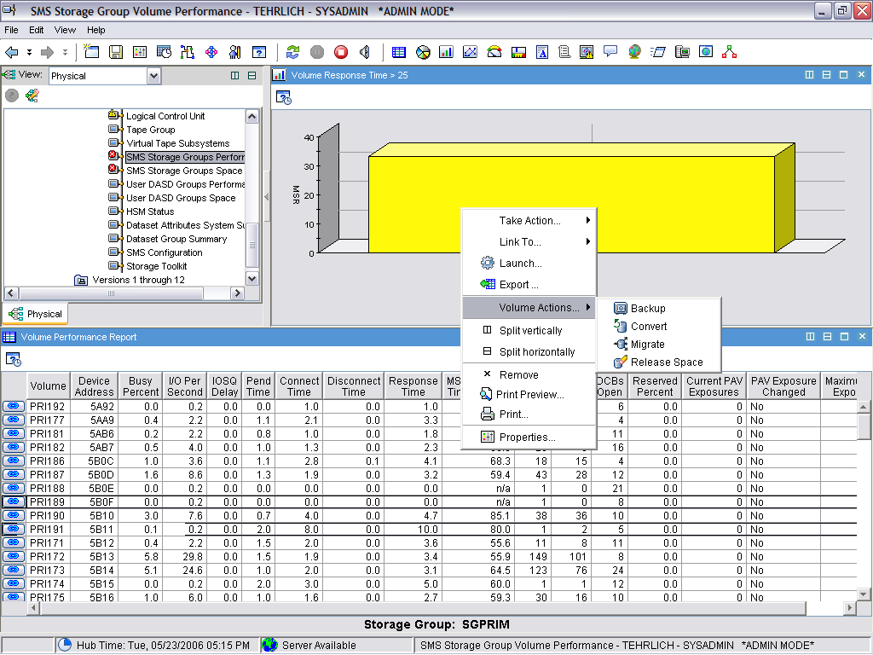
Control and Automation to Key Areas
Manage by exception – monitor key applications and limit visible information to what is needed
When situations “fire” quickly see what caused the alert, and compare current status of the situation to the initial condition that caused this alert
Pre-programmed actions can respond automatically to situations – or - Take Action by issuing commands
Automated or manual batch job responses directly from your monitoring activity
Notes:
You can set threshholds for your key applications which will fire off Situations (notices that a problem has occurred).
In this instance, a situation has fired for unsatisfactory response time. You can hover the cursor over the Situation Icon, then navigate to the the Situation Event Workspace. There you will see the data set details, showing access across all systems.
From there you easily define a z/OS address space corresponding to the application, identify all the datasets being accessed, and the associated information needed to determine the health of that application’s I/Os. Once the problem area is identified it can easily be corrected with a click of the mouse. In this case the problem was caused by XXXXXX and resolved by ZZZZZZZ.

Slide 15



Maximizing time and personnel
VISIBILITY
CONTROL
AUTOMATION
Manage by exception
Common Tools and Processes
Create collaboration through tool integration
Efficiency in doing the day to day management of your z/OS - Link actions to situations
  Automate problem responses
  Capture expert knowledge
  Common data and KPIs

Slide 16
Breaking down the Silos
VISIBILITY
CONTROL
AUTOMATION
Increase ability to meet SLAs by managing environment with intelligent alerting
Increase staff productivity through managing by exception
Maximize efficiency of staff with Common Tools and Processes
Create collaboration through tool integration and information
Efficiency in doing the day to day management - Link actions to situations
  Automate problem responses
  Capture expert knowledge
  Common data and KPIs
Is your environment managed by different teams that do not regularly work together – Integrate information
When there is a problem, quickly identify the root cause.

Slide 17

Announced Today - August 10, 2015
Suites:
    Service Management Suite for z/OS 1.3.0
    OMEGAMON Performance Management Suite for z/OS 5.3.1
    OMEGAMON for z/OS Management Suite 5.3.1
Individual Products:
  OMEGAMON XE for IMS on z/OS V5.3.0
  OMEGAMON XE for Mainframe Networks V5.3.0
  OMEGAMON Dashboard Edition on z/OS V5.3.0 (Interim Feature)
Notes:
Notes:
Instructor notes:
Purpose — List the unit objectives
Details —
Additional information —
Transition statement —

Slide 18
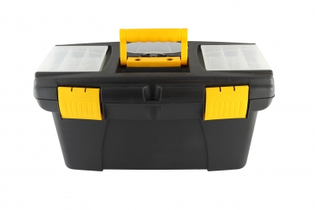
Benefits of a Suite
Simple Pricing Metric
z/OS Value Units
One stop shop for all your mainframe management needs
Pick components you need
EZ to Order
Flexible to use
ONE PID
Image taken from FreeDigitalPhotos.net
Notes:
Notes:
Instructor notes:
Purpose — List the unit objectives
Details —
Additional information —
Transition statement —

Slide 19
IBM Service Management Suite for z/OS v1.3
(Provides comprehensive service management capabilities for IBM z Systems)
One Solution
Single offering that contains capabilities to manage z/OS and all key subsystems
High Availability & Automated Operations
Improve Service Levels and reduce system downtime
Network Management
Maintain the highest degree of availability of your z Systems networks
Performance Management
Real-time and historical performance and availability management
Asset Discovery
Who is using what, where and when
Dashboards
Single point of control to monitor and operate your applications
Notes:
Notes:
Instructor notes:
Purpose — List the unit objectives
Details —
Additional information —
Transition statement —

Slide 20
NEW: Service Management Suite for z/OS 1.3
Service Management Unite
  Modern Web UI for automated operations of z and non-z Systems environments
Service Management Suite for z/OS
NetView 6.2.1 Updates
  Enhanced automation to support larger environments
OM PM Suite 5.3.1
  Enhanced problem determination with Operations Analytics
17594: Proactive Outage Avoidance with IBM Service Management Suite for z/OS
Monday, August 10, 2015: 3:15 PM-4:15 PM
Europe 1 (Walt Disney World Dolphin )
Speaker: Uwe H. Gramm(IBM)
Notes:
Notes:
Instructor notes:
Purpose — List the unit objectives
Details —
Additional information —
Transition statement —

Slide 21
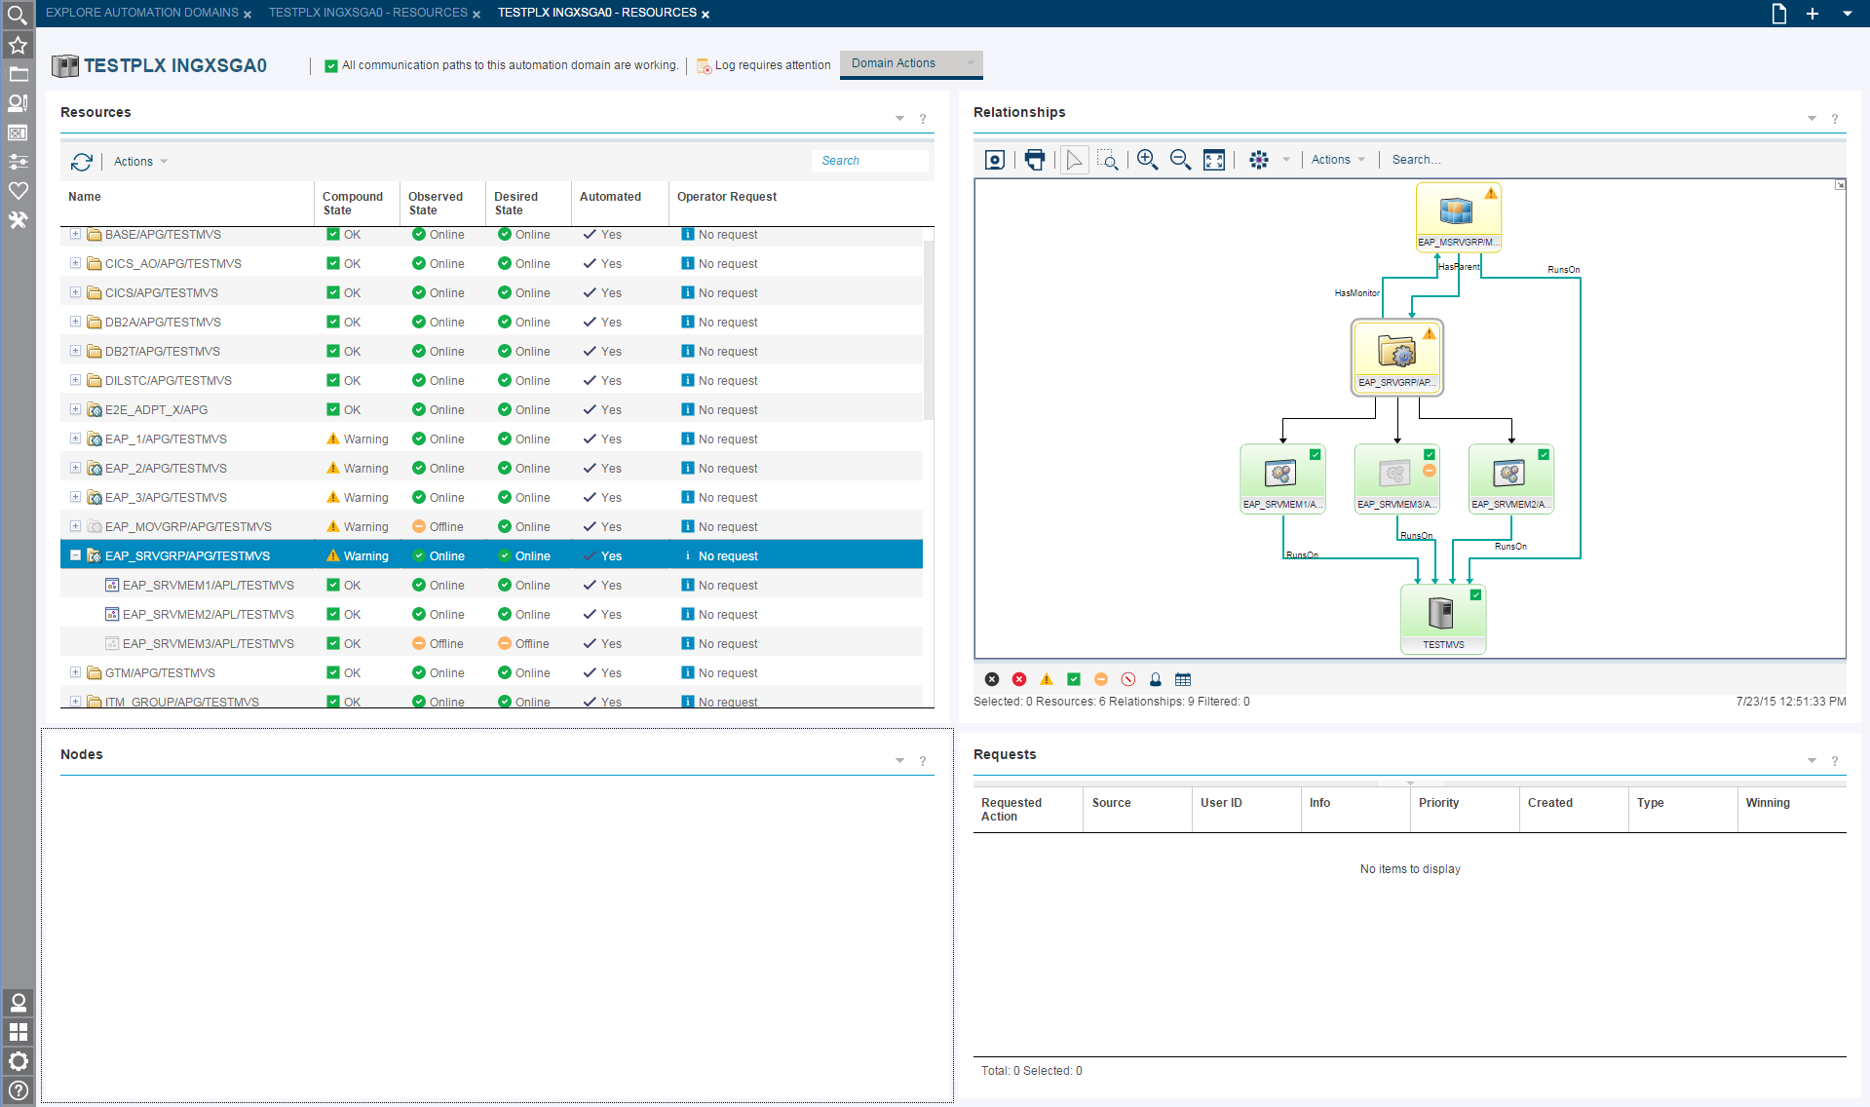

Service Management Unite
Notes:
Notes:
Instructor notes:
Purpose — List the unit objectives
Details —
Additional information —
Transition statement —

Slide 22
Service Management Suite for z/OS 1.3
OMEGAMON z/OS Perf Mgmt Suite
OMEGAMON XE for DB2 PE V5.3.0
OMEGAMON XE for Messaging on z/OS V7.3.0
OMEGAMON XE for CICS V5.3.0
OMEGAMON XE for IMS V5.3.0
OMEGAMON Dashboard Edition on z/OS 5.3.0
OMEGAMON XE for z/OS V5.3.0
OMEGAMON XE for Mainframe Networks V5.3.0
OMEGAMON XE for Storage V5.3.0
OMEGAMON DE for z/OS V5.3.0
ITCAM AD V7.1 (only ITCAM for WR component)
  (Composite Application Manager for Web Resources on z/OS 7.1.0)
Operations Analytics Log Analysis
  OMEGAMON z/OS Insight Pack
Service Management Unite V1.1.0
System Automation for z/OS V3.5
NetView for z/OS V6.2.1
Tivoli Asset Discovery V8.1
Notes:
Notes:
Instructor notes:
Purpose — List the unit objectives
Details —
Additional information —
Transition statement —

Slide 23
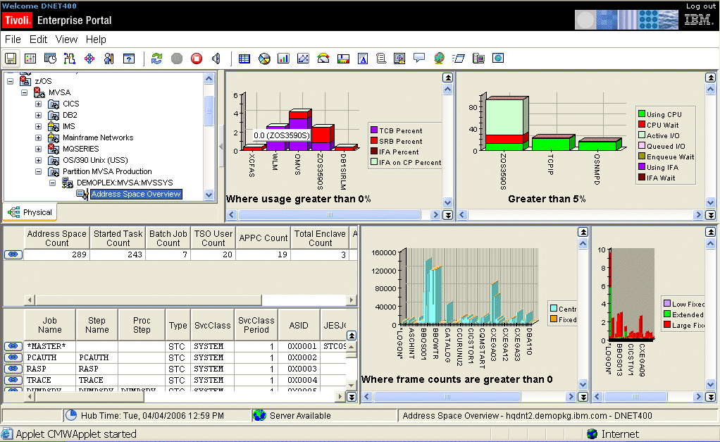
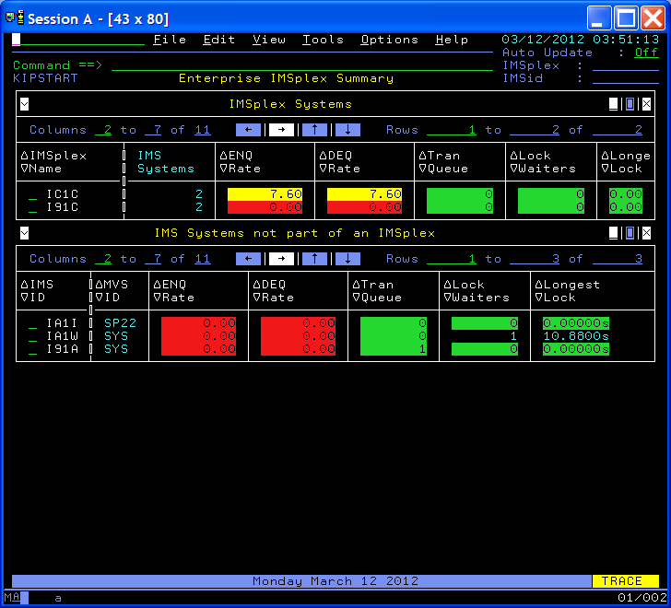
OM Performance Management Suite for z/OS v5.3.1
Integrated management solution
Extensive capabilities to monitor & manage z/OS platform. Delivers increased problem identification and resolution, reduced costs, flexibility, and decreased TCO.
  Updates to PM Suite:
  OM XE for IMS on z/OS V5.3.0
  OM XE for DB2 PE V5.3.0
  OM XE for Mainframe Networks V5.3.0
  OM DE on z/OS V5.3.0 (IF)
  Inclusion of IOAz (OM internal log analysis)
  Feature Codes for easy individual product downloads (in PM Suite, OMzMS, & SMSz)
z/OS Operating System
DB2
CICS
/ CICS TG
IMS DB/DC
Messaging
(MQ)
WAS on Z
Networks (TCPIP / VTAM)
Storage (DASD and Tape)

Slide 24

OMEGAMON for z/OS Management Suite V5.3.1
(Optimize performance and availability of z/OS)
Suite Contains:
OMEGAMON XE on z/OS
  Proactively monitor and manage mainframe operating system environment
OMEGAMON XE for Storage for z/OS
  Quickly create commands or schedule actions that maintain and administer storage
OMEGAMON XE for Mainframe Networks
  Ensure high availability of services moving across networks
OMEGAMON Dashboard Edition on z/OS
  Create integrated view across OMEGAMON products
Notes:
Improved Application Metrics
(Citigroup - FITS MR0215077826)
Provide call statistics, wait times, and elapsed times for an
individual transaction instance instead of the entire application
schedule which typically involves multiple transaction instances.
Customer Benefit
Improves ability to monitor transaction performance as metrics
collected now accurately reflect an individual transaction instance.
Application Trace Facility (ATF) Enhancements
(T-Systems CH, Nissay – FITS MR0108104726,
MR0722096339, MR0722096622, and MR0722095950)
ATF Trace Activation at Startup
Enable application traces to be activated at OMEGAMON startup
ATF Performance Improvements
Improve throughput for trace data collection by creating separate tasks for data collection and writing trace data to journaling.
ATF Trace ID
Retain trace specifications for later reactivation and view trace data based on trace ID.
ATF Trace Exceptions
Allow trace data meeting user-defined criteria to be written to an exception-level journal.
Customer Benefit
The ATF enhancements improve the usability and performance of application tracing.

Slide 25
OMEGAMON XE for IMS v5.3
Increased efficiency
New Real-Time and Near Term History workspaces in the enhanced 3270 user interface for easier problem analysis
NTH Work Spaces
IMS and IMSPlex health and system information
Address spaces
Dependent regions
Global and local locks
Shared Queues
DBCTL Threads
Multiple Systems Coupling
OTMA
Storage Pools and subpools
New enhanced 3270UI Content
Application (ATF) Workload History
Bottleneck Analysis
DBCTL
Multiple Systems Coupling (MSC)
Response Time Analysis
Shared Queues
OTMA, Tmember and Tpipe
Storage Pools
VSAM, OSAM, and database buffer pools
Near Term History (NTH) on eligible workspaces
Embedded data support for CICS
IMS Command support (Type 1 added)

Slide 26
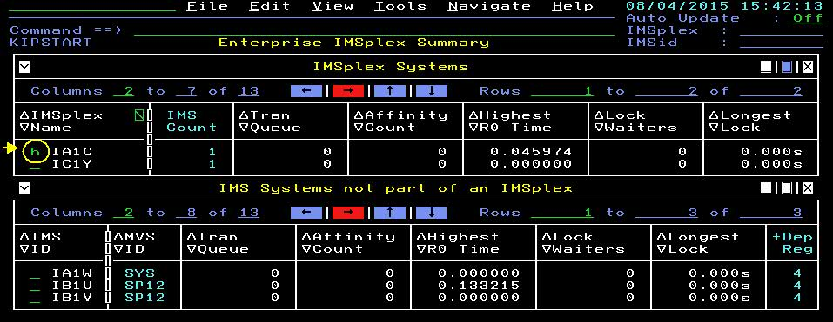
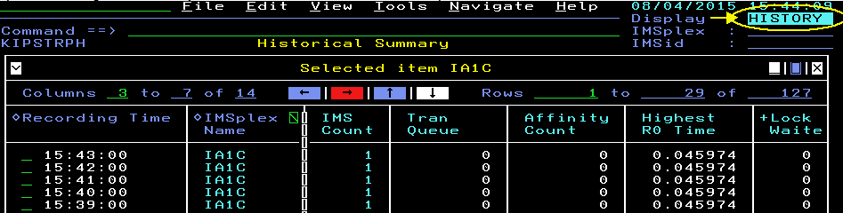
OMEGAMON XE for IMS v5.3
Faster problem resolution with Near Term History reports
Earlier list provides the eligible Near Term History reports that can be enabled in the enhanced 3270 user interface
New System Tools menu from KIPSTART to issue & view IMS Command responses and access Application History

Slide 27
OMEGAMON XE for IMS v5.3
Other Enhancements and changes
Dependent Region workspace now includes ASIDx
New health metrics are now shown in KIPSTART/KIPHLTP/KIPHLTI
  Highest R0 response time and Affinity count
Application Trace Facility improvements
  ATF trace definition Backup, Restore and Deploy utility provided
    Helps you share a single set of trace definitions across multiple IMSs
  Option added to treat message or checkpoint as a separate transaction
  New option to add a Transaction count limit to a trace definition
  New attributes: Transaction and Exception Counts plus new trace statuses
  Sorting and display enhancements
Transaction Reporting Facility (TRF) has been removed; IMS PA should be used to produce the TRF-like reports from IMS logs and ATF data.

Slide 28
OMEGAMON XE for IMS v5.3
Other Enhancements and changes
Global definitions are now text files and no longer compiled.
  They can now be shared across RTEs
  Existing global definition modules can be converted to new form
IMS Exits are
  Isolated to their own library reducing need to recycle IMS to apply maintenance
  Now use Exits wherever possible to collect performance metrics and removed 10+ hooks into IMS
Day 1 support of IMS v14.1 and implemented the IMS v14 Monitor Exit
Support latest CICS releases
Toleration of 128 CPUs per LPAR
We now automatically begin collecting the highest response times for LTERMS and transactions(RMON is automatically started).
OMEGAMON startup messages to better support automation needs
ICAT configuration tool has been removed and full support added for PARMGEN and its First Time User support

Slide 29
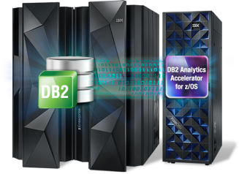
OMEGAMON XE for DB2 Performance Expert v5.3
(GA’ed 2Q15)
Productivity
Enhanced 3270 user interface
Integration with SQL analysis tools like Optim tools and SQL/PA
Extensions to DSG support to include zPARMs
DB2 Connect monitoring
Deliver enhanced integrated monitor capabilities
  Cross-monitor linking with OMEGAMON CICS
  Enhanced KPI (key performance indicators) workspaces
Extend integration with DB2 Tools for seamless DB2-focused administration
  Integration between Query Monitor and OMEGAMON DB2
Continue leadership in IDAA
  Enhanced SQL monitoringing for accelerated queries
Total cost of ownership (TCO) reduction
zIIP offload for improved resource consumption
Robust buffer pool analysis
Extensive object analysis
Advanced offerings
PERFORMANCE EXPERT ONLY: End-to-end response time analysis: Extended Insight
PERFORMANCE EXPERT ONLY: Expert stored procedure monitoring
Support for IBM Data Analytics Accelerator
FULL Day-one support for DB2 versions

Slide 30

OMEGAMON XE for Mainframe Networks v5.3
Enhanced 3270UI near -term historical support
Implemented VTAM buffer pools in the enhanced 3270 UI.
FIND command for easier use.
Faster network problem debugging with PING, NSLOOKUP, and TRACERTE commands.
Customized filters and queries
Improved navigation
Navigate to the Enterprise Mainframe Networks Health workspace
New enhanced 3270UI workspaces:
    Enterprise Mainframe Networks Health
    Enterprise TCP/IP and VTAM Overview
    TCP/IP Address Space Details
    VTAM Address Space Details
    VTAM Buffer Pools
    VTAM Buffer Pool Details

Slide 31
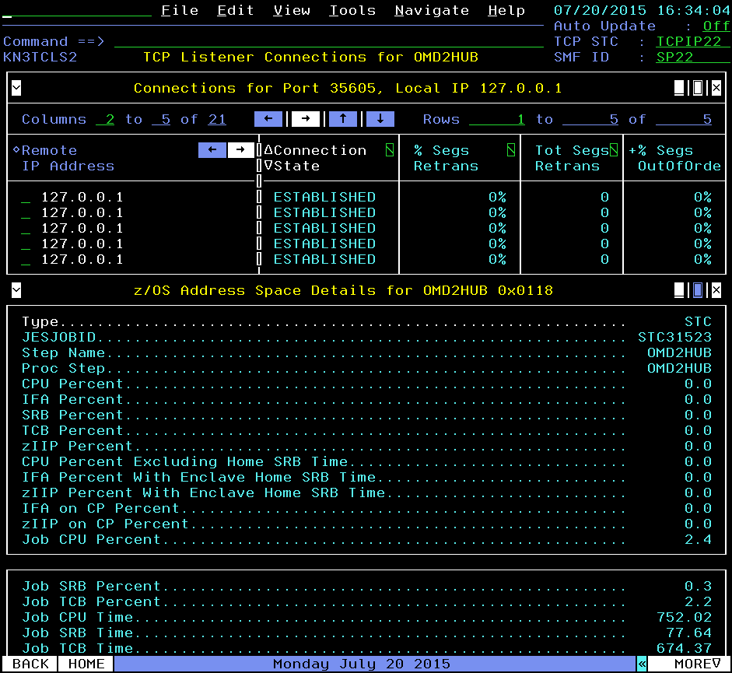
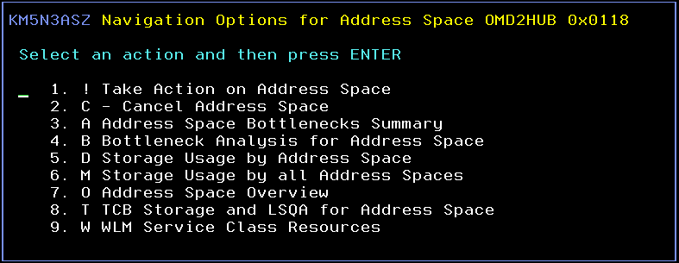
OMEGAMON XE for Mainframe Networks v5.3
Decreased problem resolution time and effort
View TCP connections and z/OS address space details together to understand when network performance is impacted by z/OS resource constraints
Zoom into OMEGAMON on z/OS workspaces to investigate further into bottlenecks, storage usage, and WLM service classes

Slide 32
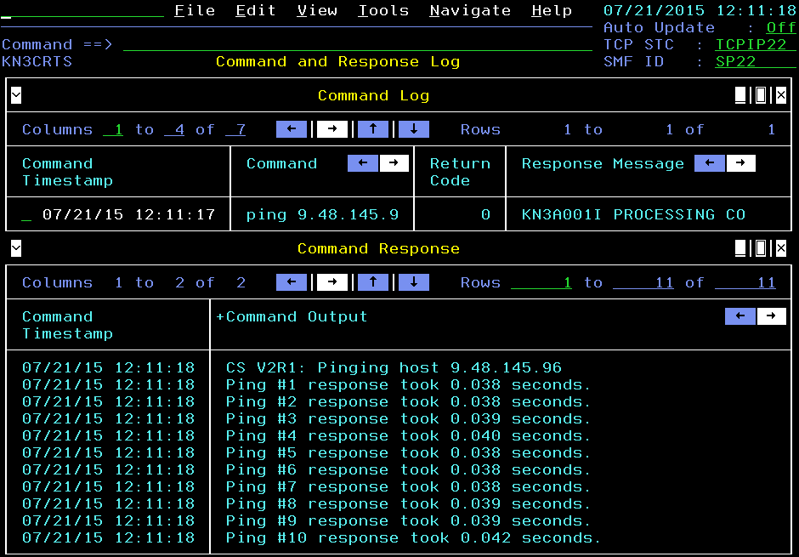
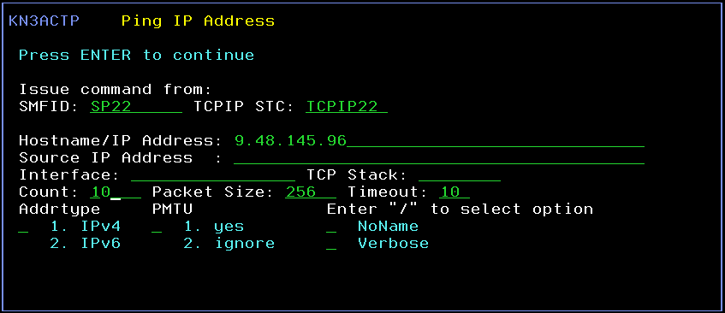
OMEGAMON XE for Mainframe Networks v5.3
Decreased problem resolution time and effort
Debug network problems faster
Issue PING, NSLOOKUP and TRACERTE commands while viewing any workspace in the enhanced 3270 user interface
The command is issued from the selected system and the output is displayed in the Command and Response Log workspace

Slide 33

OMEGAMON Dashboard Edition for z/OS v5.3
Integration the key to collaboration and efficiency
Working as a team is vital to getting the job done and the same can be said about your systems management information
Greater Visualization, Control and Automation - Integrate management Information from multiple IBM management products on a single workspace for of your enterprise views of IT resources
Reduce problem isolation time and correction - Create consolidated alerts that represent all computing resources servicing your critical workloads to quickly isolate and aviod or correct problems
Reduce response times to problems and costs - Utilize the policy feature to create sophisticated responses to the world class alerting/situations coming from the OMEGAMONs
Notes:
Main Point: Search part of Analytics focused on Log analytics

Slide 34
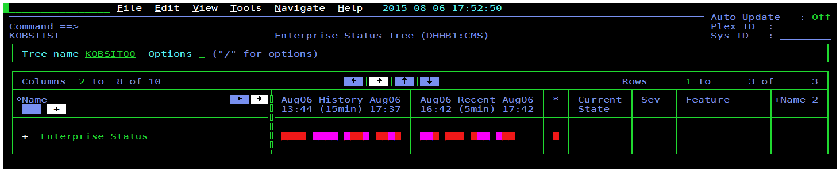
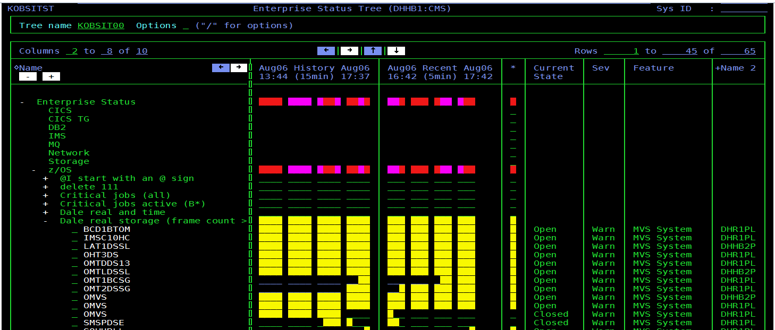
OMEGAMON Dashboard Edition v5.3 Interim Feature
Operational short term status views in E3270UI built on situations (Tivoli OMEGAVIEW 3270 replacement) and Status Tree view

Slide 35
Mainframe Service Management key to driving improved business outcomes
_{WORK LOADS}
Business Results
IT Analytics
Cost Optimization
Business Agility
Customer Satisfaction
Systems of Engagement
Systems of Record
Performance Management
Automation
Notes:
System Automation for z/OS
35
Main Point: This can be the Agenda Chart, with discussions about Automation, Performance Management, Analytics and Cloud in the rest of the deck. Cloud will be where many new workloads reside. In addition to todays, Monitoring and Automation we are seeing analytics take on additional importance. Systems of Record and Systems of Engagement will need improved analytics to support new, large big data requirements and Cloud implementations. Cloud workloads can be on either distributed or zEnterprise (zLinux or zBX). IBM solution integrated across Monitoring, Automation and Analytics.

Slide 36
Customer Driven Development
Customer programs – Work closely with OMEGAMON development as we build to ensure value and high-priority customer requirements
OMEGAMON Customer
Leadership Council
Quarterly calls
Service
Management
Connect
Roadmaps/Plans
Request for
enhancements (RFEs)
30 day reviews
90 day response
Development
Roadmap
OMEGAMON
Agile Delivery
Releases
Early Access Programs
Monthly Calls and Demos
Beta Programs
Customer driven capability driven by Agile processes - Visit Service Management Connect at
https://www.ibm.com/developerworks/mydeveloperworks/groups/service/html/communityview?communityUuid=5e65990a-9690-42e2-93b1-c2267be7620c
36
Notes:
36
Main Point: All the capabilities are built based on customer requirements and feedback

Slide 37

THANK YOU!

