Slide 1

IBM zAware
July 2015
Anuja Deedwaniya
STSM zSystems Architect - IT Analytics,
IBM Corp.
anujad@us.ibm.com

Slide 2
Trademarks
The following are trademarks of the International Business Machines Corporation in the United States, other countries, or both.
DS8000
ECKD
FICON*
GDPS*
GPFS
HiperSockets
IBM*
IBM (logo)*
InfiniBand*
Parallel Sysplex*
PR/SM
Redbooks*
System x*
System z*
System z9*
System z10*
Tivoli
WebSphere*
Z9*
z10
z10 Business Class
z10 EC
z/OS*
z/VM*
zEnterprise
The following are trademarks or registered trademarks of other companies.
Adobe, the Adobe logo, PostScript, and the PostScript logo are either registered trademarks or trademarks of Adobe Systems Incorporated in the United States, and/or other countries.
Cell Broadband Engine is a trademark of Sony Computer Entertainment, Inc. in the United States, other countries, or both and is used under license therefrom.
Java and all Java-based trademarks are trademarks of Sun Microsystems, Inc. in the United States, other countries, or both.
Microsoft, Windows, Windows NT, and the Windows logo are trademarks of Microsoft Corporation in the United States, other countries, or both.
Intel, Intel logo, Intel Inside, Intel Inside logo, Intel Centrino, Intel Centrino logo, Celeron, Intel Xeon, Intel SpeedStep, Itanium, and Pentium are trademarks or registered trademarks of Intel Corporation or its subsidiaries in the United States and other countries.
UNIX is a registered trademark of The Open Group in the United States and other countries.
Linux is a registered trademark of Linus Torvalds in the United States, other countries, or both.
ITIL is a registered trademark, and a registered community trademark of the Office of Government Commerce, and is registered in the U.S. Patent and Trademark Office.
IT Infrastructure Library is a registered trademark of the Central Computer and Telecommunications Agency, which is now part of the Office of Government Commerce.
* All other products may be trademarks or registered trademarks of their respective companies.
Notes:
Performance is in Internal Throughput Rate (ITR) ratio based on measurements and projections using standard IBM benchmarks in a controlled environment. The actual throughput that any user will experience will vary depending upon considerations such as the amount of multiprogramming in the user's job stream, the I/O configuration, the storage configuration, and the workload processed. Therefore, no assurance can be given that an individual user will achieve throughput improvements equivalent to the performance ratios stated here.
IBM hardware products are manufactured from new parts, or new and serviceable used parts. Regardless, our warranty terms apply.
All customer examples cited or described in this presentation are presented as illustrations of the manner in which some customers have used IBM products and the results they may have achieved. Actual environmental costs and performance characteristics will vary depending on individual customer configurations and conditions.
This publication was produced in the United States. IBM may not offer the products, services or features discussed in this document in other countries, and the information may be subject to change without notice. Consult your local IBM business contact for information on the product or services available in your area.
All statements regarding IBM's future direction and intent are subject to change or withdrawal without notice, and represent goals and objectives only.
Information about non-IBM products is obtained from the manufacturers of those products or their published announcements. IBM has not tested those products and cannot confirm the performance, compatibility, or any other claims related to non-IBM products. Questions on the capabilities of non-IBM products should be addressed to the suppliers of those products.
Prices subject to change without notice. Contact your IBM representative or Business Partner for the most current pricing in your geography.
Notes:
2

Slide 3
Notice Regarding Specialty Engines (e.g., zIIPs, zAAPs and IFLs):
Any information contained in this document regarding Specialty Engines ("SEs") and SE eligible workloads provides only general descriptions of the types and portions of workloads that are eligible for execution on Specialty Engines (e.g., zIIPs, zAAPs, and IFLs). IBM authorizes customers to use IBM SE only to execute the processing of Eligible Workloads of specific Programs expressly authorized by IBM as specified in the “Authorized Use Table for IBM Machines” provided at
www.ibm.com/systems/support/machine_warranties/machine_code/aut.html (“AUT”).
No other workload processing is authorized for execution on an SE.
IBM offers SEs at a lower price than General Processors/Central Processors because customers are authorized to use SEs only to process certain types and/or amounts of workloads as specified by IBM in the AUT.
Notes:
3

Slide 4
Agenda
Why IBM zAware?
What is IBM zAware?
  How does it identify and diagnose problems on your z/OS and Linux for z systems
Using IBM zAware
Operating requirements
Integration with other management products
Notes:
4

Slide 5

Background – Why IBM zAware
Systems are more complex and more integrated than ever
Errors can occur anywhere in a complex system
Some problems are particularly…
  Difficult to detect
    Several allowable anomalies can build up over time
    Symptoms / problems can manifest for hours or days
    Problem can grow, cascade, snowball
  Difficult to diagnose
    Sometimes finding the system in error is a challenge
    Many times finding the component in error is a challenge
    Volume of data is not humanly consumable, especially when seconds count
Need timely information and insight
Notes:
5

Slide 6
IBM System z Advanced Workload Analysis Reporter
Using Analytics to Improve System z Availability
The complexity and rate of change of today’s IT infrastructures stress the limits of IT to resolve problems quickly and accurately--while preserving SLAs
IT is challenged to diagnose system anomalies and restore service quickly
  Systems often experience problems which are difficult or unusual to detect
  Existing tools do little to identify messages preceding system problems
  Some incidents begin with symptoms that remain undetected
  Manual log analysis is skills-intensive, and prone to errors
IBM zAware with Expert System Diagnostics Gets it Right, Fast
  IBM zAware helps improve problem determination in near real time – helps rapidly and accurately identify problems and speed time to recovery
    Analyzes massive amounts of data to identify problematic messages, providing information to enable faster corrective action
    Analytics on log data provides a near real time view of current system state
    Cutting edge pattern recognition examines system behavior to help you pinpoint deviations
    Machine learning, modeling and historical data work to analyze your unique environment
    Improves problem diagnosis across a set of System z servers
Benefits
  Helps you diagnose problems quickly and more accurately to improve service recovery time
  Particularly helpful when problems involve multiple teams
  Reduces time and skills required to detect a problem
  Allow establishment of procedures to prevent reoccurrence
Notes:
6
► Can proactively identify and help you more quickly diagnose problems, then decide on appropriate recovery actions. Reducing the impact to users or business units
One company 2.46 M messages a day…28 per second
One company 18.6 M messages a day….215 per second

Slide 7


IBM zAware can reduce time to repair to improve availability
Without IBM zAware
With IBM zAware
Problem
Problem
Business
Impact
Application Steady State
Business
Impact
Application Steady State
Decide what to do
Decide
what to do
Little advanced warning
Often, Multiple Attempts to Correct Problem
Detect changing conditions
More Precise Corrective Action
shutdown
restart
shutdown
restart
gathering of diagnostic information
Time
gathering of diagnostic information
Time
Ineffective time spent in problem determination and trial and error. Incorrect problem identification may result in the wrong fixes being applied.
More precise and early diagnosis can shorten impact time and help you to avoid a similar problem. Gain an edge in your ability to respond to events.
Notes:
The “Decide what to do” tends to be the majority of time spent.
IBM zAware reduces this time, to improve MTTR.

Slide 8
What can zAware do for you?
Identify unusual behavior quickly
Which z/OS image is having unusual message patterns?
    High score generated by unusual messages or message patterns
    GUI shows all systems or selected subsets
Which subsystem or component is abnormal?
    Examine high-scoring messages
When did the behavior start?
    Which messages are unusual?
    How often did the message occur?
    Easily examine prior intervals or dates
Is the unusual behavior after some maintenance or upgrade?
    Easily pinpoint changes caused by new software levels, configuration settings.
Notes:
8

Slide 9
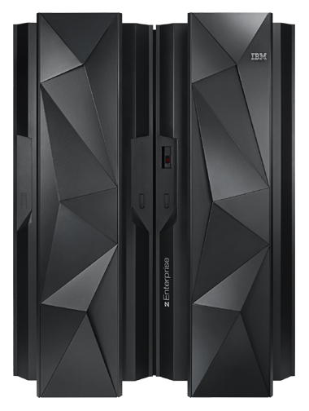
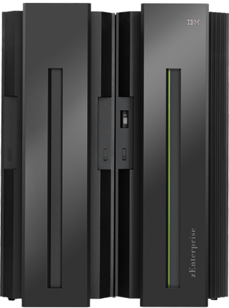
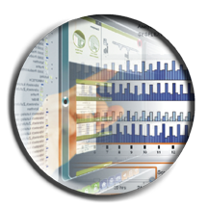
IBM zAware V2.0 - Analyze Linux on System z and z/OS logs
New!
z13 IBM zAware host
IBM zAware monitored client
z/OS
Linux
on system
z
z/OS
Linux on system z
Linux on system z
IBM
zAware
Host
Partition
IBM zAware Web GUI to monitor results
z/VM
Identify unusual system behavior of Linux on system z images
  Monitors syslog from guest or native image in real time
Improved analytics for z/OS message logs
Enhanced UI with heat map views
Notes:
9
9
Architecture Objectives
Usual zAware objectives (e.g. minimal processing on monitored system)
Exploit existing interfaces where possible
For Linux on z, reuse existing syslog interface

Slide 10
Analyzing z/OS systems
A model of “what’s normal” is created for each system
IBM zAware monitors and scores messages including all z/OS console messages, ISV and application generated messages
Reports on 10 minute intervals
  Current score is updated every 2 minutes
  Uses a sliding 10 minute window to generate the current score
  Uses 90 days baseline log data to build model by default (configurable)
Detects anomalies monitoring systems miss:
  Messages may be new, or in new patterns
  Messages may be suppressed or rare
  Messages may indicate a trend
  Customer can specify message to be ignored – prevent flood of new messages from masking real problems
XML Output is consumable through published API, can drive ISV products
Notes:
10

Slide 11
Analyzing Linux on z Systems
New!
A model of “what’s normal” is created for each system or group of systems
IBM zAware monitors and scores all Linux on z syslog messages, including ISV and application generated messages
Reports on 10 minute intervals
  Current score is updated every 2 minutes
  Uses a sliding 60 minute window to generate the score
  Recommend 120 days baseline data to build model by default (configurable)
  Early models may be built with lesser data
XML Output is consumable through published API, can drive ISV products
Notes:
11

Slide 12
Analyzing Linux on z Systems - details
New!
For Linux on System z, multiple systems can be grouped into a combined ‘model group’
  This allows multiple systems with similar operational characteristics to contribute to the generation of a single model
‘Model groups’ defined by the zAware admin using hostname wildcards
  Assumes well-defined Linux host naming conventions
  Can model systems running similar types of workload (e.g. webserver, app servers)
    By workload (e.g. one for all web servers, one for all databases, etc.)
    By ‘solution’ (e.g. one model for your Cloud)
    By VM host
Dynamic activation and deactivation of an image, common on Linux, is automatically recognized
  The Model Group support allows for analysis to be done for a system as soon as it connects to zAware, since it can use its group model
Notes:
12

Slide 13
Inside IBM zAware Analytics -- Modeling
OPERLOG (z/OS) or syslog (Linux for z) is processed
zAware recognizes any well-formed message IDs for z/OS
  recognizes similar message text and generates a message ID for Linux for z,
  including IBM and non-IBM products and customer applications
zAware summarizes the common message text and records the occurrences
zAware builds a model of normal behavior based on recent baseline data
  Called “Training”
  Automatically trains every 30 days (configurable)
  Training can be forced manually
  Training period is configurable
  Unusual days can be excluded from future models
  For z/OS,
      Each system has its own model
      Messages can be excluded from analysis scoring
  For Linux for z,
      Systems can be grouped into a combined model
z/OS utility, or a Linux command, may be used to load historical logs into zAware
Notes:
13

Slide 14
Inside IBM zAware Analytics -- Analysis
Real-time log data from each system is compared to the model
Assigns a message anomaly score to indicate deviation from the model
  Rare messages
  Out of context from normal patterns
  High counts
  Periodicity
Uses z/OS knowledge to influence the z/OS scores
Generates a heat map for each group or system at hour or day level
Generates an interval anomaly score bar per 10 minute interval
  GUI shows number of unique message IDs (bar height)
  GUI shows interval anomaly score (bar color)
Drill down on interval shows the actual messages with message scores and other details
Launch to IBM knowledge center for IBM generated z/OS messages
Notes:
14
XML output available via HTTP APIs to drive alerting

Slide 15
Enhanced zAware GUI
New!
Improved usability and GUI functional enhancements address many customer requirements
  enhanced filtering, visualization, better use of GUI real estate,
  improved UI navigation
  display local time in addition to UTC time
New improved GUIs are based on IBM One UI guidelines
Heat map display provides a high level consolidated view with ability to drill down to detail views
  z/OS grouped by sysplex, Linux grouped by model group
  Scores presented at the day and hour level
    Highest score for that hour or day for the group or system
  Quickly get to all systems in a specific group
  See the interval summaries per system with the Bar Score view
  Detailed messages and scores in the Interval view
Expanded browser support with Firefox ESR 24, 31 and IE 9,10,11
Notes:
15

Slide 16
General V2.0 Enhancements
New!
Enhanced analytics
  The new generation of technology provides improved analytics to provide better results.
  New scorers including periodicity.
Broader scope of input data to be analyzed
  The previous version required messages with z/OS message id format
  zAware can process message streams that do not have message ids
  This opens up new possibilities going forward
Notes:
16

Slide 17
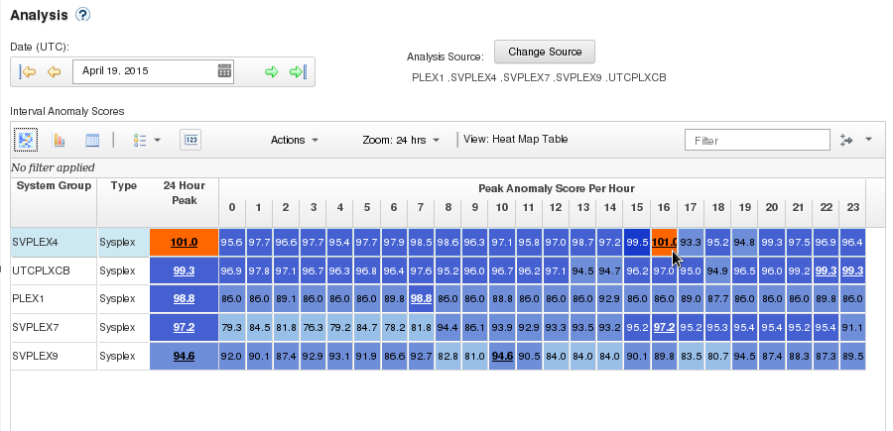
zAware enhanced GUI – Heatmap
New!
Monitor multiple plexes
Aggregated analysis score for group with ability to drill down

Slide 18
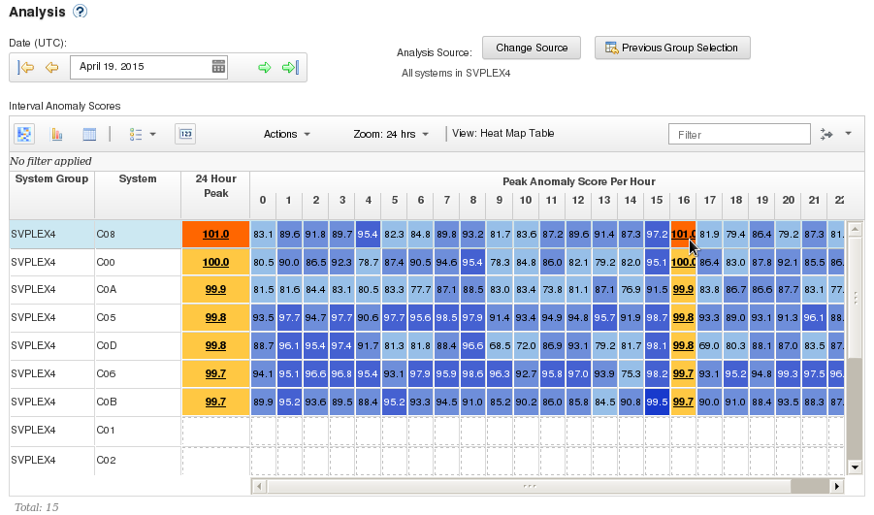
Heat Map – All systems in a group
New!
Drill down the heatmap into a particular sysplex SVPLEX4 with a high anomaly score by clicking on 101.0 in the 16 column. Now the view is drilled down and sorted by that column

Slide 19
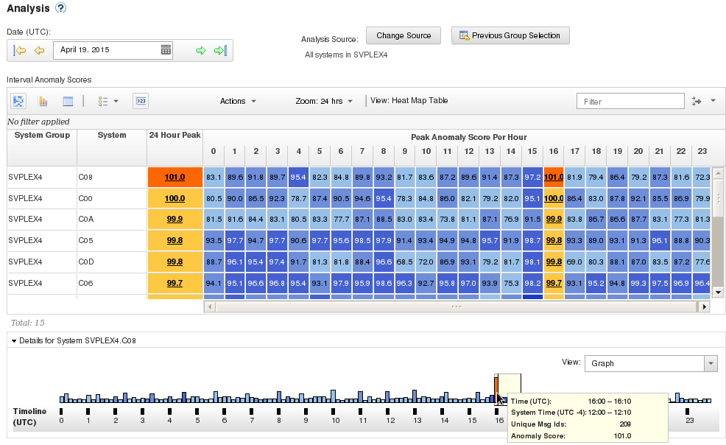
Heat Map – All systems in a group w/drilldown
New!
Details of hour 16 highlighted.
Hover shows interval summary
Click on column the 101.0 cell to bring up the details pane at the bottom with the timeline for that hour highlighted.
Hover over an interval for details
Notes:
19

Slide 20
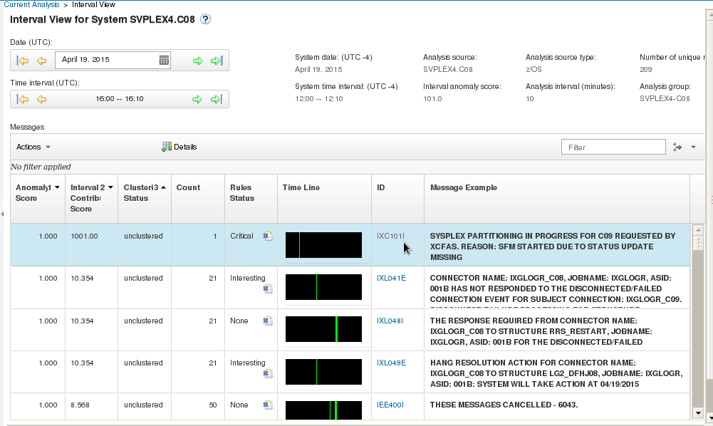
Interval View
Time Line shows occurrences within interval
Message ID is a link to knowledge center
z/OS specific rules affect anomaly score
Mark a z/OS message to be ignored
Notes:
20

Slide 21
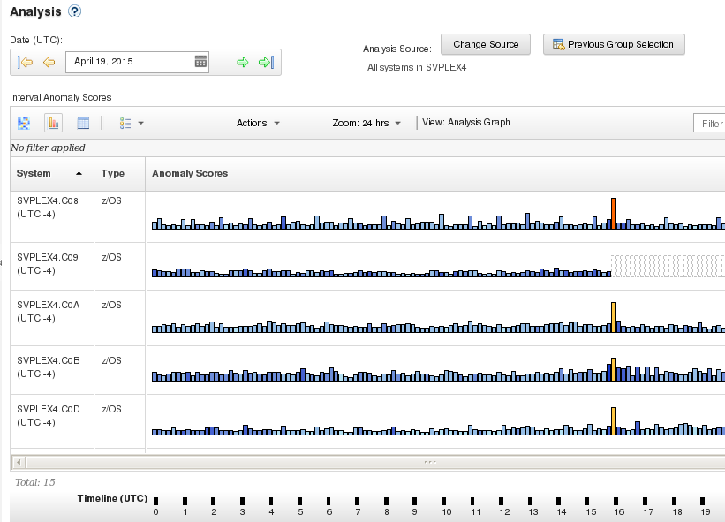
Bar Score view with interval summaries
Height shows number of unique messageIDs
Color shows anomaly score
Clicking on a bar drills down to Interval

Slide 22
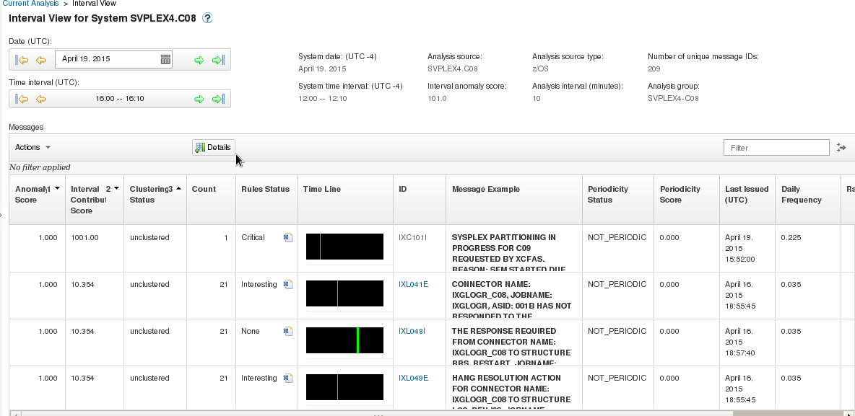
Interval View with details
Enhanced!
Notes:
22

Slide 23
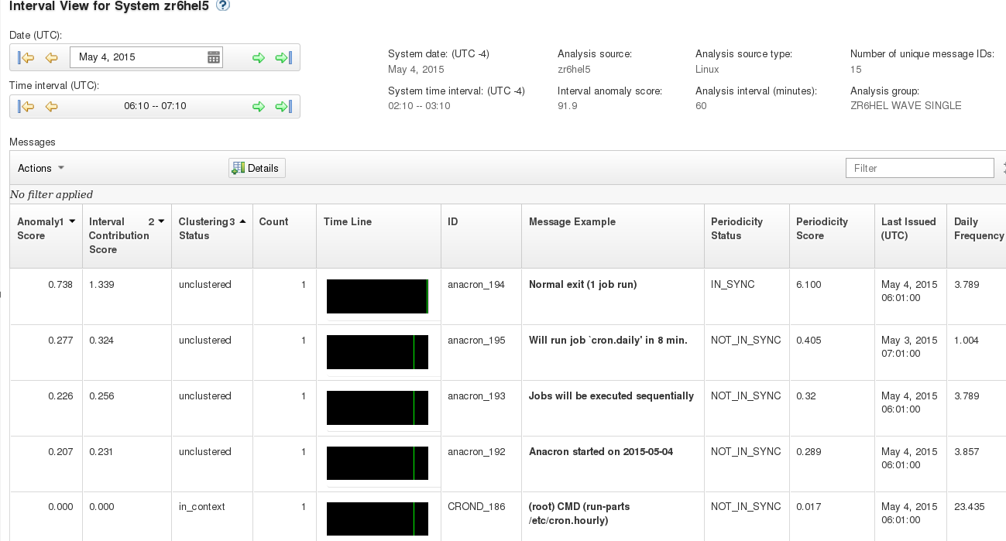
Interval View with details – Linux
New!
Ids are generated
Notes:
23

Slide 24
Sample Use cases
A client compared it to an Airbag in the car – it reacts when something is wrong
It learns as time progresses, situations happen and identifies things we know would not have been identified by normal monitoring products
  - Allows to fix before it becomes a real problem
Notes:
24

Slide 25
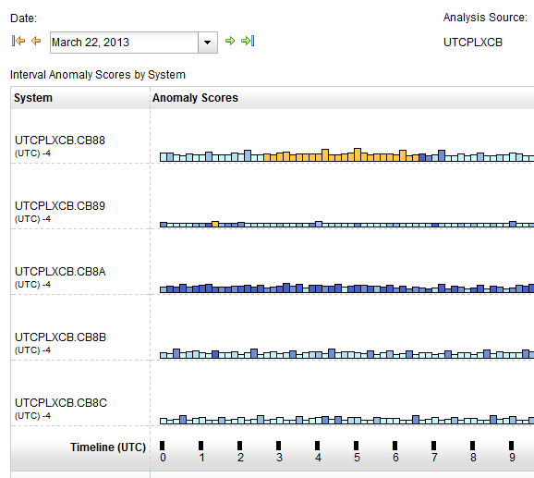
Identify unusual behavior quickly
Which z/OS image is having unusual message patterns?
  Yellow and dark blue on CB88
When did the behavior start?
  Around 2:30
Notes:
25

Slide 26
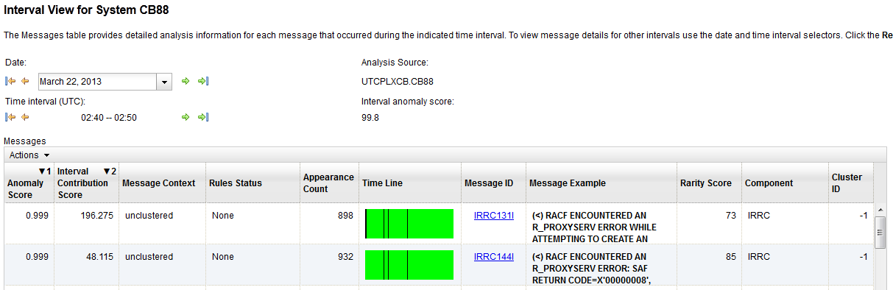
Identify unusual behavior quickly – Configuration Error
What component is having the problem?
  Drill down indicates 900 IRRC131I and IRRC144I messages per interval. A review of SYSLOG showed that this was the result of work being performed in the LDAP address spaces. Further analysis showed that the LDAP PC Callable Interface was not enabled. At 6:40, the function was enabled, and the 131I and 144I messages are no longer generated.
Impact
  Unnecessary messages blocking ability to see anything else. Impacts ability to look at the console
When did the behavior start?
  Around 2:30
Notes:
26

Slide 27
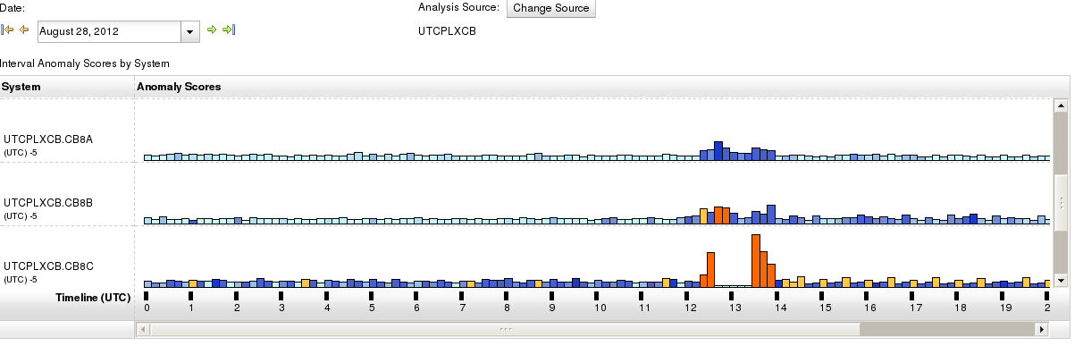
Identify unusual behavior quickly
Which z/OS image is having unusual message patterns?
  Recurring yellow and dark blue on CB8C
When did the behavior start?
  After an IPL at 13:30
Notes:
27

Slide 28
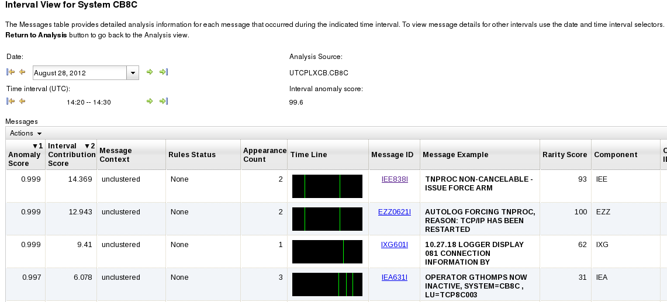
Identify unusual behavior quickly – Configuration Error
Which subsystem or component is abnormal?
    Examine high-scoring messages
When did the behavior start?
    When did the messages start to occur?
Were similar messages issued previously?
    Easily examine prior intervals or dates
Moving left and right by interval shows messages due to TNPROC being cancelled by TCP/IP
Notes:
28

Slide 29
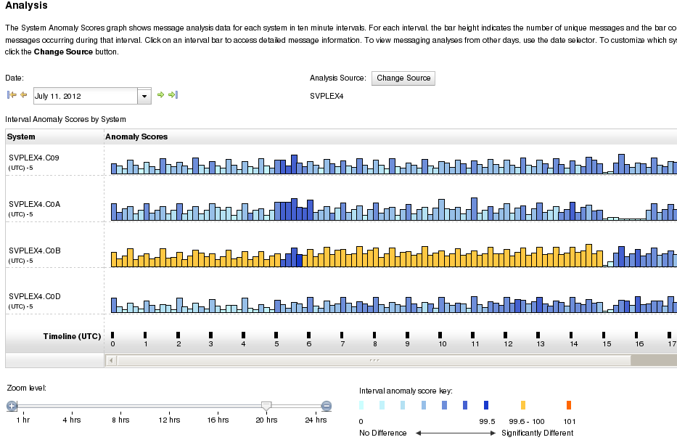
Identify behavior after a change
Are unusual messages being issued after a change?
    New / updated workload (OS, middleware, apps) was introduced
    Detected as yellow bars
    Once messages confirmed as ok, can rebuild your system model, and workload now understood as “normal.”
    Alternatively, specific messages can be “ignored”
A new model included several days of new workload
Notes:
29

Slide 30
Integration with z/OSMF
Using the z/OSMF GUI
  Configure a new external link
    to access IBM zAware from z/OSMF
  Administration > Links > Actions > New
    Provide link name, SAF suffix, zAware GUI URL
    Category – recommend Problem Determination
    Define authority required to use the link
Notes:
30

Slide 31
Integration with other System Management products
APIs
  Provides XML equivalent to GUI
    Analysis page
    Interval View page
  Requires HTTPS
    From z/OS, use AT-TLS
  HTTP GET/POST requests
    Connect and authenticate to IBM zAware server
      UserID known as a zAware user (e.g. LDAP)
    Retrieve analysis for a monitored client
      Analysis Analysis data generated
      INTERVAL Message scores for a 10-minute interval
      LPAR Interval scores for date (deprecated, replaced by analysis)
Note: API is compatible with existing callers (z/OS)
V2 required for Linux. Adds new attributes.
Notes:
31

Slide 32
Integration with other System Management products
IBM Tivoli NetView for z/OS
  Use the APIs to pull the IBM zAware results
  Sample programs are available from
https://www.ibm.com/developerworks/mydeveloperworks/wikis/home/wiki/Tivoli%20System%20z%20Monitoring%20and%20Application%20Management/page/Integration%20Scenarios%20for%20Tivoli%20NetView%20for%20zOS?lang=en
  Described in detail in the Redbook:
    Extending z/OS System Management Functions with IBM zAware
  The samples can be tailored to drive NetView message automation for high anomaly scores:
    Generate a message
    Generate an event
  CANZLOG – Browse consolidated logs for PD
Tivoli Integrated Service Management products use of IBM zAware results.
  Omegamon XE on z/OS (including predefined situations)
Other products can exploit the XML format results
  Rexx exec sample can be obtained from IBM
Notes:
32

Slide 33
Omegamon XE on z/OS
Notes:
33

Slide 34
IBM zAware
Operating Requirements
Notes:
34

Slide 35
Operating Requirements – IBM zAware Server
  Logical partition on a zEC12 or zBC12 or z13 server
    Runs on IFLs or general purpose CPs – may be dedicated or shared
    Runs its own self-contained firmware stack
    Recommended 2 partial engines
  DASD storage
      500 GB (ECKD) + 5GB per client
      Dependent on data retention settings (primarily the analytic results)
      Monitor and dynamically add or remove devices
  Memory is dependent on the number of monitored clients, message traffic rate
    Minimum Memory is 4 GB for 6 clients with light message traffic (500 msgs/sec)
    For > 6 clients + 256 MB per z/OS client required; +64 MB per Linux client
  Network resources
    HiperSockets or shareable OSA ports or IEDN; IP address for partition
  Browsers
    Internet Explorer 9, 10, 11; Firefox ESR 24, 31
Notes:
35
Check this against doc
EC12 server for zAware host system
IFL or general purpose CP
Partial engine for an “average” customer configuration, up to two engines for a larger configuration
Runs in a special purpose LPAR – firmware partition
Storage and memory resources are dependent on the number of monitored clients
DASD – can increase as you add systems. Estimates are 500G + 5G for each monitored system
Real memory – Estimates are 6G base plus 250M for each monitored system
OSA ports – for both gathering of instrumentation data and outbound communications
Need IP address for partition

Slide 36
Operating Requirements – z/OS Monitored Clients
System z servers supported as IBM zAware monitored clients
        z13
        zEC12
        zBC12
        IBM zEnterprise™ 196 (z196) or z114,
        IBM System z10™ EC or BC
        Prior generations that meet the OS and configuration requirements
  Running z/OS 1.13 + PTFs or z/OS 2.1
      APAR OA38747
      APAR OA38613
      APAR OA39256
      APAR OA42095
  System needs to be configured as a monoplex, system in a multisystem sysplex, or a member of a parallel sysplex
  Using operations log (OPERLOG) as the hardcopy medium
  Sysplex name + system name must uniquely identify system
  Requires an OSA or IEDN or HiperSocket
  for IP network connection
  z/OS zAware monitored client MIPs usage ~ 1%
Notes:
36
Check this against doc
EC12 server for zAware host system
IFL or general purpose CP
Partial engine for an “average” customer configuration, up to two engines for a larger configuration
Runs in a special purpose LPAR – firmware partition
Storage and memory resources are dependent on the number of monitored clients
DASD – can increase as you add systems. Estimates are 500G + 5G for each monitored system
Real memory – Estimates are 6G base plus 250M for each monitored system
OSA ports – for both gathering of instrumentation data and outbound communications
Need IP address for partition

Slide 37
Operating Requirements – Linux Monitored Clients
System z servers supported as IBM zAware monitored clients
        z13
        zEC12
        zBC12
        IBM zEnterprise™ 196 (z196) or z114,
        IBM System z10™ EC or BC
        Prior generations that meet the OS and configuration requirements
  Running a supported level of Linux on System z
  SLES 10 or later
  RHEL 6 or later
  Native or as z/VM guest (z/VM logs are not monitored)
  Configuration of syslog daemon is required to send RFC 5424 format
    rsyslog or syslog-ng
    No Linux client / agent is needed
    syslog is well-known, standardized, UNIX syslog data
  (e.g. /var/log/messages)
  Each Linux for System z system connects to IBM zAware, without a syslog relay
Notes:
37
Check this against doc
EC12 server for zAware host system
IFL or general purpose CP
Partial engine for an “average” customer configuration, up to two engines for a larger configuration
Runs in a special purpose LPAR – firmware partition
Storage and memory resources are dependent on the number of monitored clients
DASD – can increase as you add systems. Estimates are 500G + 5G for each monitored system
Real memory – Estimates are 6G base plus 250M for each monitored system
OSA ports – for both gathering of instrumentation data and outbound communications
Need IP address for partition

Slide 38

Summary
IBM zAware – Smarter Computing Needs Smart Monitoring
IBM zAware is a self learning, integrated solution that analyzes messages in near real time to provide insight into the behavior of your system.
Benefits
Helps diagnose problems quickly and more accurately to improve service recovery time
Reduces risk by identifying “what changed” after maintenance.
Helpful when problems involve multiple teams
Easy-to-use graphical interface
Integrates with existing alerting environment
zAware’s capacity as a ‘watch dog’ can help to detect unusual behavior in near real time
Notes:
38

Slide 39
References
IBM System z Advanced Workload Analysis Reporter (IBM zAware) Guide SC27-2623-00
http://www.ibm.com/systems/z/os/zos/bkserv/r13pdf/#E0Z
or IBMResourceLink Library → zEC12 → Publications
IBM System z Advanced Workload Analysis Reporter (IBM zAware) Guide V2.0 SC27-2632-00
  https://ibm.biz/BdEW9J
Redbook Web Doc: IBM zAware Migration from an IBM zEC12 to an IBM z13
  http://www.redbooks.ibm.com/abstracts/tips1296.html?Open
Redbook: Extending z/OS System Management Functions with IBM zAware http://www.redbooks.ibm.com/abstracts/sg248070.html?Open
IBM Mainframe Insights blog www.ibm.com.systemz
  The Journey to IBM zAware
http://www.ibm.com/connections/blogs/systemz/entry/zaware?lang=en_us
  zAware Installation and Startup
http://www.ibm.com/connections/blogs/systemz/entry/zaware_installation?lang=en_us
  Top 10 Most Frequently Asked Questions About IBM zAware
http://www.ibm.com/connections/blogs/systemz/entry/zawarefaq?lang=en_us
  IBM zAware Demo
  http://www.ibm.com/connections/blogs/systemz/entry/zawaredemo?lang=en_us
Notes:
39

Slide 40


Notes:
40

Slide 41
What is IBM zAware?
IBM System z Advanced Workload Analysis Reporter (IBM zAware) V1 was released with the zEC12 in September 2012
Version 2 was delivered with z13 in 2015
Features
  Delivers cutting edge pattern recognition analytics applied to z/OS OPERLOG messages with minimal impact to z/OS workloads
    Helps diagnose major problems while they are occurring in near real time
    Heightens awareness of small problems before they become big problems
    Reduces mean time to recovery
    Reduces the time and skill required to diagnose a problem
  A browser based view, which can show the entire z/OS footprint in one window
Notes:
41

