Slide 1
IBM Smarter Social Programs
Integrated Eligibility: Improving Access to Health and Social Programs
March 26th, 2015
Jeff Mann
Strategy and Market Development
IBM Cúram Social Program Management
John J. Sweeney
Sr. Product Manager
IBM Smarter Care and Social Programs

Slide 2



Contents
IBM Commitment
Integrated Eligibility
The Solution
Summary

Slide 3
IBM has a strong, long-standing commitment to social programs, which expanded with the acquisition of Cúram Software
Commercial off-the-shelf, software for line of business users in health and social programs, covering all types of organizations
More than 700 IBM subject matter experts in social programs:
  40 subject matter experts in social programs policy
  300 service professionals experienced in building social program management systems
  320 dedicated software developers with expertise in social programs business processes
Social programs policy research center—the IBM Cúram Research Institute

Slide 4
Social program management is the core of what we do
 | Family services | Employment | Public pensions | Disability management | Social assistance | Government health
National government | Family benefits | Unemployment benefits | National pensions | Disability benefits and pensions | Tax credits Social benefits | National health schemes
State and provincial | Child welfare |  |  | Workers’ compensation |  | Private insurance Exchanges
Cities / Counties | Homeless child and adult care | Employment services | Employer pension Personal pension Industry pensions | Disability management services
Serving health and social programs organizations at all levels of government, as well as non-governmental organizations

Slide 5



Focus on Outcomes & Collaboration
Operational
Process Support
Intake &
Investigations
Placements
On-Going Case
Management
Service
Delivery
Outcome
Management
Assessment
Service
Planning
Outcome
Evaluation
Multi-disciplinary Approach
Family
Shared
Case & Client Info
Multi-Disciplinary
Teams
Notes:
5

Slide 6


IBM’s Social Program Management approach enables governments to make necessary changes
Needs
To
Outcomes
Identify
Triage & Screening & Applications
Benefit Planning
& Selection
Life Event Management
Outreach Management
Social Record Management
Personalized Response
Identity & Fraud Prevention
Assess
Social Context Analysis
Evidence Management
Strength & Needs Assessment
Advisor
Priority, Complexity & Risk (PCR)
Predictive & Content Analytics
Respond
Integrated Eligibility & Entitlement
Intake & Enrollment
Differential Response
  Crisis
  Diversion
  Prevention
  No Touch
  Manage Case
  High Touch
Evidence-based Models
Manage
Outcome Plans
Personal Budgets
Service & Provider Provisioning
Collaboration and Social Media
Multidisciplinary Teams
Provider Management
Financial Management
Measure
Outcome Evaluation
  Clients
  Providers
  Programs
  Processes
  Spend
Multidimensional Analytics
  Fraud
  Social Innovation Programs
  Assessment & Response Models
Outcome Evaluation
  Clients
  Providers
  Programs
  Processes
  Spend
Multidimensional Analytics
  Fraud
  Social Innovation Programs
  Assessment & Response Models

Slide 7
Contents
IBM Commitment
Integrated Eligibility
The Solution
Summary

Slide 8


Integrated Eligibility

Slide 9
A variety of challenges are driving the need for change in health and social programs
Growing Pressure
High youth unemployment e.g. 58% in Spain
5% of New York high-need consume 50% of care budget
By 2025: EU aged 50-56 will grow 20 25%...
Reform
US Affordable Care Act, Health Homes
Healthy China 2020
UK Personal Independence Payments (PIP)
Australia National Disabilities Insurance Scheme
Notes:
Purpose of slide: Set up the environment, identify the challenges
<Martin’s points>
The Chinese government recently declared the pursuit of “Healthy China 2020,” a program to provide universal healthcare access and treatment for all of China by the year 2020, mostly through revised policies in nutrition, agriculture, food, and social marketing.[7] Much of the program centers on chronic disease prevention, and promoting better lifestyle choices and eating habits.
In the UK, the government looked at the disability program and realised it was really designed for a previous age. So instead of looking at what can’t you do, it looked at what could you do . Ability not disability. This has led to a wholesale reform of the how disability is looked at – how you support people to engage in work and how you help those who are truly unable to work.
And finally – another example of major reform from Australia – introducing a whole new area of coverage – the National Disabilities Insurance Scheme. Reflecting the realities of gaps in the systems and like the UK – the new reality of social programs in the 21st Century. In this case, new funding, new organizations, new ways of working new accountabilities between federal, state and the not for profit sector.
<Original talking points:>
Talking points:
It’s been a tough few years, but we are seeing signs of coming out of the recession: strong in the US, mixed elsewhere
But the progress is fragile, and there are continued issues
Unemployment – the situation improves for some. But others are being left behind: youth, and those with disabilities
Rising costs of healthcare
Growing demand for healthcare due to the expansion of the elderly population
Reforms are being implemented
Addressing employment in Europe
Legislation to on healthcare access in the US
Government commitment to improve population “wellness” in China
Change the models for assisting people with disabilities in Australia and the UK
You are the organizations and agencies who have to react and respond. You are the ones who deal with this.

Slide 10
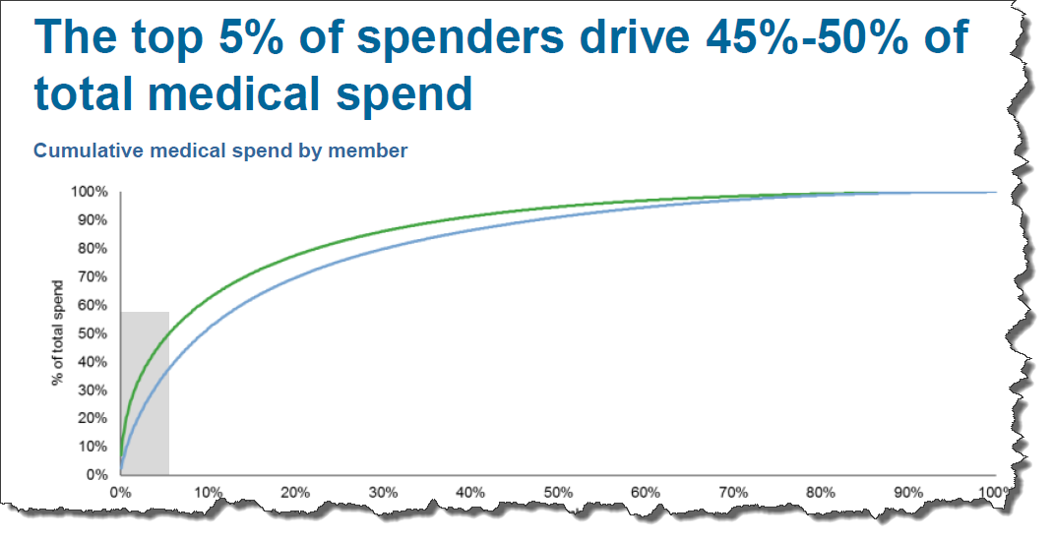

How do we improve the lives of needy populations while lowering the unsustainable growth in cost to care for them?
Slide 10, http://www.hfma.org/anihandouts/xtbce9adrpp1/A03.pdfSource: Commercial Sample – MarketScan Commercial claims data; Medicare Sample – Medicare 5% sample.

Slide 11
Super-utilizers
Face an array of complex social challenges joblessness, homelessness, substance abuse, etc.
50%
Of Cost
5%
Of Clients

Slide 12
Governments need new approaches to address emerging social trends and issues
Business Megatrends
Requirements
Coordination
One-size-fits-all social programs no longer appropriate
Need to focus on prevention, early intervention
Societal changes need to be addressed with holistic view of citizens, their benefits and services
Differential response to target resources for greatest impact
Predictive models to identify those most in need or at risk
Outcomes - not outputs - focus, in both policy and service delivery
Foundation
Program coverage expands to all populations, rural and urban
Increasing reform of large-scale social assistance, employment, disability and pension programs
Restructured financial models needed for longer-term economic vitality and new sources of funding
New delivery channels need to be integrated, existing delivery channels need to be modified
Modern delivery systems to provide straight-through processing, accurate payments and increased efficiency
Dynamic programs to implement new policies rapidly
Shared and integrated service delivery models across government, cities and non-government sector to improve effectiveness and lower costs
Universal access models to bring together
the social ecosystem to focus on people and
their families
Notes:
12

Slide 13
Person-Centered Design Principles
Enabling the multidisciplinary team to be more effective and efficient across the Planning and Delivery phases
Holistic
Adaptive
Multi-disciplinary
Understanding, adapting and responding to the Citizen, environment, the context, the situation and the team
  Inclusive understanding of the client, their social network, and their engagement with the care network

Slide 14
Contents
IBM Commitment
Integrated Eligibility
The Solution
Next Steps

Slide 15
Product
Overview

Slide 16
IBM Cúram Social Program Management Platform is the foundation
Social Programs Industry Specific
  Domain specific platform, built for core needs of social programs organizations
  Pre-defined, best-in-class business processes supporting the complete social care lifecycle
  Role-based user experience targeted at the needs of stakeholders
Dynamic Programs
  Business user tools for program creation and modification
  Configurable, end-to-end business processes support
  Configurability built on top of a core social application, delivering the flexibility and adaptability required by social organizations
Platform for the Future
  Flexibility to support traditional and outcome-focused delivery
  Toolsets to support differential response
  Agility to prototype and adopt new programs and delivery models (e.g., conditional cash transfers, social impact bonds)
Notes:
16
Social Industry Specific
Domain Specific Platform, built to address the core needs of Social Organizations
Pre-defined, best-in-class business processes supporting the complete social lifecycle
Role-based User Experience targeted at the needs of stakeholders
Dynamic Programs
Business User Tools for program creation and modification
Configurable, end-to-end business processes support
Configurability built on top of a core social application, delivering the flexibility and adaptability required by Social organizations
Platform for the Future
Flexibility to support Traditional and Outcome-focused delivery
Toolsets to support differential response
Agility to prototype and adopt new programs and delivery models (e.g., conditional cash transfers, social impact bonds)

Slide 17
IBM Cúram Social Program Management Platform Reference Architecture
Citizens
Workers
Management
Providers
Employers
CBO, NGO
Multi-channel
Access
Web
Mobile
Phone/ IVR
Email
Chat
Paper/ Fax
Local Office
Single
Sign-on
Presentation
Citizen Portals
Worker Portals
Partner Portals
Req. Management
User
Identity
Process
Architecture & Design
Identify
Assess
Respond
Manage
Measure
Application Security
Triage, Screening & Applications
Strengths & Needs Assessment
Eligibility & Entitlement
Outcome Plans
Outcome Evaluation
Development Environment
Personalized Response
Social Context Analysis
Intake & Enrollment
Personal Budgets
Prebuilt KPIs
System Monitoring
Outreach Management
Evidence Management
Benefit Planning and Selection
Provider Management
Fraud Detection
Test Management
Social Record Management
PCR
Collaborative Planning
Financial Management
Life Event Management
Predictions
Differential Response
Appeals
Configuration Management
Identity Management
Evidence Based Models
Fraud Investigations
Build Automation
Fraud Prevention
Security
and
Monitoring
Case Management
Development Lifecycle
Analytics
Executive Dashboard
KPIs
Embedded Analytics
Predictive
Analytics
Content Analytics
Information
Social Services
Data Model
Content Repository
Master Client and Provider Index
Operational
Analytical
Integration
SOA Foundation
Legacy
Systems
Financials and
Budgeting
Human
Resources
v1.1
Verification and
Data Sources
Payment
System
Notes:
NOTE: THIS IS A CONTROLLED SLIDE. To get the latest version or to request changes, please visit the community page for social services reference architecture. The version number is hyperlinked to the community.
17

Slide 18









The IBM Cúram application suite
Modular for flexibility to trends and challenges
Social
assistance
Family
services
Employment
Disability management
Pensions
Healthcare reform
Care management
IBM Cúram Solution Modules
Configurable with best practices and industry expertise
IBM Cúram Child Welfare | IBM Cúram Verification | IBM Cúram Life Event Management | IBM Cúram Provider Management
IBM Cúram Income Support | IBM Cúram Appeals | IBM Cúram Social Enterprise Collaboration | IBM Cúram Outcome Management
IBM Cúram Income Support for Medical Assistance | IBM Cúram Evidence Broker | IBM Cúram Business Intelligence & Analytics | IBM Cúram Universal Access
IBM Cúram Application Modules
IBM Cúram Social Program Management platform
Administration suite and application development platform
Funded program management
Contribution management
Financial management
Supervisor workspace
Common intake
Evidence management
Participant management
Eligibility and entitlement
Business and technical services

Slide 19



A social program data model that supports over 50 programs out of the box
  Client-centric, multi-program data model delivers a holistic view
  Prebuilt social services data structure and relationships support over 50 social programs out of the box
Social program–specific data model to consistently store and report on client and provider performance and organizational outcomes
Notes:
Because the model is client centric it allows us to support many kinds of programs.
The data structure and relationships support over 50 programs OOTB.
---
Client centric
Support over 50 social programs OOTB
Store and report on client and provider performance and outcomes
19

Slide 20
The IBM Cúram supports a range of social programs that assist eligible individuals and their families during economic hardship
Supports health and social programs that provide:
  cash payment programs
  tax credits
  food assistance
  housing subsidies
  utility subsidies
  child care
  medical care
  and other programs
Helps caseworkers
work more effectively:
  Screening eligible program participants to identify optimal programs for their needs
  Determining benefit entitlement and eligibility
  Making payments
  Managing ongoing changes in circumstances that may affect entitlement.

Slide 21
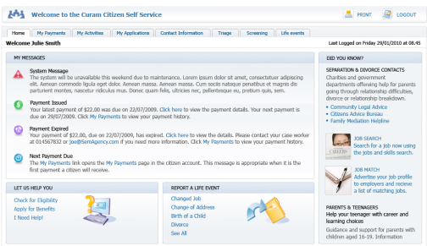
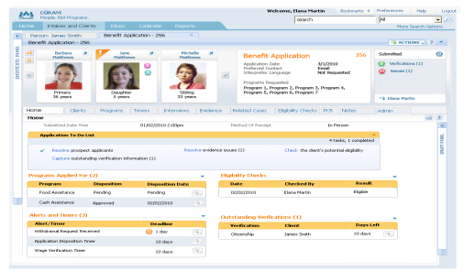
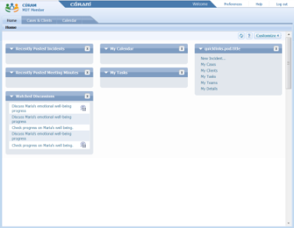
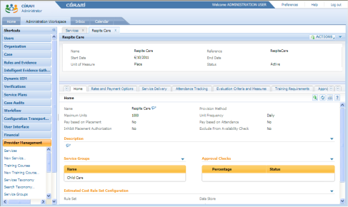
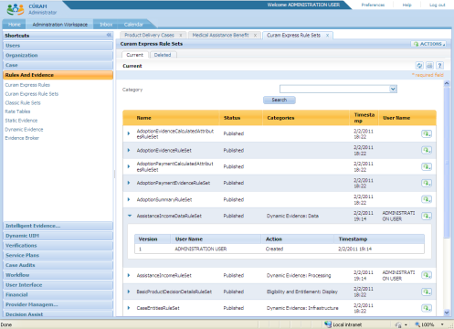
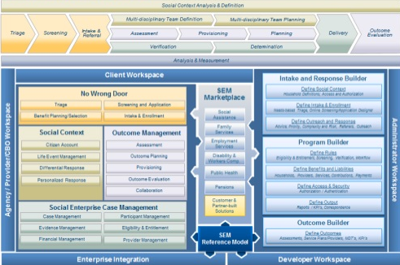
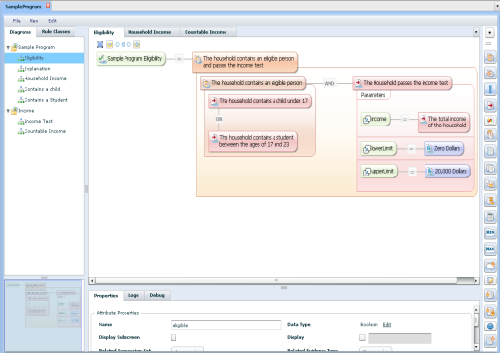
Role-based portal workspaces
Citizen Account
Case Worker
Workspace
Multi-Disciplinary
Team Workspace
Provider Workspace
Administrative
Workspace
Social
Program Management
Platform
Business Analyst Workspace

Slide 22
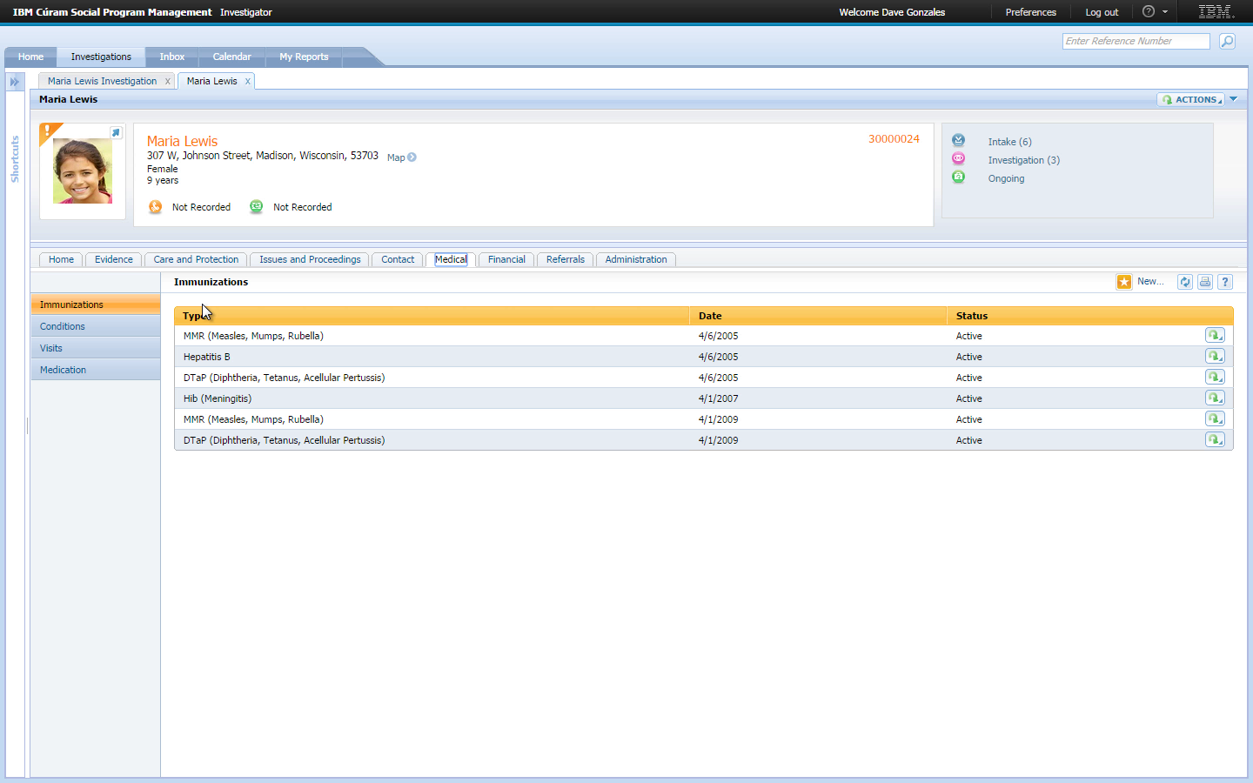
Person Home Page: holistic views of the individual’s information
Ability to update as changes in circumstances occur
Access to historical person and case data
Ability to view person’s cases across programs and geographies

Slide 23
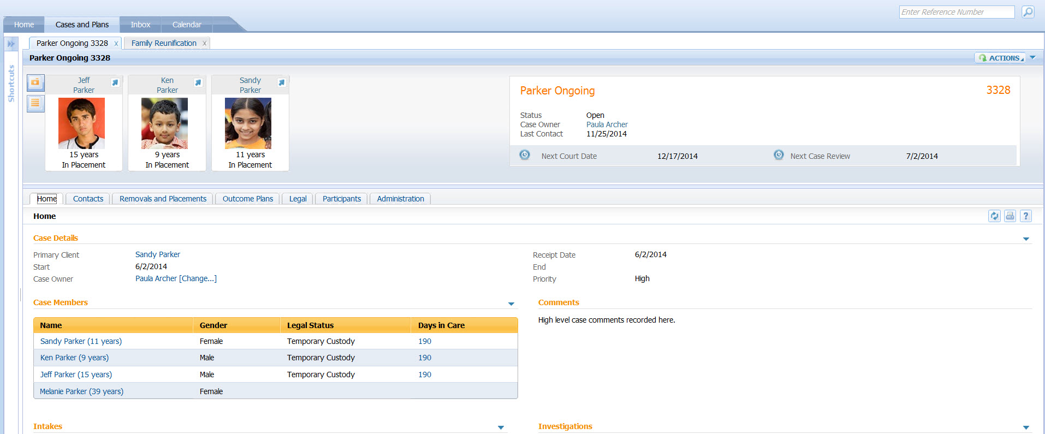
Ongoing Case Home Page: easy access to case status and activities, with integrated view of legal actions, outcome plans, referrals and placements
Notes:
Talk about case home page as platform for recording updates.

Slide 24
Contents
IBM Commitment
Integrated Eligibility
The Solution
Summary

Slide 25
Summary

Slide 26


Cross-program eligibility allows you to enter complex rules once and then use them across programs
Business user tools for rapid updates, such as translation of legislation and policy into eligibility and entitlement rules
One-time capture of client information for re-use across multi-program eligibility
Assistance unit determination based on program-specific definitions applied to household relationships
Notes:
Eligibility is very complex. Enter once and use across programs.
Household may be defined by blood relation, or people under one roof, or other.
---
Tools for rapid translation of legislation into rules
Capture info once and leverage for multiple programs
Determine benefits based on program applied to household
26

Slide 27
Commercial off-the-shelf solution

Slide 28

IBM Cúram Social Program Management incorporates the best features of packaged solution and custom development
Custom
Cúram
Cúram is built on the premise that all social program organizations have common core processes that can be supported out of the box
The unique requirements of any given organization are satisfied by extending the base application via configuration and the integrated development environment
Flexibility
Transfer
Package
Cost-effectiveness
Notes:
28

Slide 29

The IBM Cúram approach to configuration and extension promotes reuse
  Agency extensions
  For subset of agency requirements not met by out of the box configuration
  Agency configurations
  Agency-specific requirements can be met without coding, using Cúram commercial off-the-shelf (COTS) solution
  IBM Cúram enterprise modules
  Solutions for agency business programs
  Enhanced by IBM Cúram COTS solution
  IBM Cúram Enterprise Framework
  Application foundation: a single view of client and integrated case management capabilities

Slide 30
IBM Cúram Social Program Management value proposition
Enables rapid, lower-risk implementation by leveraging prebuilt and configurable social service elements and business processes
Empowers the business to define and deploy new programs with configuration tools in a runtime environment
Protects current investments and provides flexibility to address new and emerging service delivery trends
Reduces overall costs and the time needed to deploy new programs
Notes:
Low risk: Pre-built and configurable
Empowers business: Define new programs thru configuration tools
Protect investment: Platform for the future—address new and emerging delivery trends
30

Slide 31


Thank you.
John J. Sweeney
Sr. Product Manager
IBM Smarter Care and Social Programs
jjsweeney@us.ibm.com
Jeff Mann
Strategy and Market Development
IBM Cúram Social Program Management
jmann@us.ibm.com
http://www-03.ibm.com/software/products/en/social-assistance-solution

Slide 32
Trademarks and notes
© IBM Corporation 2015
IBM, the IBM logo, ibm.com, and Cúram are trademarks or registered trademarks of International Business Machines Corporation in the United States, other countries, or both. If these and other IBM trademarked terms are marked on their first occurrence in this information with the appropriate symbol (® or ™), these symbols indicate U.S. registered or common law trademarks owned by IBM at the time this information was published. Such trademarks may also be registered or common law trademarks in other countries. A current list of IBM trademarks is available on the Web at “Copyright and trademark information” at ibm.com/legal/copytrade.shtml.
Other company, product, and service names may be trademarks or service marks of others.
References in this publication to IBM products or services do not imply that IBM intends to make them available in all countries in which IBM operates.

