Slide 1
IBM Cúram Solution for Social Assistance
Presenter: Martin Duggan

Slide 2
IBM has a strong, long-standing commitment to social programs – going back to the 1930s – which was expanded with the acquisition of Cúram Software
Offers industrial-strength, line-of-business software for social programs, covering all types of organizations
Adds some 700 subject matter experts in social programs to IBM:
40 client-facing specialists with deep industry knowledge
300 service professionals experienced in social programs
320 dedicated social program product development resources
Provides a new social programs policy research capability—the IBM Cúram Research Institute
While definitions can vary from one country to another, for the purposes of this deck, the term “social programs” is used as a collective term to describe social security, social services, human services, social welfare and workers compensation/labor accident programs and agencies or organizations.
The term “social assistance” refers to a range of means tested or insurance based programs designed to assist individuals and families facing social and economic hardship. This programs include those that provide: cash payments, tax credits, food assistance, housing or utility subsidies, child care, medical care and other types of assistance.

Slide 3
There are challenges and issues that governments need to address
Societal shifts
Resurgence of social exclusion and poverty
Changes in family structures: the vulnerable are more reliant on programs for help
Increasing and changing patterns of migration
Changes in work patterns—fewer “jobs for life” in one location
Generational shifts
Aging societies and the demographic bulge
Growth in unemployment, particularly among the young
Intergenerational solidarity breakdown
Government status quo
Old and unstable technology
Budgetary constraints
Government shifts
Increased outsourcing to non-governmental organizations and the private sector
Greater spending needed for social and health programs
More sickness and invalidity benefit recipients
Less tolerance of fraud, abuse, waste and error

Slide 4
IBM Cúram has a clear vision to address these challenges - Needs to Outcomes™
It starts with the individual and their family
And understanding their complete needs
Not just what they might apply for
Non-Government
Organizations (NGO)
Government
Agencies
Providers
Universal Access
Client
Finance
Food
Shelter
Life Events
Health
Safety
Needs
Education
Social Context
Notes:
This is the our vision for how Cities and Governments should work together to provide Smarter Social Programs to help people and their families achieve their social and economic potential.
On the left you see the actors that are involved in a social ecosystem.
The client or citizen, the government agencies, service providers and non-government organizations such as charities or private sector organizations
The orange part at the bottom represents the need to understand the social context of the individual and their family – agencies and providers must work together to understand a person’s social context, strengths, needs and barriers stopping them from being a productive member of the community.
You have to know the complete needs.

Slide 5
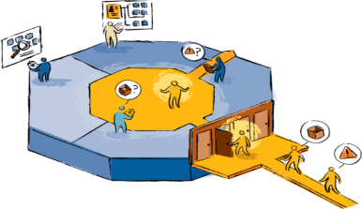
The concept of Universal Access opens up the door to all the benefits and services that might be appropriate for the needs
Non-Government
Organizations (NGO)
Government
Agencies
Screening & Application
Social Program
Case Management
Benefit Planning & selection
Life Event Management
Providers
Needs-Based Triage
Universal Access
Outcome Management
Client
Finance
Food
Shelter
Life Events
Health
Safety
Needs
Education
Social Context
Notes:
With this understanding it is then possible to find the most useful help available to them through a Universal Approach to Service delivery – shown as the left hand blue block.
It may be that you look at their needs through screening and triage, or apply for one or more benefits, or that you go through a life event.

Slide 6
You can reach out to the non-government organizations
Non-Government Organizations
Referral
Screening & Application
Benefit Planning & selection
Life Event Management
Needs-Based Triage
Universal Access
Finance
Food
Shelter
Health
Safety
Education
Social Context
Notes:
The first place many people will look will be the resources available in the community.
Food banks, local support programs, charities that can provide help.
In some countries this is a deliberate strategy – called diversion – that diverts people first to the community resources.
In others, it is a complementary strategy to the core government programs.
And in many – it is often ignored as the government offices only help you with government programs

Slide 7
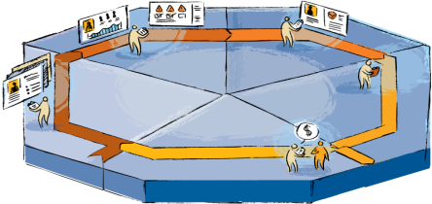
And to the government organizations across many different program areas
Government Agencies
Non-Government Organizations
Social Assistance
Family Services
Pensions
Health Care
Employment
Disability &
Workers’ Comp
Evidence Management
Eligibility & Entitlement
Referral
Participant Management
Provider Management
Non-Government
Organizations (NGO)
Financial Management
Intake & Enrollment
Social Program
Case Management
Government
Agencies
Screening & Application
Benefit Planning & selection
Life Event Management
Providers
Needs-Based Triage
Universal Access
Client
Finance
Food
Shelter
Life Events
Health
Safety
Needs
Education
Social Context
Notes:
Of course the individual may also need to apply for city and government programs – shown in the middle. These can often come from different departments and different levels of government – cities, states and Federal. This is where eligibility is worked out and the entitlements are calculated.
These may include employment programs, pensions, social assistance or welfare, various family services such as child welfare or adult services. It may include health care or disability and workers compensation programs.
Enlightened governments will understand the intersection between the programs and between levels of government. Allowing you to apply once and receive the relevant benefits together.

Slide 8
Who might contract out to community based organizations or service providers
Government Agencies
Non-Government Organizations
CBOs & Service Providers
Social Assistance
Family Services
Pensions
Health Care
Employment
Disability &
Workers’ Comp
Evidence Management
Eligibility & Entitlement
Referral
Participant Management
Provider Management
Non-Government
Organizations (NGO)
Financial Management
Intake & Enrollment
Social Program
Case Management
Government
Agencies
Screening & Application
Benefit Planning & selection
Life Event Management
Providers
Needs-Based Triage
Universal Access
Client
Finance
Food
Shelter
Life Events
Health
Safety
Needs
Education
Social Context
Notes:
Some services may be contracted out to service providers, who may well be operating in their own right as community providers on the left. Or they might be for profit organizations.

Slide 9
All of whom deliver service in a fragmented way
Government Agencies
Non-Government Organizations
CBOs & Service Providers
Social Assistance
Family Services
Pensions
Health Care
Employment
Disability &
Workers’ Comp
Evidence Management
Eligibility & Entitlement
Referral
Participant Management
Provider Management
Non-Government
Organizations (NGO)
Financial Management
Intake & Enrollment
Social Program
Case Management
Government
Agencies
Screening & Application
Benefit Planning & selection
Life Event Management
Providers
Needs-Based Triage
Universal Access
Client
Finance
Food
Shelter
Life Events
Health
Safety
Needs
Education
Social Context
Notes:
Typically, this means that there are a range of benefits and services are delivered to the individual and their family – these conveyor belts show the often fragmented nature of delivery today with services coming from the community, benefits from multiple government programs and services from contracted service providers – all delivered separately and rarely coordinated.
It is estimated in the UK that the most severely deprived 120,000 families – what we call troubled families – receive on average over 5 interventions from government, averaging £75,000 or roughly $100,000 per family. And it is not working. These families are often multi-generational unemployed, responsible for much petty crime and generally create social dysfunction in the community.
This may sound like an extreme example, but these families and this disconnect exist in all countries.

Slide 10
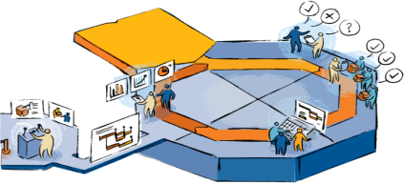
Outcome Management coordinates the provision of benefits and services
Government Agencies
Non-Government Organizations
CBOs & Service Providers
Social Assistance
Family Services
Pensions
Health Care
Employment
Disability &
Workers’ Comp
Evidence Management
Eligibility & Entitlement
Referral
Participant Management
Provider Management
Non-Government
Organizations (NGO)
Financial Management
Integrated Service Delivery
Intake & Enrollment
Social Program
Case Management
Government
Agencies
Screening & Application
Outcome Identification
Benefit Planning & selection
Life Event Management
Outcome Evaluation
Service Provisioning
Outcome Planning
Providers
Needs-Based Triage
Outcome
Plan
Universal Access
Outcome Management
Client
Finance
Food
Shelter
Life Events
Health
Safety
Needs
Education
Social Context
Notes:
This is where outcome management comes in – shown on the right – by providing a focus on dealing with the social context we started with, outcome management makes sure that all those benefits and services are having an effect – that they deal with the issue and help move the family to a better outcome.
This means you have to be able to assess their needs, select the right services and then build a plan – collaborating among service providers, non-government organizations and of course the government.
Once you have built the plan – the services have to be delivered and you have to track whether the family are moving towards the outcome. If the evaluation is that they need more help, you go back around the cycle.
So, this is more than just coordination. It is about assessments, planning and delivery. But you have to coordinate as well.
And it is coordination across boundaries. Coordination across social and health programs for instance. Coordination across levels of government. And coordination across services providers, non-government organizations and the government.
Many countries do some of this today, but most want to do a lot more. They want to do it because they need to achieve better outcomes at a lower cost.

Slide 11
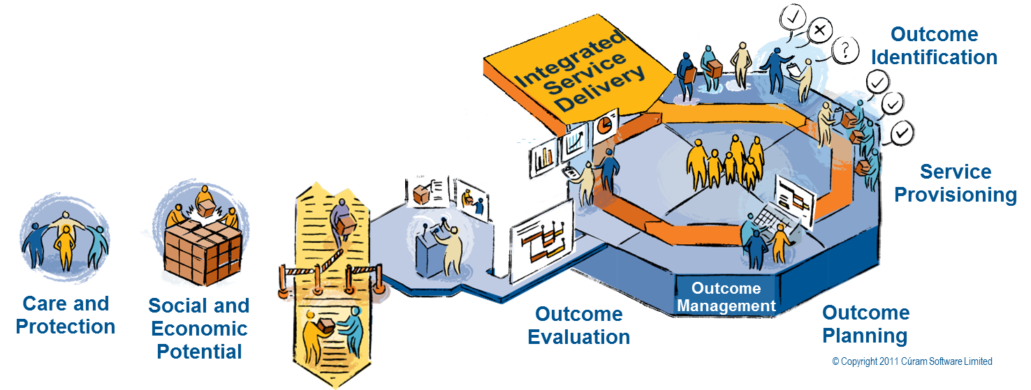
Outcome management capabilities give workers new insights into client needs and accomplishments, program efficacy, and resource utilization to help drive better outcomes
Lack of coordination:
Inconvenience to clients
Economic waste
Ineffectual use of resources
Extreme child welfare cases: further injury or even death
Supporting high-risk populations: 20 percent of families commonly account for 80 percent of social expenditures

Slide 12
Government can shift from a care and protection model to enabling social and economic potential
Government Agencies
Non-Government Organizations
CBOs & Service Providers
Social Assistance
Family Services
Pensions
Health Care
Employment
Disability &
Workers’ Comp
Evidence Management
Eligibility & Entitlement
Referral
Participant Management
Provider Management
Non-Government
Organizations (NGO)
Financial Management
Integrated Service Delivery
Intake & Enrollment
Social Program
Case Management
Government
Agencies
Screening & Application
Outcome Identification
Benefit Planning & selection
Life Event Management
Outcome Evaluation
Service Provisioning
Outcome Planning
Providers
Needs-Based Triage
Outcome
Plan
Universal Access
Outcome Management
Client
Finance
Food
Shelter
Life Events
CARE and
PROTECTION
Health
Safety
SOCIAL and
ECONOMIC POTENTIAL
Needs
Education
Social Context
Notes:
That’s the IBM Cúram vision for the industry. To shift from a focus on providing care and protection to a focus on how to help citizens achieve their social and economic potential.
We have tested this now in many countries. Across all sorts of social systems and all levels of government.
People get this. They see where they fit in the picture.
If they are involved in national policy, they see where not only their organization fits, but where their country needs to move towards.

Slide 13
IBM’s Social Program Management approach enables governments to make necessary changes
Needs
To
Outcomes
Identify
Triage & Screening & Applications
Benefit Planning & Selection
Life Event Management
Outreach Management
Social Record Management
Personalized Response
Identity & Fraud Prevention
Assess
Social Context Analysis
Evidence Management
Strength & Needs Assessment
Advisor
Priority, Complexity & Risk (PCR)
Predictive & Content Analytics
Respond
Integrated Eligibility & Entitlement
Intake & Enrollment
Differential Response
Crisis
Diversion
Prevention
No Touch
Manage Case
High Touch
Evidence-based Models
Manage
Outcome Plans
Personal Budgets
Service & Provider Provisioning
Collaboration and Social Media
Multidisciplinary Teams
Provider Management
Financial Management
Measure
Outcome Evaluation
Clients
Providers
Programs
Processes
Spend
Multidimensional Analytics
Fraud
Social Innovation Programs
Assessment & Response Models

Slide 14
IBM Cúram Social Program Management Platform is the foundation
Social Industry Specific
Domain Specific Platform, built to address the core needs of Social Organizations
Pre-defined, best-in-class business processes supporting the complete social lifecycle
Role-based User Experience targeted at the needs of stakeholders
Dynamic Programs
Business User Tools for program creation and modification
Configurable, end-to-end business processes support
Configurability built on top of a core social application, delivering the flexibility and adaptability required by Social organizations
Platform for the Future
Flexibility to support Traditional and Outcome-focused delivery
Toolsets to support differential response
Agility to prototype and adopt new programs and delivery models (e.g., conditional cash transfers, social impact bonds)
Notes:
14
Social Industry Specific
Domain Specific Platform, built to address the core needs of Social Organizations
Pre-defined, best-in-class business processes supporting the complete social lifecycle
Role-based User Experience targeted at the needs of stakeholders
Dynamic Programs
Business User Tools for program creation and modification
Configurable, end-to-end business processes support
Configurability built on top of a core social application, delivering the flexibility and adaptability required by Social organizations
Platform for the Future
Flexibility to support Traditional and Outcome-focused delivery
Toolsets to support differential response
Agility to prototype and adopt new programs and delivery models (e.g., conditional cash transfers, social impact bonds)

Slide 15
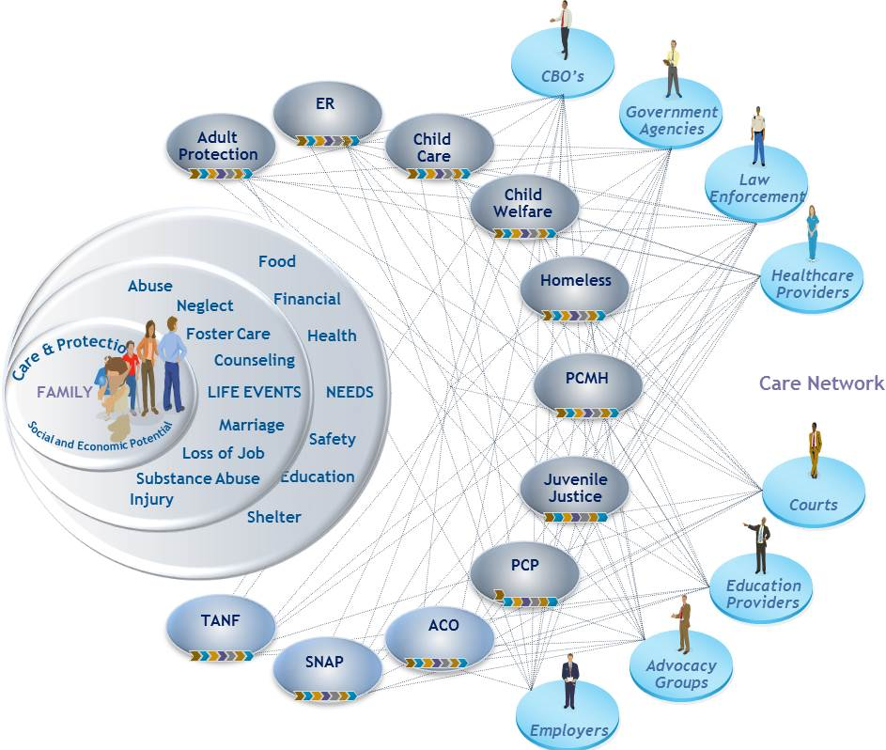
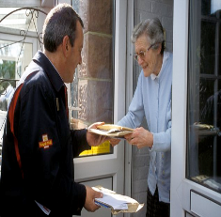
The IBM Cúram Solution for Social Assistance supports a range of social programs that assist eligible individuals and their families during economic hardship
The IBM Cúram Solution for Social Assistance supports a broad array of social programs including:
TANF
SNAP
Homeless
Child Welfare
Child Care
Juvenile Justice
Adult Protection Services
The IBM Cúram Solution for Social Assistance helps caseworkers:
Screen eligible program participants to identify optimal programs for their needs;
Determine benefit entitlement and eligibility;
Make payments; and
Manage ongoing changes in circumstances that may affect entitlement
Social Network

Slide 16
The IBM Cúram for Social Assistance features include:
Citizen-centric service delivery to ensure that programs and services are based on a solid understanding of the individual’s and family’s needs.
Support for modern caseworkers with program-specific processes, information and tools for more efficient, effective management.
Integrated eligibility and entitlement payment management systems that allow new programs to be created, existing programs to be modified quickly, and recipient changes to be applied automatically.
Outcome Management to achieve desired outcomes and for long-term self-sufficiency.
A configurable design based on service-oriented architecture (SOA) so solutions can be configured and administered, rather than coded in costlier, traditional approaches.

Slide 17
A Canadian government agency responsible for administering social services programs implements IBM Cúram to streamline processes and improve outcomes through a better understanding of citizen needs
Needs Focused
Fiscal management and controls allow fund allocation based on needs and priorities
Accuracy
Improved the accuracy of eligibility determinations
Low Risk
Flexible modularity and simple integration with existing systems reduces risk, cost, and time associated with large technology investments
Business Challenge: A complex and fragmented system of government and independent agencies provided access to services in this Canadian province. Over time, the complex nature of the system resulted in inequitable and inefficient service delivery. Many different paper-based processes and dozens of disparate IT applications were used to evaluate each citizen’s needs, identify available services, request funding and recommend placement.
The ministry also experienced difficulty measuring the demand for services, resulting in ineffective planning for funding requirements.
The Solution: By implementing a suite of IBM Cúram software, the ministry streamlined its business processes including a standard application and assessment process that ensures people’s needs are assessed consistently. Clear eligibility criteria for accessing services allow the ministry to make more consistent eligibility decisions, helping to reduce errors and possible fraud. In addition, individual support plans, service profiles and active case management through system automation enable better outcomes for citizens while stronger fiscal management and control allows funds to be allocated based on assessed needs and priorities.
Solution components
IBM Cúram Appeals
IBM Cúram Evidence Broker
IBM Cúram Provider Management
IBM Cúram Social Program Management Platform
IBM Cúram Verification Engine
IBM Cúram Business Intelligence and Analytics
IBM Cúram Social Enterprise Collaboration
Notes:
17

Slide 18
A U.S. county social services department implements IBM Cúram to improve services and outcomes for citizens
Accessible
provides a single point of access to social programs and services
Automated
expedites eligibility determination, the issuance of benefits and the subsequent closing of cases
Business Challenge:. A U.S. county social services organizations that provides financial and medical assistance primarily for childless adults and protective services for seniors needed to replace a case management system that no longer supported the county's data-collection requirements. This included the storage of documentation and evidence used to process referrals from other agencies and hospitals. The case-management function was only used for clients with serious and recurring problems. The outdated system's technical environment required programming expertise to generate management reports. Fragmented information prevented the tracking of outcomes of the county’s social assistance programs.
The Solution: The county replaced their outdated benefits administration system with a solution that can more effectively manage its client base. With an enhanced process covering all steps, from application to case integration to benefit delivery, staff can serve clients more quickly than before. And the organization gained unprecedented insight into the way it serves citizens. The county can now conduct same-day eligibility determinations to meet emergency needs more efficiently. Data-management capabilities have helped reduce redundancy in the collection of data from outside agencies.
Flexible
configuration functions help administrators more easily change the system to address unforeseen or future needs
Solution component
IBM Cúram Social Program Management Platform
IBM Cúram Universal Access
IBM Cúram Verification
IBM Cúram Provider Management
IBM Cúram Income Support
IBM Cúram Business Intelligence and Analytics
Notes:
18

Slide 19
IBM Cúram Social Program Management value proposition
Enables rapid, lower-risk implementation by leveraging prebuilt and configurable social service elements and business processes
Empowers the business to define and deploy new programs with configuration tools in a runtime environment
Protects current investments and provides flexibility to address new and emerging service delivery trends
Reduces overall costs and the time needed to deploy new programs
Notes:
Low risk: Pre-built and configurable
Empowers business: Define new programs thru configuration tools
Protect investment: Platform for the future—address new and emerging delivery trends
19

Slide 20
Thank you.
For additional information: www.ibm.com/smartersocialprograms
martin.duggan@uk.ibm.com
linkedin: http://www.linkedin.com/in/martingduggan
Twitter: @martingduggan

Slide 21
Trademarks and notes
© IBM Corporation 2015
IBM, the IBM logo, ibm.com, and Cúram are trademarks or registered trademarks of International Business Machines Corporation in the United States, other countries, or both. If these and other IBM trademarked terms are marked on their first occurrence in this information with the appropriate symbol (® or ™), these symbols indicate U.S. registered or common law trademarks owned by IBM at the time this information was published. Such trademarks may also be registered or common law trademarks in other countries. A current list of IBM trademarks is available on the Web at “Copyright and trademark information” at ibm.com/legal/copytrade.shtml.
Other company, product, and service names may be trademarks or service marks of others.
References in this publication to IBM products or services do not imply that IBM intends to make them available in all countries in which IBM operates.

