Slide 1
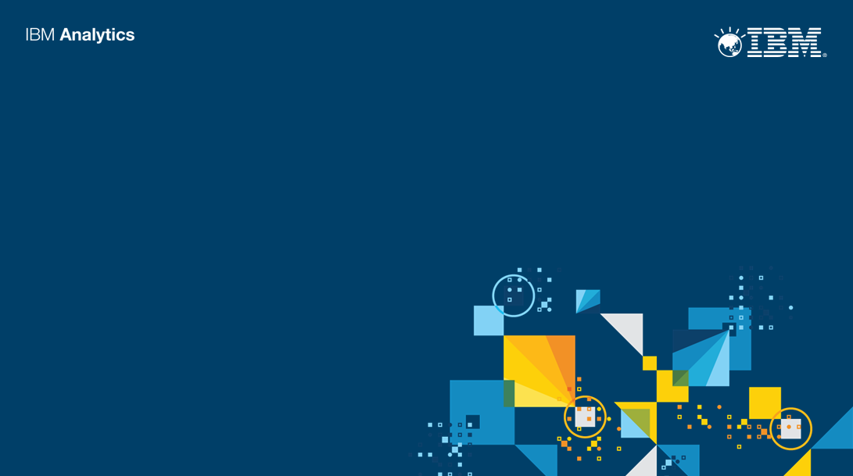

Slide 2
Kieran Hagan
Technical Sales Manager, IBM Analytics Platform- ANZ
khagan@au1.ibm.com

Slide 3
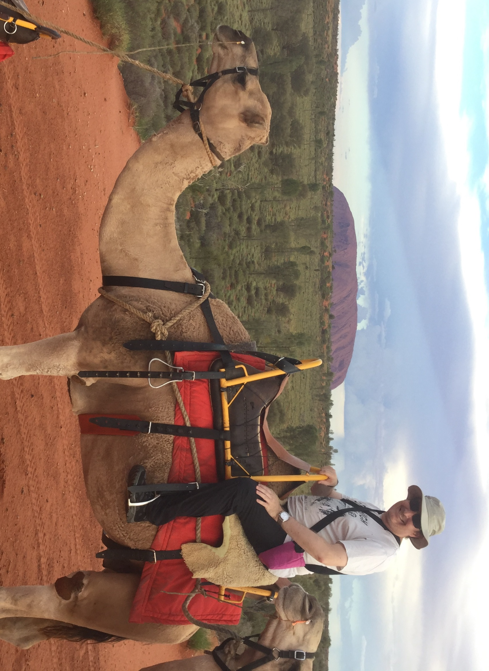
Scene setting
Notes:
Context – my holidays!
Big. Many heard, few visit. Story of one language “One people” same challenge today for big data.

Slide 4
The New Insight Economy…
Change reaps benefits:
Analytics pay back $13.01 for every dollar spent ¹
69% created significant positive impact on business outcomes ²
60% created significant positive impact on revenues ²
53% created significant competitive advantage ²
…needs new tools to realise
¹ Analytics Pays Back $13.01 for Every Dollar Spent” Nucleus Research, September 2014
² Analytics: The speed advantage” IBM Institute for Business Value, 2014

Slide 5
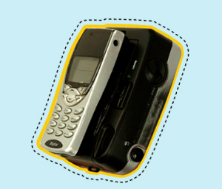

Technology checkpoint – Spark!
An Apache Foundation open source project. Not a product.
An in-memory compute engine that works with data. Not a data store.
Enables highly iterative analysis on large volumes of data at scale
Unified environment for data scientists, developers and data engineers
Radically simplifies process of developing intelligent apps fueled by data.
Notes:
Spark is a big data processing framework built for speed, ease of use, and sophisticated anlaytics that enables application sin Hadoop clusters, or stand alone, to run 100 times faster in memory and 10 times faster when running on disk
According to Gartner 30 percent of near real-time data integration and data management use cases will be supported by stacks that include Apache Spark by 2018.
Spark enables data scientists, developers and data engineers to work together to access all data, build analytic models quickly, iterate fast in a unified programming model, and deploy those analytics everywhere.

Slide 6
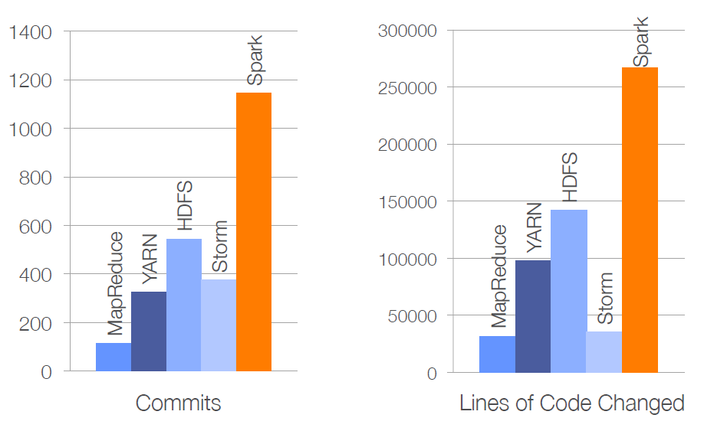
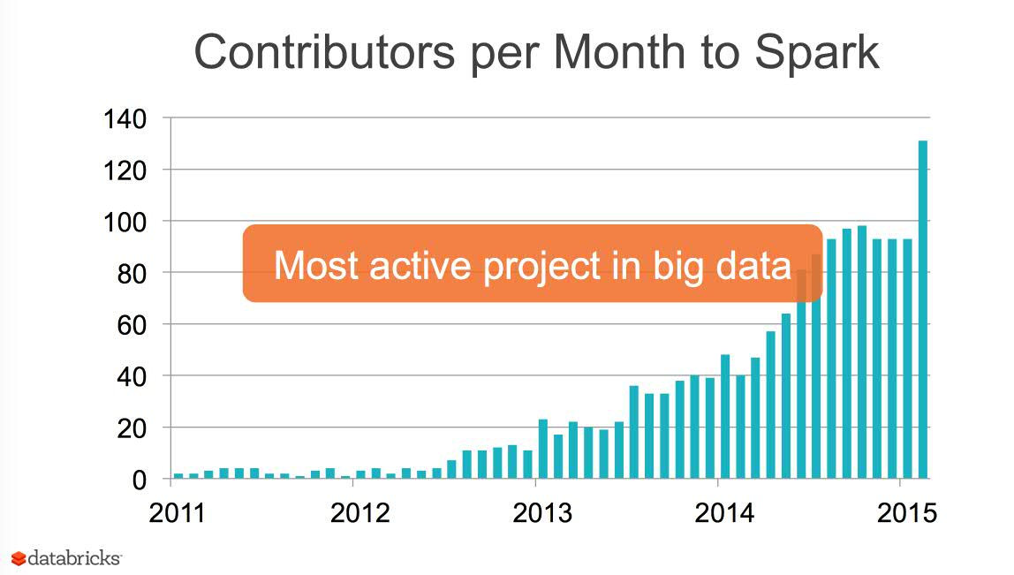
Reference Slide
Brief History of Spark
2002 – MapReduce @ Google
2004 – MapReduce paper
2006 – Hadoop @ Yahoo
2010 – Spark paper
2011 – Hadoop 1.0 GA
2014 – Apache Spark top-level
2014 – 1.2.0 release in December
2015 – 1.3.0 release in March
2015 – 1.4.0 release in June
Activity for 6 months in 2014
(from Matei Zaharia – 2014 Spark Summit)
Spark is most active project in Apache Software Foundation
Databricks founded by creators of Spark from UC Berkeley’s AMPLab

Slide 7
Why the sudden interest?
Spark is open so accelerates community innovation
Spark is fast 100x faster than Hadoop MapReduce
Spark is about all data for large scale data processing
Spark supports agile data science to iterate rapidly
Spark can be integrated with solutions
Notes:
As data and analytics are embedded into the fabric of business and society – from popular apps to the Internet of Things (IoT) – Spark brings essential advances of large scale data processing.
First it dramatically improves the performance of data dependent apps.
Second, it radically simplieds the process of developing intelligent apps, which are fueled by data
We see Spark as the foundation for innovation in the community, and we see it integrated into our IBM Analytics Platform and solutions – now and in the future

Slide 8


Spark processes data from ANY source
Business Applications and Business Intelligence
Spark
SQL
Spark
Streaming
MLlib
(machine
learning)
GraphX
Apache Spark
Data-
warehouse
Hadoop
Database
Mainframe

Slide 9
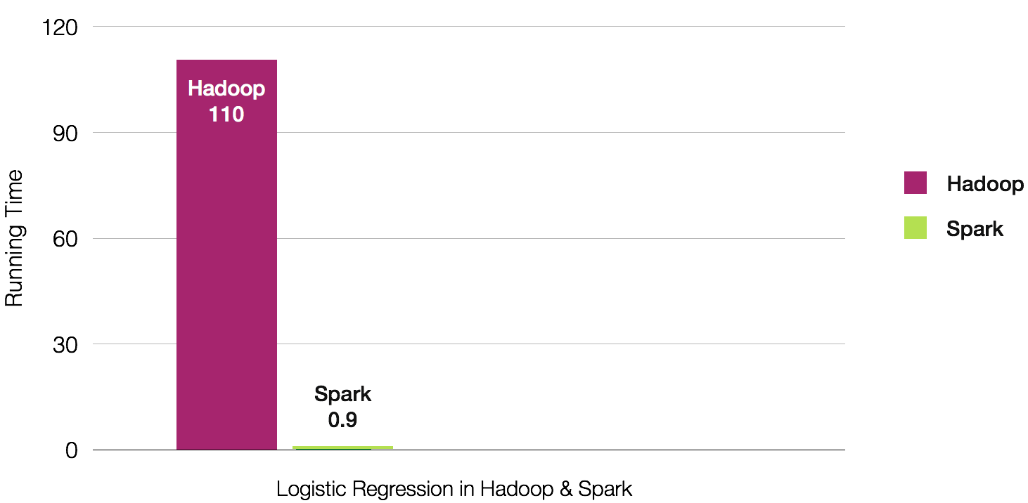
Spark is complementary to Hadoop, but much faster, with in-memory performance
Hadoop
Spark
Running Time (seconds)
Spark
0.9
Logistic Regression in Hadoop & Spark

Slide 10



Who uses Spark?
Data Engineer
App Developer
Data Scientist
“the thinker”
“the builder”
“the convincer”
Put right data to work for the job at hand
Abstract data access complexity
Enable real-time solutions
Build analytics applications
Optimise performance
Leverages machine learning embedded
Identify patterns, trends, and risks
Discover new actionable insights
Build new models
https://datascientistworkbench.com
Notes:
Data engineer
What they want to do:
Bridge between the Data Scientist and the App Developer
Implement machine learning algorithms at scale
Put the right data system to work for the job at hand.
(Hadoop, Graph databases, Cloudant NoSQL, Relational, Streaming, In-Memory)
How can Spark help:
Abstract data access complexity (Spark doesn’t care what your data store is)
Enables near-real time solutions at web-scale (e.g. pipelined machine learning workflows)
Application Developer
What do they want to do:
Build applications that lever advanced analytics in partnership
with the data scientist and data engineer
Follow agile design methodologies
Optimize performance and meet SLAs
How can Spark help:
Supports the top analytics app languages such as Python and Scala
Eliminates programming complexity with libraries such as MLlib and simplifies DevOps
Makes it easy to embed advanced analytics into applications
Data Scientist
What they want to do:
Identify patterns, trends, risks, and opportunities in data
Tell a story with data
Discover new actionable insights
Build new algorithms and models that move data science into the application
How can Spark help:
Supports the entire data science workflow. Data access & Integration, to Machine Learning, to Visualization using the language of choice – typically Python.
Provides a growing library of machine learning algorithms via MLlib

Slide 11
Why does Spark matter to a business?
1
Spark makes it easier to access
and work with all data
2
Spark lets you develop line-of-business
applications faster
3
Spark learns from data and delivers in real-time

Slide 12
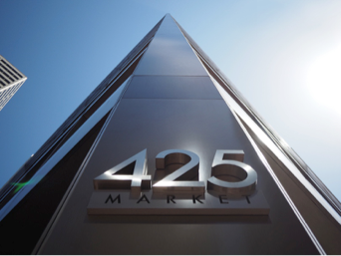
IBM has the largest investment in Spark of any company in the world
IBM Spark Technology Center
Top committer/contributor
300+ inventors
Commitment to educate 1 million data scientists
Contributed SystemML
Founding member of AMPLab
Partnerships in the ecosystem
Notes:
Our vision of the role of Spark goes beyond others in the marketplace.
Yes, as Hadoop vendors like Cloudera say, Spark is good at fast access to dat ain Hadoop and certainly we also see Spark fills a need there
But we see those as only a small subset of the value of Spark.
The tru value of Spark is that is enables more people
Now
IBM Open Platform with Apache Hadoop
IBM InfoSphere Streams
IBM Platform Computing
Targeted for later in year
Apache Spark as a Service on IBM Bluemix (in beta)
IBM Watson Analytics
SPSS Modeler & Analytics Server
IBM DataWorks
IBM PureData Systems with Fluid Query
IBM Commerce

Slide 13
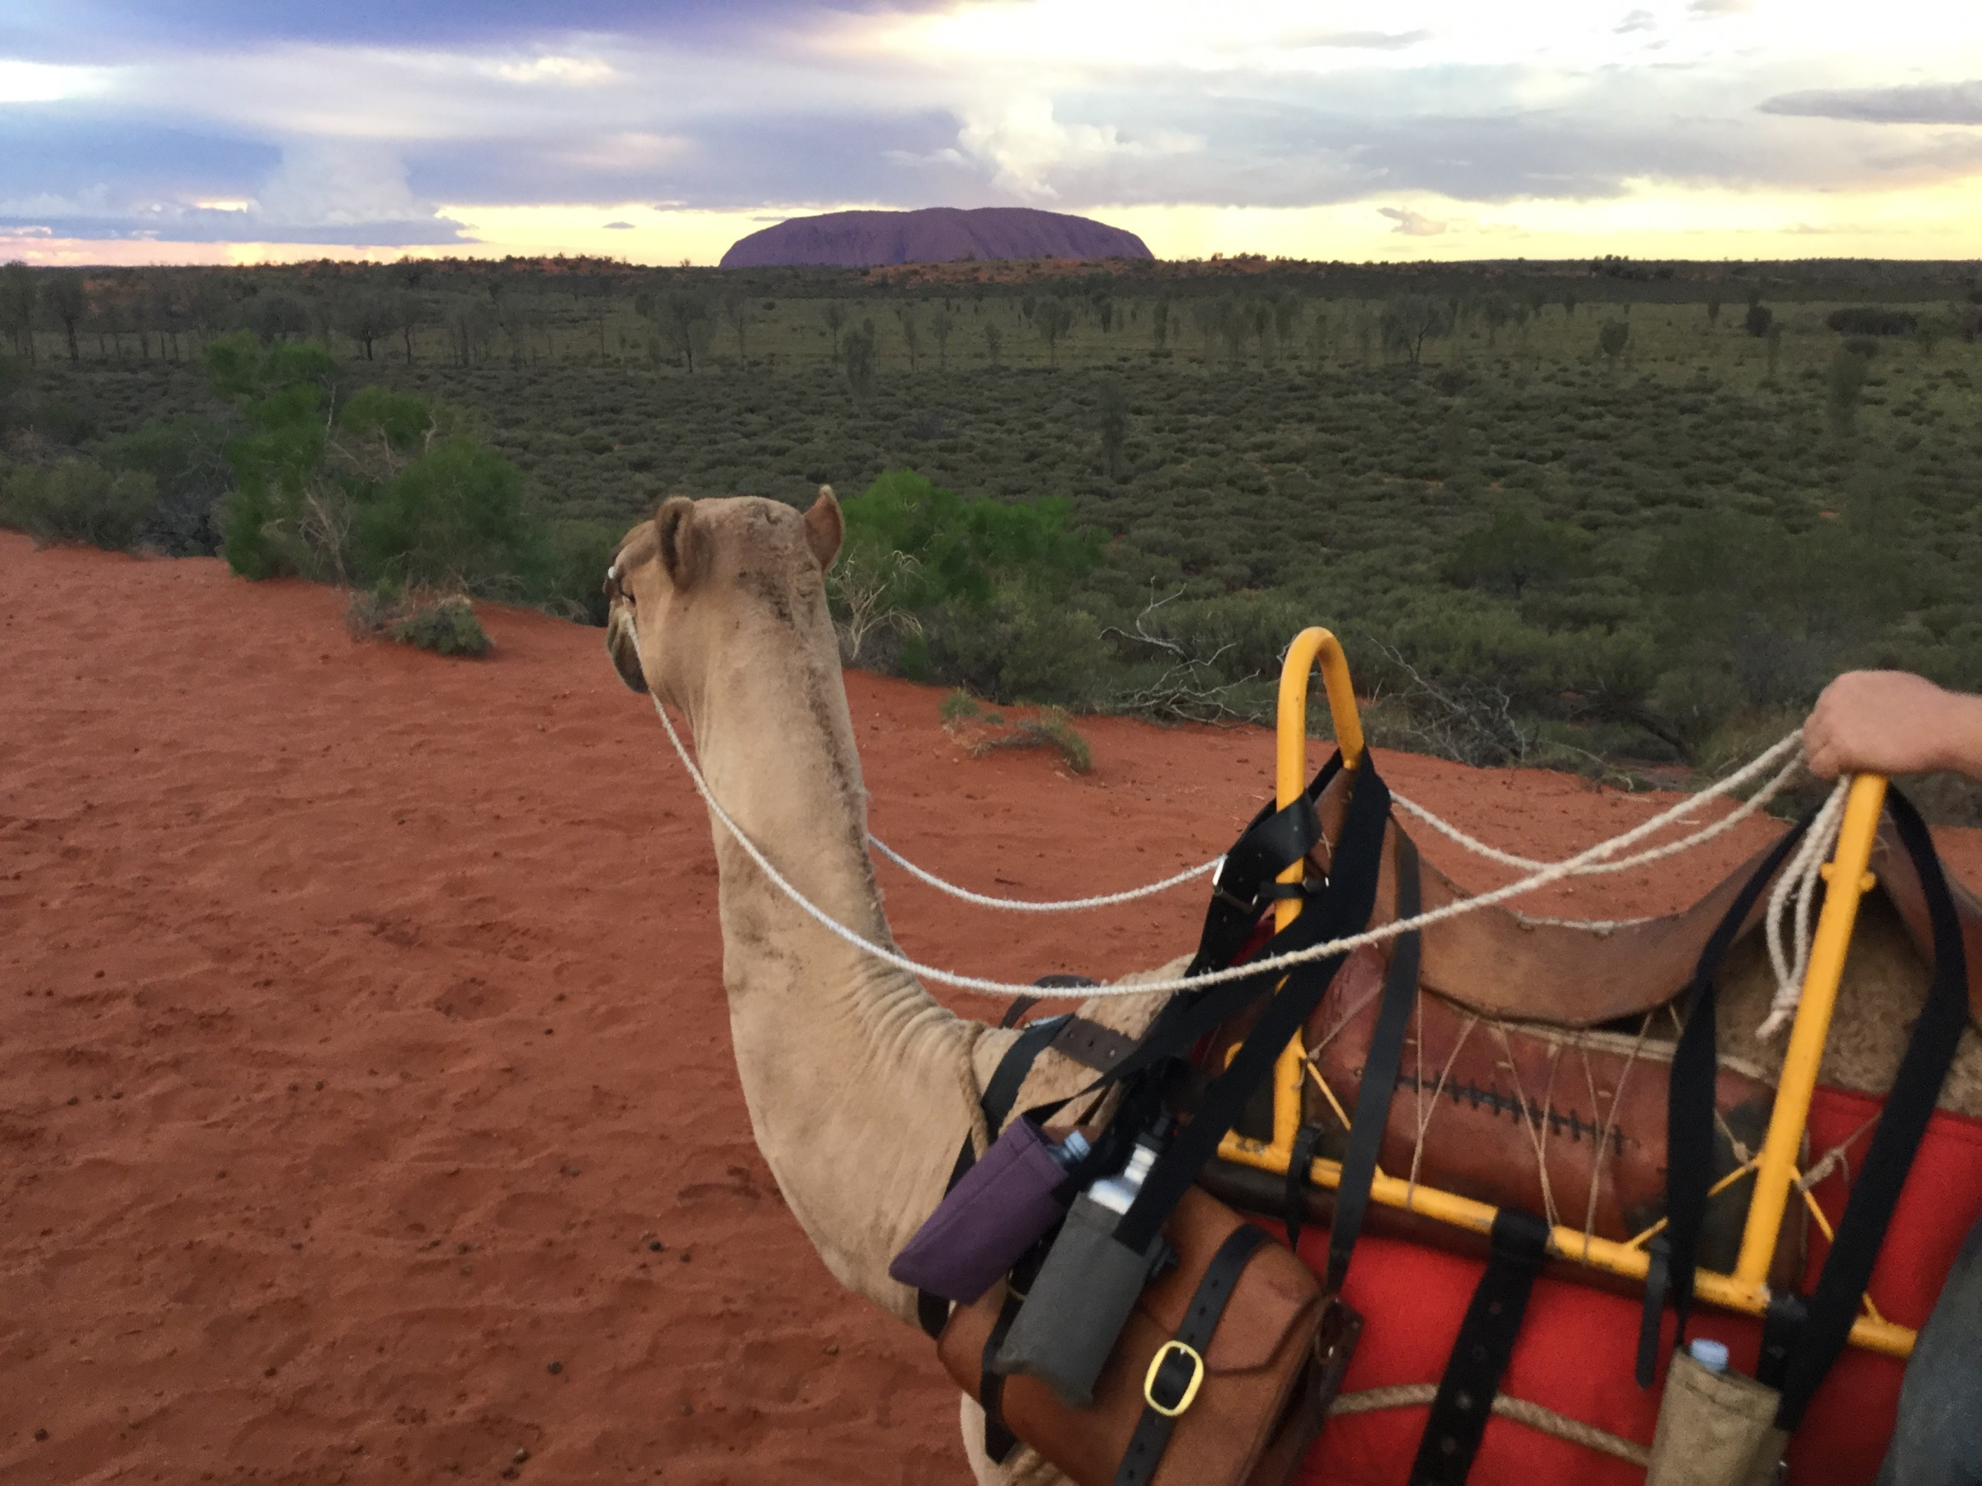
Take the Journey!

Slide 14
Rob Parkin
Principal Data Scientist, IBM Commerce

Slide 15
Agenda
What is a Data Scientist?
Why Spark?
Journey Analytics
Real-Time Personalization

Slide 16
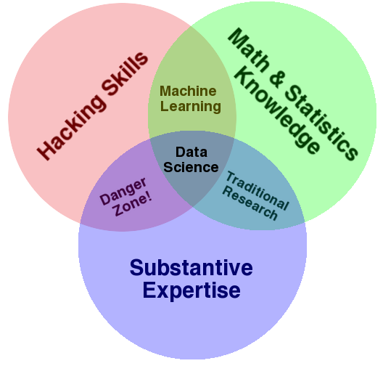
The art and science of
Discovering what we don’t know from data
Obtaining predictive, actionable insight with analytics
Creating Data Products that have immediate impact
Communicating relevant business stories from results
Learning from decisions to drive business value
What is Data Science?
Drew Conway, 2010

Slide 17
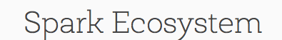
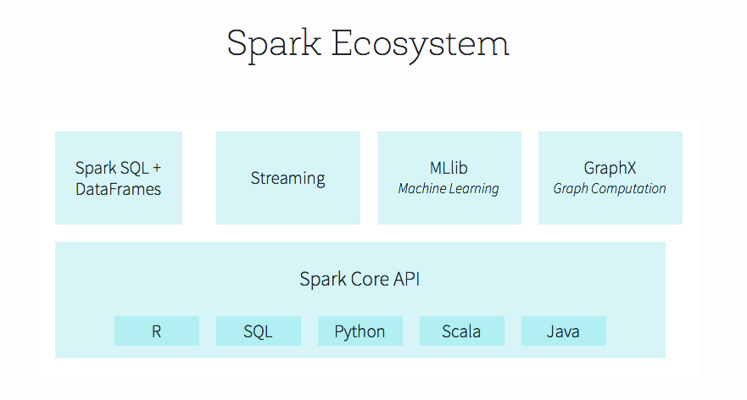
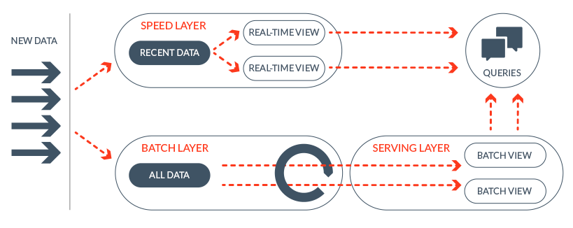
Disruptive Innovations:
Generalized Analytic Workflows and Lambda Architectures
Paco Nathan, 2013

Slide 18
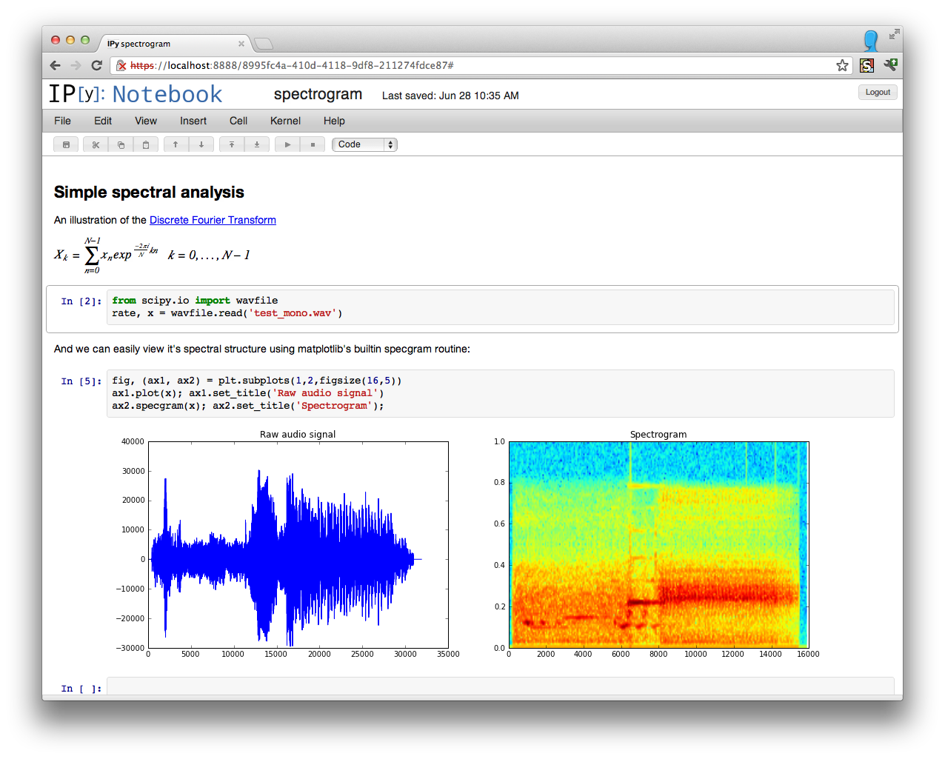
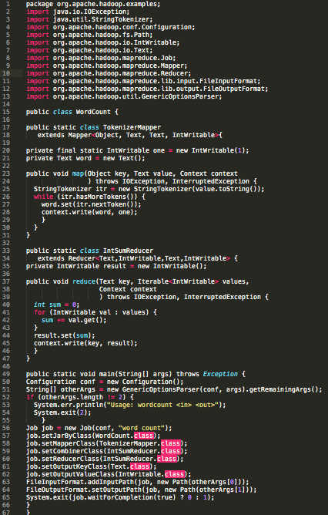
Disruptive Innovations:
Interactive Notebooks and Functional Programming
Jupyter Notebooks
Map-Reduce in Java
Scala on Spark

Slide 19
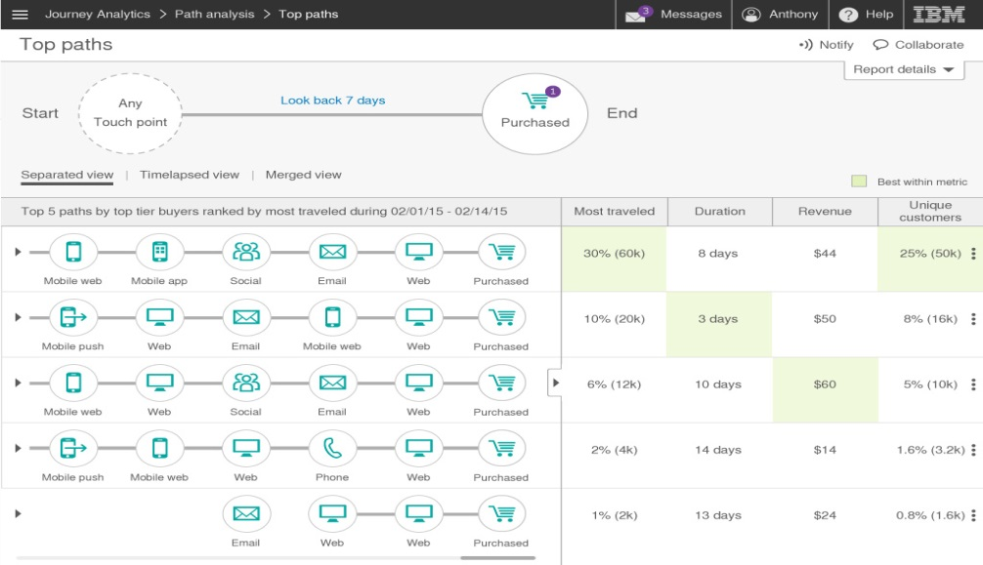
Visualize
customer journeys
Track and measure actual customer journeys across channels
Understand journeys in terms of multiple outcomes and starting points
Design based on successful paths

Slide 20
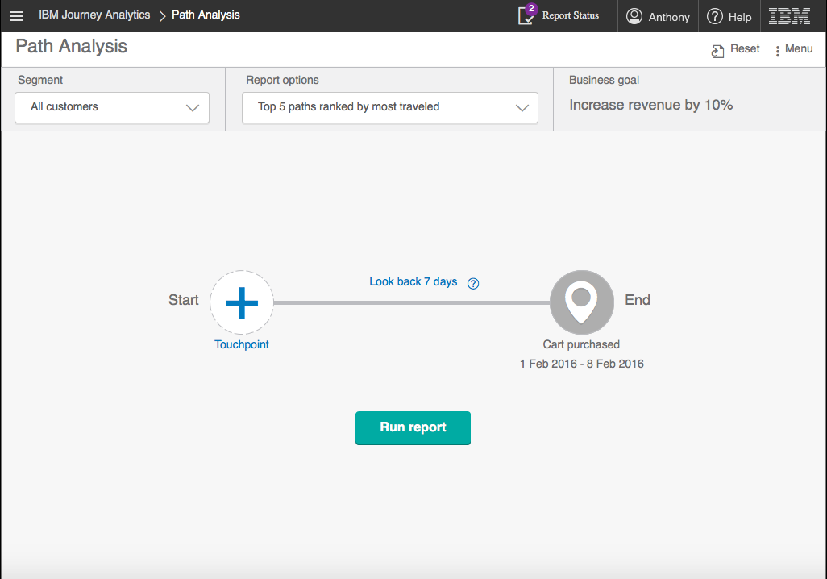

Slide 21
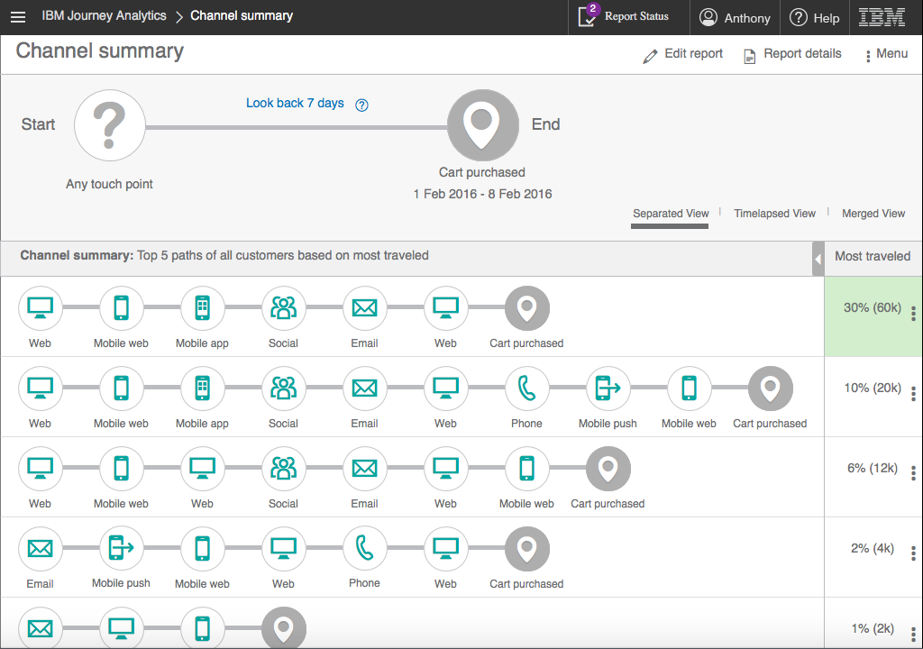

Slide 22
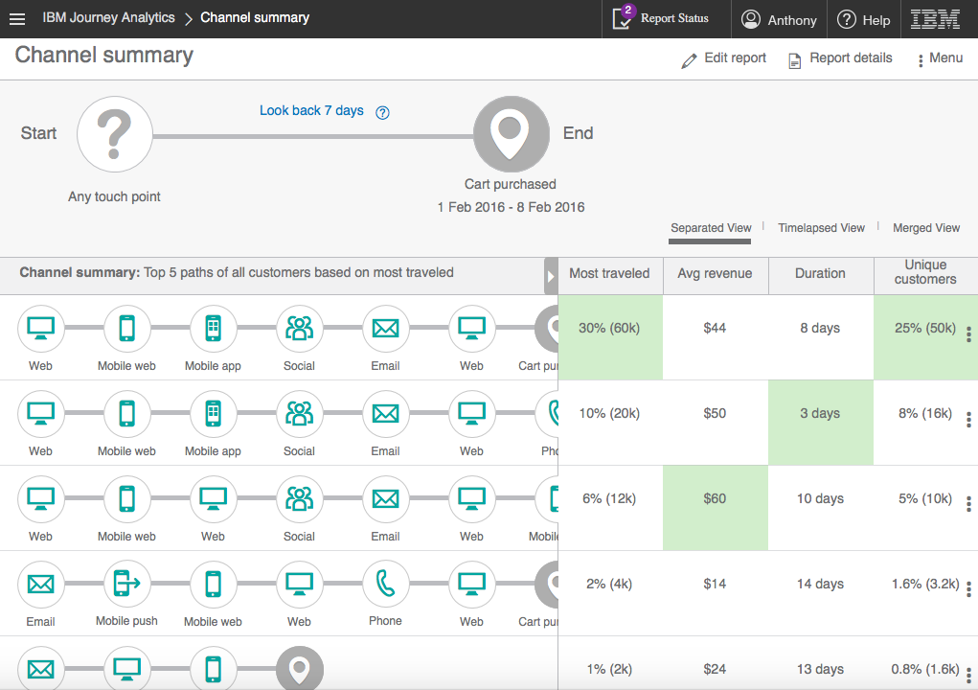

Slide 23
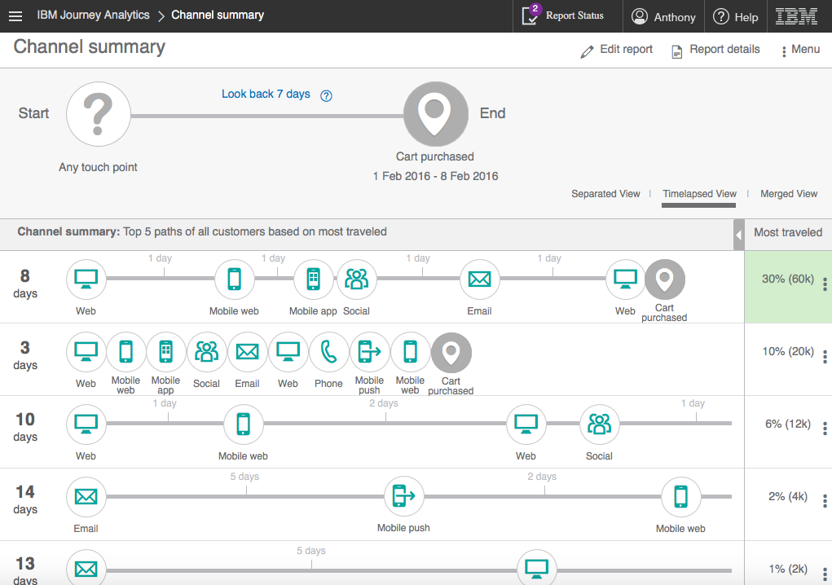

Slide 24
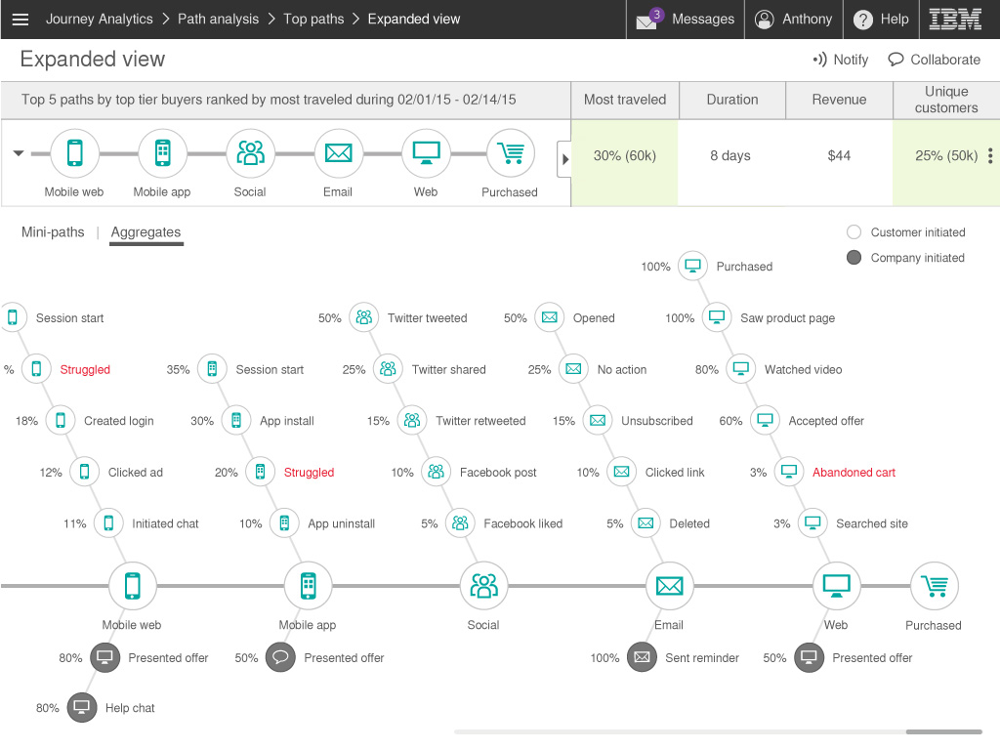

Slide 25
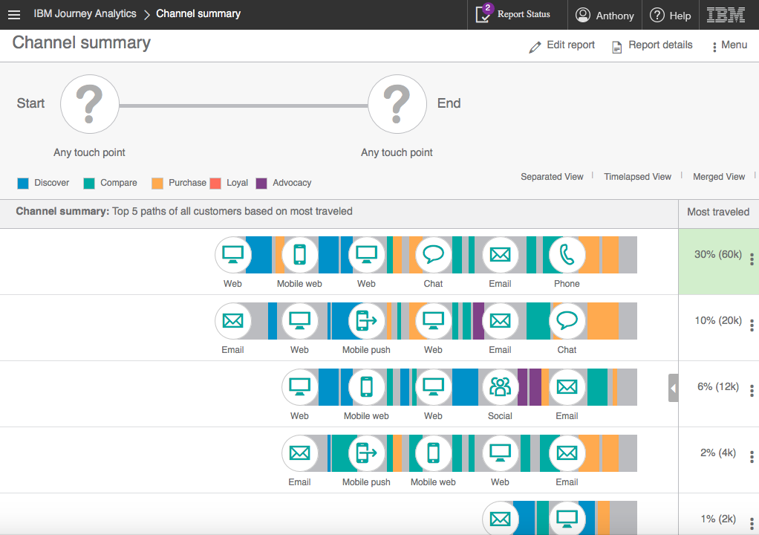


Slide 26
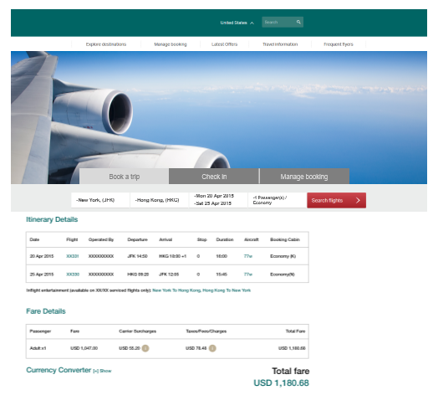
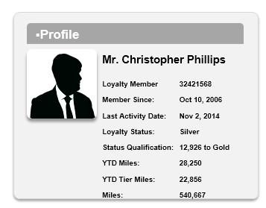

Real-Time Personalization
The right offer at the right time in the right context
Will Christopher Phillips buy at this price?

Slide 27

Real-Time Personalization
An elite member looks for a business trip that begins in 3 days…
Mr. Christopher Phillips
Loyalty Member 32421568
Member Since: Oct 10, 2006
Loyalty Status: Gold
Status Qualification:
20,500 to Platinum
YTD Miles: 78,250
YTD Tier Miles: 54,500
Mile balance : 540,667
1Y Business/First segments : 14
1Y Miles Redemption Activity : 4
Current trip search
 | FLIGHTS
Sun 13 Sep | JFK → SFO Dep. 07:00 AM Arr. 10:29 AM | #469 6h 29m Nonstop View seats | Main Cabin Changeable / Nonrefundable Baggage Information | Price per Passenger $901.39 Taxes and Fees $95.81
Thu 17 Sep | SFO → JFK Dep. 04:00 PM Arr. 12:39 AM Arrives next day | #2040 5h 39m Nonstop View seats | Main Cabin Changeable / Nonrefundable Baggage Information | Passengers 1 adult
AVAILABLE OFFERS
5% price discount
Discounted business class upgrade
25% bonus tier miles
50% bonus tier miles
50% bonus miles
25% bonus miles
Free pass to business lounges
Free chauffeur service

Slide 28
Real-Time Personalization
Selecting the right offer based on the context
Tier level
Gold
Time to departure
3 days
Probability of acceptance
15%
Cognitive Score
82
Miles to next tier
20,500 miles
Passengers
1 adult
AVAILABLE OFFERS
5% price discount
Discounted business class upgrade
25% bonus tier miles
50% bonus tier miles
50% bonus miles
25% bonus miles
Free pass to business lounges
Free chauffeur service
Key influencers
# of business class flights
Total flight time
Tier level
# Passengers
Time to departure
Miles to next tier
Business class flown
14 segments
Total flight time
6.5 hours

Slide 29
Real-Time Personalization
Mr. Phillips looks for 2 tickets to Jamaica for the holidays
Mr. Christopher Phillips
Loyalty Member 32421568
Member Since: Oct 10, 2006
Loyalty Status: Gold
Status Qualification:
20,500 to Platinum
YTD Miles: 78,250
YTD Tier Miles: 54,500
Mile balance : 540,667
1Y Business/First segments : 14
1Y Miles Redemption Activity : 4
Current trip search
 | FLIGHTS
Thu 24 Dec | JFK → MBJ Dep. 09:00 AM Arr. 01:17 PM | #441 4h 17m Nonstop View seats | Main Cabin Changeable / Nonrefundable Baggage Information | Price per Passenger $941.00 Taxes and Fees $156.05
Mon 28 Dec | MBJ → JFK Dep. 02:15 PM Arr. 06:13 PM | #718 3h 58m Nonstop View seats | Main Cabin Changeable / Nonrefundable Baggage Information | Passengers 2 adults
AVAILABLE OFFERS
5% price discount
Discounted business class upgrade
25% bonus tier miles
50% bonus tier miles
50% bonus miles
25% bonus miles
Free pass to business lounges
Free chauffeur service

Slide 30
Real-Time Personalization
Mr. Phillips looks for 2 tickets to Jamaica for the holidays
Tier level
Gold
Time to departure
15 weeks
Probability of acceptance
35%
Cognitive Score
77
Miles to next tier
20,500 miles
Passengers
2 adults
AVAILABLE OFFERS
5% price discount
Discounted business class upgrade
25% bonus tier miles
50% bonus tier miles
50% bonus miles
25% bonus miles
Free pass to business lounges
Free chauffeur service
Key influencers
Tier level
Miles to next tier
YTD miles
Trip date to year end
# Passengers
Ticket price
YTD miles
78,250 miles
Ticket price
$1,097/person

Slide 31
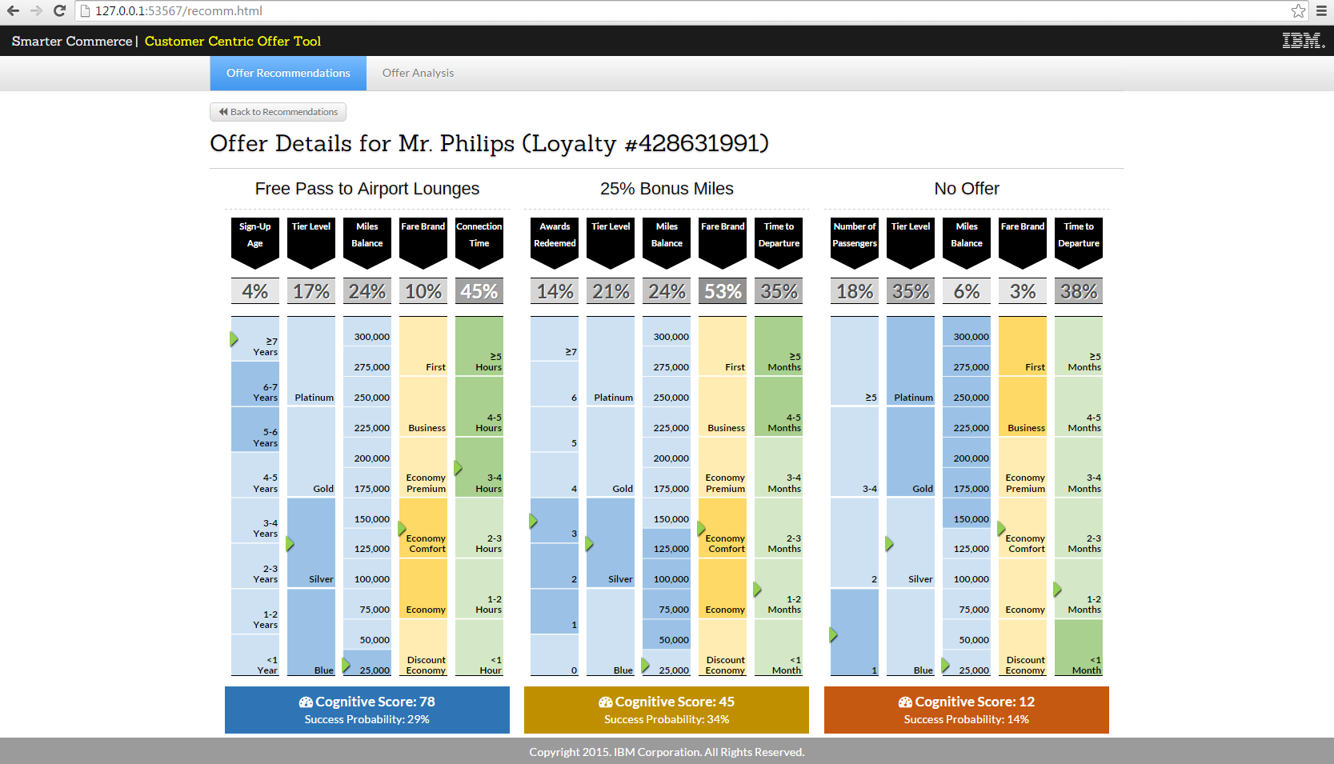

Slide 32
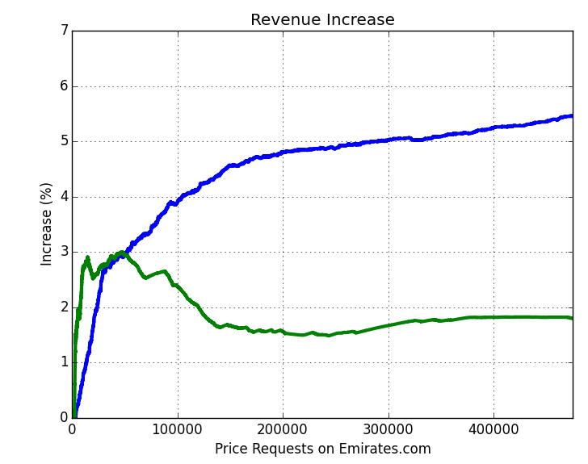
Real-Time Personalization
Proof-of-Concept
Simulated 500,000 website searches and customer responses (purchase/no purchase) based on actual .com booking data
Recorded revenue lift over as-is scenario (no offers)
Observations
Optimized promotions without personalization yield modest revenue improvements (1-2%)
Personalization leads to a much higher gross revenue lift (5-6%) driven by higher conversions
No personalization
Personalization
Our simulations showed 2-3% net revenue lift (revenue increase - cost of offers)

Slide 33

Chris Howard FBCS CITP
Chief Analytics Architect, IBM Analytics - Asia Pacific
@kitard

Slide 34
Agenda
Re-cap
Next Generation Platform / the Analytics Operating System
Spark Journey
Getting Started

Slide 35
Big Data Maturity
Operations
Data
Warehousing
Line of Business
and Analytics
New Business
Imperatives
Most Businesses
Are Here
Value
Data-informed Decision Making
Full dataset analysis (no more sampling)
Extract value from non-relational data
360º view of all enterprise data
Exploratory analysis and discovery
Business Transformation
Create new business models
Risk-aware decision making
Fight fraud and counter threats
Optimize operations
Attract, grow, retain customers
Warehouse
Modernization
Data lake
Data offload
ETL offload
Queryable archive and staging
Lower the Cost
of Storage
Big Data Maturity

Slide 36
Why use Spark ?
Build and deploy in less time
Get better answers in less time
Transition to next-generation analytics with Notebooks
Accelerate time to market

Slide 37






Spark and Hadoop are components
of a next generation platform
Third Party Query, Reporting, Modelling Tools
(Freedom to Use All Tools)
1
  Makes it easier to access and work with all data
Tools
Distributed Query and Algorithms
(SQL, R, Machine Learning, Matching)
2
  Enables rapid development of applications infused with analytics
3
Processing
  Delivers next generation Machine Learning to drive business insights
Distributed
Metadata Management (Location Transparency)
4
  Empowers organizations with integrated componentry to reduce cost and deliver more
Massively-Parallel Grid Architecture
Data
File / Object Store
Relational
Data
Data
as a Service

Slide 38




IBM Analytics Operation System
Architecture (1 of 5)
1
  Fluid Data Query and Algorithms drive data location independence
Data Engineers • Data Analysts • Data Scientists • Developers • CEO, CIO, CMO
Data Preparation
Tools
Data Modelling
Tools
Development
Tools
Data Visualisation
Tools
Advanced Analytics
Data Integration
Data Governance
Entity Analytics
ANSI BigSQL
Data Streaming
In-Hadoop ETL
Advanced Metadata Management
Classify, Validate,
Cleanse
Master Data Management
Data Lineage
Data Privacy
Scalable BigR for Machine Learning
Open Source Distributed System ML
GUI-based Statistical Libs
GUI-based Predictive Modelling
Scalable Pipeline
Probabilistic Matching
Entity Extract
/ Resolution
Spark Analytics Operating System
In-memory processing | Batch and mini-batch | Unified API | Machine Learning
  Apache Hadoop Ecosystem
  Ambari Cluster and Yarn Resource Management
  HDFS Storage
RDBMS, Object Stores
and NoSQL Engines
On-premises • Cloud • Hybrid • Docker Images

Slide 39
IBM Analytics Operation System
Architecture (2 of 5)
1
  Fluid Data Query and Algorithms drive data location independence
Data Engineers • Data Analysts • Data Scientists • Developers • CEO, CIO, CMO
Data Preparation
Tools
Data Modelling
Tools
Development
Tools
Data Visualisation
Tools
2
Advanced Analytics
  Advanced Metadata Management enables data quality, lineage, trust
Data Integration
Data Governance
Entity Analytics
ANSI BigSQL
Data Streaming
In-Hadoop ETL
Advanced Metadata Management
Classify, Validate,
Cleanse
Master Data Management
Data Lineage
Data Privacy
Scalable BigR for Machine Learning
Open Source Distributed System ML
GUI-based Statistical Libs
GUI-based Predictive Modelling
Scalable Pipeline
Probabilistic Matching
Entity Extract
/ Resolution
Spark Analytics Operating System
In-memory processing | Batch and mini-batch | Unified API | Machine Learning
  Apache Hadoop Ecosystem
  Ambari Cluster and Yarn Resource Management
  HDFS Storage
RDBMS, Object Stores
and NoSQL Engines
On-premises • Cloud • Hybrid • Docker Images

Slide 40
IBM Analytics Operation System
Architecture (3 of 5)
1
  Fluid Data Query and Algorithms drive data location independence
Data Engineers • Data Analysts • Data Scientists • Developers • CEO, CIO, CMO
Data Preparation
Tools
Data Modelling
Tools
Development
Tools
Data Visualisation
Tools
2
Advanced Analytics
  Advanced Metadata Management enables data quality, lineage, trust
Data Integration
Data Governance
Entity Analytics
ANSI BigSQL
Data Streaming
In-Hadoop ETL
Advanced Metadata Management
Classify, Validate,
Cleanse
Master Data Management
Data Lineage
Data Privacy
Scalable BigR for Machine Learning
Open Source Distributed System ML
GUI-based Statistical Libs
GUI-based Predictive Modelling
Scalable Pipeline
Probabilistic Matching
Entity Extract
/ Resolution
3
  Grid-based data integration, massive scale-out, built for open source
Spark Analytics Operating System
In-memory processing | Batch and mini-batch | Unified API | Machine Learning
  Apache Hadoop Ecosystem
  Ambari Cluster and Yarn Resource Management
  HDFS Storage
RDBMS, Object Stores
and NoSQL Engines
On-premises • Cloud • Hybrid • Docker Images

Slide 41
IBM Analytics Operation System
Architecture (4 of 5)
1
  Fluid Data Query and Algorithms drive data location independence
Data Engineers • Data Analysts • Data Scientists • Developers • CEO, CIO, CMO
Data Preparation
Tools
Data Modelling
Tools
Development
Tools
Data Visualisation
Tools
2
Advanced Analytics
  Advanced Metadata Management enables data quality, lineage, trust
Data Integration
Data Governance
Entity Analytics
ANSI BigSQL
Data Streaming
In-Hadoop ETL
Advanced Metadata Management
Classify, Validate,
Cleanse
Master Data Management
Data Lineage
Data Privacy
Scalable BigR for Machine Learning
Open Source Distributed System ML
GUI-based Statistical Libs
GUI-based Predictive Modelling
Scalable Pipeline
Probabilistic Matching
Entity Extract
/ Resolution
3
  Grid-based data integration, massive scale-out, built for open source
4
  Memory-optimized, open source distributed data processing
Spark Analytics Operating System
In-memory processing | Batch and mini-batch | Unified API | Machine Learning
  Apache Hadoop Ecosystem
  Ambari Cluster and Yarn Resource Management
  HDFS Storage
RDBMS, Object Stores
and NoSQL Engines
On-premises • Cloud • Hybrid • Docker Images

Slide 42
IBM Analytics Operation System
Architecture (5 of 5)
1
  Fluid Data Query and Algorithms drive data location independence
Data Engineers • Data Analysts • Data Scientists • Developers • CEO, CIO, CMO
Data Preparation
Tools
Data Modelling
Tools
Development
Tools
Data Visualisation
Tools
2
Advanced Analytics
  Advanced Metadata Management enables data quality, lineage, trust
Data Integration
Data Governance
Entity Analytics
ANSI BigSQL
Data Streaming
In-Hadoop ETL
Advanced Metadata Management
Classify, Validate,
Cleanse
Master Data Management
Data Lineage
Data Privacy
Scalable BigR for Machine Learning
Open Source Distributed System ML
GUI-based Statistical Libs
GUI-based Predictive Modelling
Scalable Pipeline
Probabilistic Matching
Entity Extract
/ Resolution
3
  Grid-based data integration, massive scale-out, built for open source
4
  Memory-optimized, open source distributed data processing
Spark Analytics Operating System
In-memory processing | Batch and mini-batch | Unified API | Machine Learning
  Apache Hadoop Ecosystem
  Ambari Cluster and Yarn Resource Management
  HDFS Storage
RDBMS, Object Stores
and NoSQL Engines
5
  Cloud and Hybrid deployment future-proofs investment
On-premises • Cloud • Hybrid • Docker Images

Slide 43
Spark’s range of capabilities enable an upgrade path to support both initial and future needs
Longer term
Innovate Product
Mid term
Innovate Process
Immediate
Gain Visibility
  Enable future business models through near real-time analysis and response (e.g. Internet of Things, proactive health monitoring, etc.)
  Improved analysis and decision-making through analytics and data mining
Potential Use Case
Interactive querying of current business and other information
Roles
  Data Analyst
  Data Scientist
  Data Scientist
  App Developer

Slide 44
IBM’s vision for IBM Analytics for Apache Spark
We make Spark ACCESSIBLE, INTEGRATED and POWERFUL
2
3
Free Trial
As-A-Service
Pay as you go
Managed
Education
Datasets
Notebooks / Tools
Templates / Boilerplate
Autoscaling (elastic)
Connectors

Slide 45


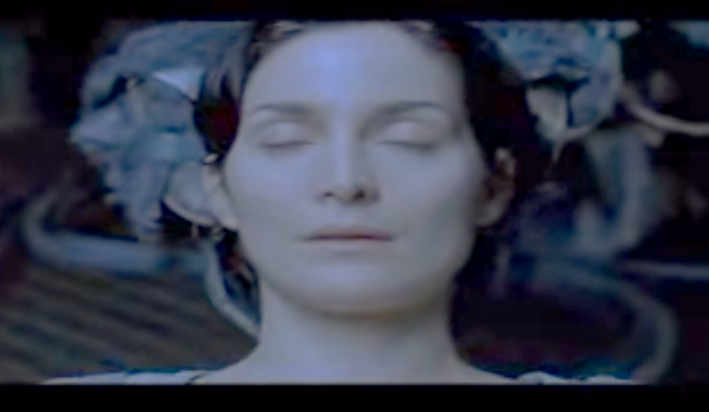

New Skills - Accelerating Adoption
Tank. I need a
pilot program for a B212 helicopter
Lets Go !

Slide 46
Infused throughout IBM products
with a range of consumption options
Standalone
Within
Platforms
Within
Solutions
Spark as a Service
On IBM Bluemix
IBM Open Platform (with Apache Spark)
BigInsights on Cloud (with Apache Spark)
IBM Streams
…many others underway
Analytics (SPSS, Watson Analytics, DataWorks)
Commerce
Watson Health
…many others underway

Slide 47

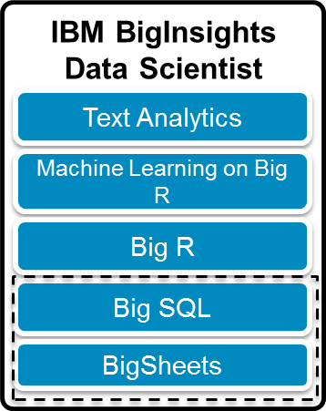

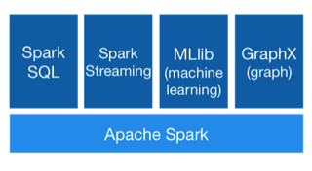
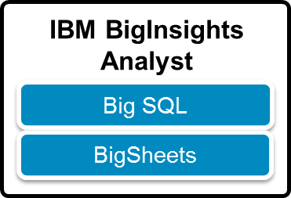


Leverage Bluemix for Rapid Development
Client Environment
Spark as a service
Apps
Apps
Apps
Request
Apps
Result
Data
Data
IBM hosted, managed, secure environment
IBM Open Platform + Apache Spark
Environment
Data
Secure, Dedicated Bare-metal
Infrastructure
BigInsights for Apache Hadoop
Managed environment on dedicated bare metal cluster for client control and performance
ibm.com/hadoop
Apache Spark as a Service
Fully-managed Spark environment accessible on-demand
ibm.com/spark

Slide 48
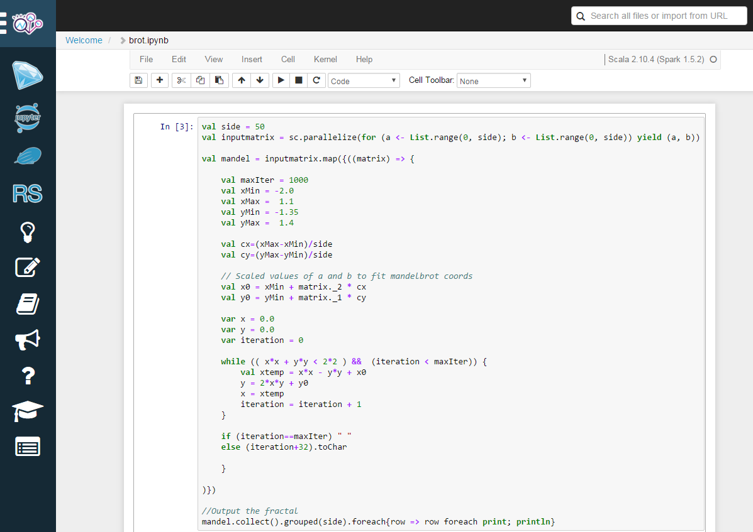
Explore, Experiment and get Notebook Savvy
!!!!!!!!!!!!!!!!!!!!!!!!!!""""""""""""""""""""""""""""""""""""""""""""""""""""""""""""""""""""""""""""""""""""""""""""""""""""""""""""""""""""""""""""
!!!!!!!!!!!!!!!!!!!!!!!!!"""""""""""""""""""""""""""""""""""""""""""""""""""""""""""""""""""""""""""""""""""""""""""""""""""""""""""""""""""""""""""""
!!!!!!!!!!!!!!!!!!!!!!!!""""""""""""""""""""""""""""""""""""""""##################""""""""""""""""""""""""""""""""""""""""""""""""""""""""""""""""""""
!!!!!!!!!!!!!!!!!!!!!!!!""""""""""""""""""""""""""""""""""##############################""""""""""""""""""""""""""""""""""""""""""""""""""""""""""""""
!!!!!!!!!!!!!!!!!!!!!!!"""""""""""""""""""""""""""""""######################################""""""""""""""""""""""""""""""""""""""""""""""""""""""""""
!!!!!!!!!!!!!!!!!!!!!!""""""""""""""""""""""""""""##############################################""""""""""""""""""""""""""""""""""""""""""""""""""""""
!!!!!!!!!!!!!!!!!!!!!""""""""""""""""""""""""""####################################################"""""""""""""""""""""""""""""""""""""""""""""""""""
!!!!!!!!!!!!!!!!!!!!!""""""""""""""""""""""""########################################################"""""""""""""""""""""""""""""""""""""""""""""""""
!!!!!!!!!!!!!!!!!!!!""""""""""""""""""""""##############################################################""""""""""""""""""""""""""""""""""""""""""""""
!!!!!!!!!!!!!!!!!!!"""""""""""""""""""""##################################################################""""""""""""""""""""""""""""""""""""""""""""
!!!!!!!!!!!!!!!!!!!"""""""""""""""""""############################################$$$$$$$$$$$$$$############""""""""""""""""""""""""""""""""""""""""""
!!!!!!!!!!!!!!!!!!"""""""""""""""""""#########################################$$$$$$$$$$%%%$$$$$$$$###########""""""""""""""""""""""""""""""""""""""""
!!!!!!!!!!!!!!!!!""""""""""""""""""#########################################$$$$$$$$$%%&&%%%%%$$$$$$$##########"""""""""""""""""""""""""""""""""""""""
!!!!!!!!!!!!!!!!!""""""""""""""""#########################################$$$$$$$$$$%%()')%%%%%$$$$$$$$##########"""""""""""""""""""""""""""""""""""""
!!!!!!!!!!!!!!!!""""""""""""""""########################################$$$$$$$$$$$%%&'),*'&%%%%$$$$$$$$$#########""""""""""""""""""""""""""""""""""""
!!!!!!!!!!!!!!!!""""""""""""""########################################$$$$$$$$$$$$%%%&&(+)'&&&%%%$$$$$$$$$##########""""""""""""""""""""""""""""""""""
!!!!!!!!!!!!!!!""""""""""""""########################################$$$$$$$$$$$$%%%%&&(,+)&&&&&%%$$$$$$$$$##########"""""""""""""""""""""""""""""""""
!!!!!!!!!!!!!!!"""""""""""""#######################################$$$$$$$$$$$$$%%%%%&&'*W*('&&')%%$$$$$$$$$$##########"""""""""""""""""""""""""""""""
!!!!!!!!!!!!!!""""""""""""########################################$$$$$$$$$$$$$$%%%%%&&'27/*(''(3'%$$$$$$$$$$$##########""""""""""""""""""""""""""""""
!!!!!!!!!!!!!!"""""""""""#######################################$$$$$$$$$$$$$$$%%%%%&&&')*0,))*+-(&%$$$$$$$$$$$##########"""""""""""""""""""""""""""""
!!!!!!!!!!!!!"""""""""""#######################################$$$$$$$$$$$$$$$%%%%%%&&''()-7+,31)'&%%$$$$$$$$$$$##########""""""""""""""""""""""""""""
!!!!!!!!!!!!!""""""""""#######################################$$$$$$$$$$$$$$$$%%%%%%&&'(()+1/1,)''&&%%$$$$$$$$$$###########"""""""""""""""""""""""""""
!!!!!!!!!!!!""""""""""#######################################$$$$$$$$$$$$$$$$%%%%%%&&''(()+-5,*)''&&%%%$$$$$$$$$$###########""""""""""""""""""""""""""
!!!!!!!!!!!!"""""""""#######################################$$$$$$$$$$$$$$$$%%%%%%%&'''((*+36,*)''&&%%%$$$$$$$$$$$###########"""""""""""""""""""""""""
!!!!!!!!!!!"""""""""######################################$$$$$$$$$$$$$$$$$%%%%%%%&&''((*-.23-,)(''&%%%%%$$$$$$$$$$###########""""""""""""""""""""""""
!!!!!!!!!!!""""""""######################################$$$$$$$$$$$$$$$$$%%%%%%%&&'())*,4FDA1.)(('&&%%%%%$$$$$$$$$$###########"""""""""""""""""""""""
!!!!!!!!!!""""""""######################################$$$$$$$$$$$$$$$$$%%%%%%%&&'()5,+,0D 7/*))+'&%%%%%%$$$$$$$$$############""""""""""""""""""""""
!!!!!!!!!!"""""""######################################$$$$$$$$$$$$$$$$$%%%%%%%&&&(,:1/.42 7.++68(&%%%%%%%$$$$$$$$$############"""""""""""""""""""""
!!!!!!!!!""""""""#####################################$$$$$$$$$$$$$$$$$%%%%%%%&&&')1/61=g ź<6/.4+('&%%%%%%%$$$$$$$$$############""""""""""""""""""""
!!!!!!!!!"""""""#####################################$$$$$$$$$$$$$$$$$%%%%%%&&&&''(*,3Ip 516/('&&%%%%%%%%$$$$$$$############""""""""""""""""""""
!!!!!!!!!""""""#####################################$$$$$$$$$$$$$$$$$%%%%%&&&&&'''()+/| R0+(''&&%%%%%%%%$$$$$$$############"""""""""""""""""""
!!!!!!!!""""""#####################################$$$$$$$$$$$$$$$$$%%%%&&&&&&'''(()30> xF-*(''&&&%%%%%%%%$$$$$$#############""""""""""""""""""
!!!!!!!!""""""####################################$$$$$$$$$$$$$$$$%%%%&&&&&&&''''((*:9H 6:*('''&&&%%%%%%%%%$$$$$#############"""""""""""""""""
!!!!!!!""""""####################################$$$$$$$$$$$$$$$$%%%%&&&&&&&''''(()*.8Ǣ H6*(('''&&&&&%%%%%%%$$$$#############"""""""""""""""""
!!!!!!!"""""####################################$$$$$$$$$$$$$$$%%%%&&&&&&''''''(())*,;L 6-*)(('''&&&&&&&&&%%%$$$$#############""""""""""""""""
!!!!!!!"""""###################################$$$$$$$$$$$$$$%%%%%&'''((((''''(())**,0= ȃ9,*))(((''&&&&&&&''&%$$$$##############"""""""""""""""
!!!!!!"""""###################################$$$$$$$$$$$$$$%%%%%&())()=/(((()*****+,.4 š/,+*)))0)'''&&&''(5(&%$$$$#############"""""""""""""""
!!!!!!""""###################################$$$$$$$$$$$$$%%%%%%&&(00--8-*)))*m3-,3../29 L3/.,.,++/,)(''''''(+-&&%$$$##############""""""""""""""
!!!!!!""""##################################$$$$$$$$$$$$%%%%%%%&&'(*4861-+***,I}3/YI:DĕAR F>;<i:-/A>+(((''(()7*'&%$$$$#############""""""""""""""
!!!!!!"""##################################$$$$$$$$$$%%%%%%%%%&&&'(*.?B4/4-++-4 T4ö¨Ƅ ¤ ú0WČ62)))))))+2*('%%$$$##############"""""""""""""
!!!!!""""################################$$$$$$$$$$%%%%%%%%%%&&&&'(0@1:U8;5--/I ˷ > O-***//<+,5,**%%$$$##############"""""""""""""
!!!!!"""################################$$$$$$$$$%%%%%%%%%%%&&&&''(*,.B @0Kò 41.++.S1<.28-(&%%$$$##############""""""""""""
!!!!!"""###############################$$$$$$$$%%%%%%%%%%%%&&&&&''()+3q 4Ì q=-2; ÛND;u*'&%%$$$##############""""""""""""
!!!!"""###############################$$$$$$%%%%%%%%%%%%%%%&&&&&'(()+E ů =1¦ Ì6,:'&%%%$$$##############"""""""""""
!!!!"""#############################$$$$$$%%%%%%%%%%%%%%%%&&&&&''(()+J: gh 7-*(&&%%%$$$##############"""""""""""
!!!!""#############################$$$$$%%%%%%%%%%%%%%%%%&&&&&&'(()*+-2k D _5*'&&%%%$$$###############""""""""""
!!!!""###########################$$$$$%%%%%%%%%%%%%%%%%%&&&&&&'((**+,/1K W3)'&&%%%$$$$##############""""""""""
!!!""###########################$$$$$%%%%%%%%%%%%%%%%%&&&&&&&'')*Q0-/^: ͋</*('&&&%%%$$$###############"""""""""
!!!""#########################$$$$$%%%%%%%%%%%%%%%%%%&&&&&&&'')8CF211b 5/+*(''&&%%%$$$###############"""""""""
!!!""######################$$$$$$%%&&&&&&&%%%%%%%%%&&&&&&&'''()B>VAb7» `,*(''&&%%%$$$$##############"""""""""
!!!"#####################$$$$$$$%%()'&&&&&&&&&&&&&&&&&&&''''((),KV N <31)(''&%%%$$$$###############""""""""
!!!"##################$$$$$$$$%%%&'0*)&&&&&&&&&&&&&&''''''''(()+-­ M*)(('&%%$$$$###############""""""""
!!""################$$$$$$$$$%%%&&')3)('''''''')(''''''''''(((*+-1: =.+*)*+&%%$$$$###############""""""""
!!"##############$$$$$$$$$$$%%%%&&')G)(('''''():)(('''''''((()+s1Éś 1/7,45'%%$$$$$###############"""""""
!!"############$$$$$$$$$$$%%%%%&&&'+3*))(('(((.>*)((''''(((()*2h 8ǩ>0?*'%%$$$$$###############"""""""
!!"##########$$$$$$$$$$$$%%%%%%&&&(*:,*)*,)))*3.+)))((((((())+5Z ń ŧ ªq+'%%$$$$$###############"""""""
!!"########$$$$$$$$$$$$$%%%%%%%&&&((2005,7+)*+-364**,*))))))*+.3^ 12)&&%$$$$$################""""""
!!#######$$$$$$$$$$$$$$%%%%%%%%&&''(*,-:3R.I++-/?8--2,*))))**,o5| 73,)'&&%$$$$$$###############""""""
!"######$$$$$$$$$$$$$$%%%%%%%%&&&''()*+97<41-2/3DA007/+*****+1W -*('&%%$$$$$$###############""""""
!"#####$$$$$$$$$$$$$$%%%%%%%%%&&'''()*+.< f91;6? 639v.7++++,.4U F*('&%%$$$$$$###############""""""
!"####$$$$$$$$$$$$$$%%%%%%%%%%&&'''()*.1E m9AÍƧ ¨Ď 4A-++,,0Õ /+/'&%%$$$$$$###############""""""
!"###$$$$$$$$$$$$$$$%%%%%%%%%&&''''))+.1J ¹ A¾8.---1é řµ/@'&%%$$$$$$################"""""
!###$$$$$$$$$$$$$$$%%%%%%%%%%&''''(**+-/6Ï­ X=0.-.9] J/'&%%$$$$$$################"""""
!###$$$$$$$$$$$$$$%%%%%%%%%%&''''()0,./9@ =0/07 kG>)'&%%$$$$$$$###############"""""
!##$$$$$$$$$$$$$$%%%%%%%%%%&'(((()*.1B7; J11; ,)'&%%%$$$$$$$###############"""""
!##$$$$$$$$$$$$$%%%%%%%%%&&',((())*,/M j33D =.+'&%%%$$$$$$$###############"""""
!#$$$$$$$$$$$$$%%%%%%&&&&&'(*,*)))++/6S >5m =)'&%%%$$$$$$$###############"""""
!#$$$$$$$$$$$$$%%&&&&&&&'''(+6+++,,.3C 9 /*(&&%%%$$$$$$$###############"""""
!$$$$$$$$$$$$%%&&&&&&&&'''((*,/--0-/3L = 2)'&&%%%$$$$$$$###############"""""
!$$$$$$$$$$$%&&&&&&&&&''''()*+910E316 j 1-('&%%%%$$$$$$$################""""
!$%%%%%%%%&'''&&&&&&'''''())*,0@A`E99 b7('&&%%%%$$$$$$$################""""
!%%%%%&&&''*(''''&&'(((((***3.4= ? X)('&&%%%%$$$$$$$################""""
!%%%%&&&'''**'((()6)(())*?++.87 ¢ Q*(''&&%%%%$$$$$$$################""""
!&'%''((()*0N*)***3+++*.,1/0?= /+)(''&&%%%%$$$$$$$################""""
!&()()))()*< ,+*+,4,,,,/15128K .+)(''&&%%%%$$$$$$$################""""
!%%%&&&&'''*+)((()1)(())+3,-/E: .*(''&&%%%%$$$$$$$################""""
!%%%%&&&&''))''''''(((((),*+0/5C C .)('&&%%%%$$$$$$$################""""
!$%%%%%&&&&)'''&&&&&'''''())+-0;Ub`D] Z5('&&%%%%$$$$$$$################""""
!$$$%%%%$$$%%&&&&&&&&'''''()*+431:516 | 1*'&&%%%%$$$$$$$################""""
!$$$$$$$$$$$$%%&&&&&&&&'''((*,5..0./3Ň ? f('&&%%%$$$$$$$###############"""""
!#$$$$$$$$$$$$%%%&&&&&&&'''(*4,+,,,.8f : .*'&&%%%$$$$$$$###############"""""
!#$$$$$$$$$$$$$%%%%%&&&&&''(+,*))*+,/5¯ đ6 ŗÈ)'&%%%$$$$$$$###############"""""
!#$$$$$$$$$$$$$$%%%%%%%%&&&'4*()))*,.8 Ð54Q 0+'&%%%$$$$$$$###############"""""
!##$$$$$$$$$$$$$$%%%%%%%%%%&'(((()*,3?¿K b12 C,)'&%%%$$$$$$$###############"""""
!##$$$$$$$$$$$$$$$%%%%%%%%%%&''''(*7-/0JF A1/0B /+('&%%$$$$$$$###############"""""
!###$$$$$$$$$$$$$$%%%%%%%%%%%&''''(*++-05E v2...ā ĩ H1'&%%$$$$$$################"""""
!"###$$$$$$$$$$$$$$%%%%%%%%%%&&''''))+-0O ^ K^C.--.1B S 10'&%%$$$$$$################"""""
!"####$$$$$$$$$$$$$$%%%%%%%%%%&''''()*7KX ;Ğ  L5E-,+,,=Y Ǵ1,-'&%%$$$$$$###############""""""
!"#####$$$$$$$$$$$$$$%%%%%%%%%&&'''()),/7 S2:@; 95`c0<,+++,.5 /*)'&%%$$$$$$###############""""""
!"######$$$$$$$$$$$$$$%%%%%%%%&&&''()*+/4_66.30©r105<,+****+/O p0)('&%%$$$$$$###############""""""
!!#######$$$$$$$$$$$$$$%%%%%%%%&&''(*+-4:>/.,,-09X-.2,*))))**,98 5/+('&&%$$$$$$###############""""""
!!"#######$$$$$$$$$$$$$$%%%%%%%&&&((-474-4+**+-185++.*))))))*+.3z 0B(&&%$$$$$################""""""
!!"#########$$$$$$$$$$$$$%%%%%%&&&(*/,+**3*))*1/,*)))((((())*+1; J@+&&%$$$$$###############"""""""
!!"###########$$$$$$$$$$$$%%%%%&&&(00*)))(((()/0*)((('''(((()+qEA < ËAA+'%%$$$$$###############"""""""
!!"#############$$$$$$$$$$$%%%%%&&')0*(('''''().+((''''''(((()+:1OØ 2DY-E*'%%$$$$$###############"""""""
!!""###############$$$$$$$$$$%%%&&'(/)('''''''(-(''''''''''(()*,.1Ĳ ā/,+*+.&%%$$$$$##############""""""""
!!!"##################$$$$$$$$%%%&'+,)'&&&&&&&&&&''''''''''((()+-q <*)))(&%%$$$$###############""""""""
!!!"####################$$$$$$$%%&')(&&&&&&&&&&&&&&&&&&'''''(()+J9 ~ ª7T)(('&&%%$$$$###############""""""""
!!!""######################$$$$$$%&'&&&&&&&%%%%%%%&&&&&&&&'''()7:xPĺ9 ]-,)(''&%%%$$$$###############""""""""
!!!""########################$$$$$%%%&&&%%%%%%%%%%%%%&&&&&&''')2:w4:2f 8/+*(''&&%%%$$$###############"""""""""
!!!""##########################$$$$$%%%%%%%%%%%%%%%%%%&&&&&&&'(*+1/-0Â? E3,*('&&&%%%$$$###############"""""""""
!!!!""###########################$$$$$%%%%%%%%%%%%%%%%%&&&&&&&'()N,+,o5h ?.('&&%%%$$$$##############""""""""""
!!!!""############################$$$$$$%%%%%%%%%%%%%%%%&&&&&&''(()*+-1:H Q PV*'&&%%%$$$###############""""""""""
!!!!"""#############################$$$$$$%%%%%%%%%%%%%%%&&&&&&''())+/D ǤB >-*(&&%%%$$$###############""""""""""
!!!!"""##############################$$$$$$$%%%%%%%%%%%%%%&&&&&&'(()+Bΐ Ď X37 e;+/'&%%%$$$##############"""""""""""
!!!!!"""###############################$$$$$$$%%%%%%%%%%%%%&&&&&''()+JE 6¦ B.0i FxB6+'&%%$$$###############"""""""""""
!!!!!"""################################$$$$$$$$%%%%%%%%%%%%&&&&''(*,.: l14đŔ °7{Q,,0P29132+(&%%$$$##############""""""""""""
!!!!!""""################################$$$$$$$$$$%%%%%%%%%%&&&&'(1N0; >L4..49  -+**1U;+,8,+*&%%$$$##############""""""""""""
!!!!!""""#################################$$$$$$$$$$$%%%%%%%%%&&&'(,8If;0B0,,.9 oÉ] 2 4-)))**)*+0*('%%$$$##############"""""""""""""
!!!!!!""""#################################$$$$$$$$$$$$%%%%%%%%&&'(*.Mk0-,+**FCv30C9I¦ISȝ UFæ>D=~./9>+)((((()*s)'&%%$$$##############"""""""""""""
!!!!!!""""##################################$$$$$$$$$$$$$%%%%%%%&'(-:-/J,*)))*3C0,F0/027z 300.1V+-1:)((''''((,6'&%$$$##############""""""""""""""
!!!!!!"""""###################################$$$$$$$$$$$$$%%%%%%&53*)*/3)(((),++*+,-.2 o/-++*)*.)('''&'''(2*&%$$$$#############"""""""""""""""
!!!!!!!""""####################################$$$$$$$$$$$$$$%%%%%&'''(*)(((((()))*+,/C 1,+*))((''&&&&&&&')&%%$$$##############"""""""""""""""
!!!!!!!"""""####################################$$$$$$$$$$$$$$$%%%%&&''''''''''(())*+> 9-*)(((''&&&&&&&&&%%%$$$$#############""""""""""""""""
!!!!!!!""""""####################################$$$$$$$$$$$$$$$%%%%&&&&&&&'''''(()*-2_ 2*(('''&&&&&&%%%%%%$$$$##############""""""""""""""""
!!!!!!!!"""""#####################################$$$$$$$$$$$$$$$$%%%%&&&&&&&''''((*]Dp 6;+((''&&&&%%%%%%%%$$$$$#############"""""""""""""""""
!!!!!!!!""""""#####################################$$$$$$$$$$$$$$$$%%%%&&&&&&&'''(()23] 5-*(''&&&%%%%%%%%%$$$$$#############""""""""""""""""""
!!!!!!!!"""""""#####################################$$$$$$$$$$$$$$$$$%%%%&&&&&&'''()+/E `;*(''&&%%%%%%%%$$$$$$$############"""""""""""""""""""
!!!!!!!!!"""""""#####################################$$$$$$$$$$$$$$$$$%%%%%&&&&&''(*+; y Y7633('&&%%%%%%%%$$$$$$$#############"""""""""""""""""""
!!!!!!!!!"""""""######################################$$$$$$$$$$$$$$$$$%%%%%%&&&&')=-:49ZÁ R?//2+('&%%%%%%%%$$$$$$$$############""""""""""""""""""""
!!!!!!!!!!"""""""######################################$$$$$$$$$$$$$$$$$%%%%%%%&&')0;9/.p6E 50,,=/(&&%%%%%%%$$$$$$$$############"""""""""""""""""""""
!!!!!!!!!!""""""""######################################$$$$$$$$$$$$$$$$$%%%%%%%&&'()1-+-1J 6.+*)-'&%%%%%%$$$$$$$$$############""""""""""""""""""""""
!!!!!!!!!!!""""""""######################################$$$$$$$$$$$$$$$$$%%%%%%%&&'(,**,1jNB50*(('&&%%%%%$$$$$$$$$$###########"""""""""""""""""""""""
!!!!!!!!!!!"""""""""######################################$$$$$$$$$$$$$$$$$%%%%%%%&&''()+.054./)(''&%%%%%$$$$$$$$$$###########""""""""""""""""""""""""
!!!!!!!!!!!""""""""""######################################$$$$$$$$$$$$$$$$$%%%%%%%&'''()*,6?,*)('&&%%%%$$$$$$$$$$###########"""""""""""""""""""""""""
!!!!!!!!!!!!""""""""""######################################$$$$$$$$$$$$$$$$$%%%%%%&&''((*+->,*)''&&%%%$$$$$$$$$$$##########""""""""""""""""""""""""""
!!!!!!!!!!!!"""""""""""#######################################$$$$$$$$$$$$$$$%%%%%%%&''(()+/3/+)''&&%%$$$$$$$$$$$##########"""""""""""""""""""""""""""
!!!!!!!!!!!!!"""""""""""#######################################$$$$$$$$$$$$$$$%%%%%%&&''()37,./.('&%%$$$$$$$$$$$##########""""""""""""""""""""""""""""
!!!!!!!!!!!!!""""""""""""#######################################$$$$$$$$$$$$$$$%%%%%&&&')*.0)*+,+'&%$$$$$$$$$$$##########"""""""""""""""""""""""""""""
!!!!!!!!!!!!!!""""""""""""#######################################$$$$$$$$$$$$$$%%%%%%&&'+,3*((')-'%%$$$$$$$$$$##########""""""""""""""""""""""""""""""
!!!!!!!!!!!!!!"""""""""""""########################################$$$$$$$$$$$$$%%%%%&&'+ +(''''+&%$$$$$$$$$$##########"""""""""""""""""""""""""""""""
!!!!!!!!!!!!!!!""""""""""""""#######################################$$$$$$$$$$$$$%%%%&&(/,*'&&&&&%$$$$$$$$$$##########""""""""""""""""""""""""""""""""
!!!!!!!!!!!!!!!!""""""""""""""########################################$$$$$$$$$$$$%%%&&(*)'&&&%%%$$$$$$$$$##########""""""""""""""""""""""""""""""""""
!!!!!!!!!!!!!!!!"""""""""""""""########################################$$$$$$$$$$$$%%&'(-)'&%%%%$$$$$$$$$##########"""""""""""""""""""""""""""""""""""
!!!!!!!!!!!!!!!!!""""""""""""""""########################################$$$$$$$$$$$%%'*(*&%%%%$$$$$$$$##########"""""""""""""""""""""""""""""""""""""
!!!!!!!!!!!!!!!!!"""""""""""""""""#########################################$$$$$$$$$$%&&&&%%%%$$$$$$$$##########""""""""""""""""""""""""""""""""""""""
!!!!!!!!!!!!!!!!!!""""""""""""""""""##########################################$$$$$$$$$%%%%%$$$$$$$###########""""""""""""""""""""""""""""""""""""""""
!!!!!!!!!!!!!!!!!!""""""""""""""""""""###########################################$$$$$$$$$$$$$$$$###########""""""""""""""""""""""""""""""""""""""""""
!!!!!!!!!!!!!!!!!!!"""""""""""""""""""""##############################################$$$$$###############""""""""""""""""""""""""""""""""""""""""""""
!!!!!!!!!!!!!!!!!!!!""""""""""""""""""""""##############################################################""""""""""""""""""""""""""""""""""""""""""""""
!!!!!!!!!!!!!!!!!!!!""""""""""""""""""""""""##########################################################""""""""""""""""""""""""""""""""""""""""""""""""
!!!!!!!!!!!!!!!!!!!!!""""""""""""""""""""""""""####################################################"""""""""""""""""""""""""""""""""""""""""""""""""""
!!!!!!!!!!!!!!!!!!!!!!"""""""""""""""""""""""""""################################################"""""""""""""""""""""""""""""""""""""""""""""""""""""
!!!!!!!!!!!!!!!!!!!!!!!""""""""""""""""""""""""""""""########################################"""""""""""""""""""""""""""""""""""""""""""""""""""""""""
!!!!!!!!!!!!!!!!!!!!!!!""""""""""""""""""""""""""""""""""################################"""""""""""""""""""""""""""""""""""""""""""""""""""""""""""""
!!!!!!!!!!!!!!!!!!!!!!!!""""""""""""""""""""""""""""""""""""""######################""""""""""""""""""""""""""""""""""""""""""""""""""""""""""""""""""
!!!!!!!!!!!!!!!!!!!!!!!!!"""""""""""""""""""""""""""""""""""""""""""""""""""""""""""""""""""""""""""""""""""""""""""""""""""""""""""""""""""""""""""""
!!!!!!!!!!!!!!!!!!!!!!!!!!""""""""""""""""""""""""""""""""""""""""""""""""""""""""""""""""""""""""""""""""""""""""""""""""""""""""""""""""""""""""""""
!!!!!!!!!!!!!!!!!!!!!!!!!!""""""""""""""""""""""""""""""""""""""""""""""""""""""""""""""""""""""""""""""""""""""""""""""""""""""""""""""""""""""""""""
!!!!!!!!!!!!!!!!!!!!!!!!!!!"""""""""""""""""""""""""""""""""""""""""""""""""""""""""""""""""""""""""""""""""""""""""""""""""""""""""""""""""""""""""""

Slide 49


Leverage Embedded Spark from a Broad Suite of Capabilities
Data Engineers • Data Analysts • Data Scientists • Developers • CEO, CIO, CMO
Data Preparation
Tools
Data Modelling
Tools
Development
Tools
Data Visualisation
Tools
Advanced Analytics
Data Integration
Data Governance
Entity Analytics
BigInsights BigIntegrate
BigInsights Analyst
BigInsights Data Scientist
BigInsights
Big Match
SPSS Analytic Server
BigInsights
BigQuality
DataWorks
SPSS Modeler
Spark Analytics Operating System
  Apache Hadoop Ecosystem
  Ambari Cluster and Yarn Resource Management
  HDFS Storage
RDBMS, Object Stores
and NoSQL Engines
On-premises • Cloud • Hybrid • Docker Images

Slide 50



IBM, NASA, and the SETI Institute are collaborating to analyse complex deep space radio signals using Spark in a hunt for patterns to understand and explain the origin of the universe. Analysing 100 million radio signals.
Notes:
Transient signal detection
Leverage Spark capabilities to create a strong analytic foundation to enable new ways to analyze and collaborate on telescope data, initially for professional researchers but eventually to engage all "citizen scientists”

