Slide 1

Longbeach
April 11th 2012
Fraud Discussion
Banking & Financial Markets
Michael Green
Alan Horton-Bentley
0

Slide 2
Today’s topics
Capturing information, process improvement & compliance a good start for fighting fraud
2) Acting On Fraud: Optimizing investigative and ad-hoc business processes with advanced case management
3) Better Insights: New capabilities to keep pace with the criminal element and hackers – “connecting the dots”

Slide 3













Enterprise Content Management (ECM) - Improving the efficiency of paper based/manual business processes
Traditional ECM
For more than 25 years the finance Industry has implemented ECM solutions
Business Applications
  Account opening
  Lending origination
  Trust document management
  Records management
  Content centric workflow processes
  Archiving
  E-mail management
Compelling ROI & benefits:
  Reduced Cycle Times
  Reduced costs
  Improved customer experience
  Improved compliance
  Reduce errors and Fraud
Mortgage
lending
Commercial lending
Consumer
lending
Student
lending
Claims
Underwriting
Wealth
management
Fraud and illegal
transactions
Wholesale
banking
Credit card
processing
New account
opening

Slide 4
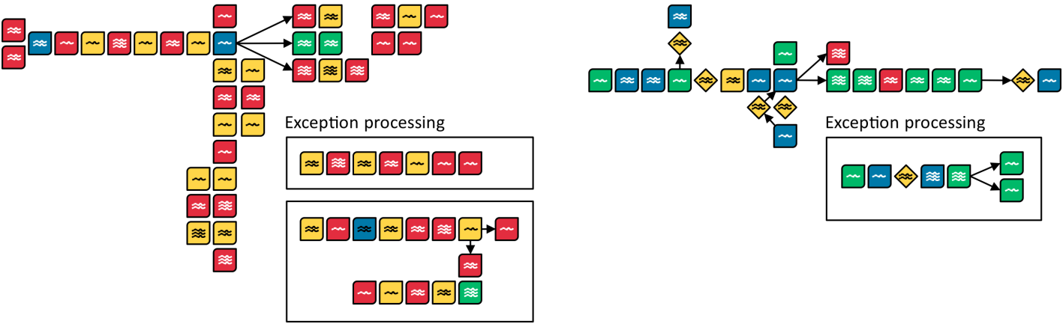
Business process management (BPM) a positive impact on reducing errors and Fraud
Before BPM was applied
After
Manual
Wait
Semi Automated
Fully Automated
Notes:
3

Slide 5
Consolidation and optimisation?
Extend to Analysis and Optimization
Extend to Integration and Federation
Actionable Content:
Business information data marts with unstructured content
BI content analytics
Unstructured content applied learning
Unstructured content advanced analytics
Predictive analysis
Enterprise process optimization
Extend to
Business Processes
Content as Knowledge:
Content classification and discovery
Enterprise business taxonomy
Master Content Management
Content federation and consolidation
Single view for client
Content governance framework
Core Content Services
Content in Motion:
Content-centric workflow management
Business process management
Trading partner process integration
Enterprise process automation
Static Content:
Capturing digitized
content
Electronic content search and retrieval
Content lifecycle and
records management
Basic
Content capture / store / deliver
Level of ECM Maturity
Sophisticated
Harness the informational
value of content
Achieving higher levels of ECM maturity helps businesses:
Manage the ever-growing complexity, volume, and variety of information
Improve business performance by leveraging actionable information
Move decision-making beyond “gut checks” to include "decision analysis"
Gain insights from previously subjective and inaccessible data sources
Predict and identify risk events and build resiliency and agility to respond and act quickly
Improve customer relationships
Respond to discovery and compliance demands
4

Slide 6





Many new and complex challenges facing the Industry
The risks of having to much information - Has the industry crossed the line and needs to retool to take advantage of this bonanza?
TRUST
Become a trusted advisor to clients to support future client growth and so gain cross and up-sell opportunities
Trust also in the form of transparency and being viewed as financially solid
Information
Explosion
COMPETITION
Competition is intensifying
with all competitors currently engaged in looking how to better support client and monetize their transactional data
REGULATION
Radically increased oversight is ushering in a new era of regulatory requirements - Dodd/Frank
CLIENT’S NEEDS
Clients have rapidly evolving expectations for offerings and services, unbiased advice, and convenience
£
CAPITALISATION
Mature market segments and
emerging market segments alike focus on rebuilding their
capital reserves and managing their liquidity – Basel 111- stress test
1 – Source: IBM Institute for Business Value/ Economist intelligence unit, business analytics survey 2010

Slide 7

Given the time you should be able to find the necessary information, assimilate it, and make a good decision
But in today's high speed on-line world customer won’t wait and the risks of uninformed decision making carries great consequences
So many data points - complex decisions –
Risk critical decisions
Customer satisfaction decisions
Cross line-of-business considerations
Fraud issues
Compliance decisions
Legal decisions
The risks of poor decision making?
Financial exposure
Reputational risk
Regulatory exposure
Legal exposure (liability)
Customer retention risk
Poor organic growth
Customer dissatisfaction
Making decisions without all the data , but it can be later proved that you had the data all of the time, carries huge exposure

Slide 8




To achieve competitive edge organizations need to be smarter & faster
  77% of CEOs say they do not have real-time information to make key business decisions
  1 in 3 business leaders frequently make business decisions based on information they don’t have, or don’t trust
  1 in 2 business leaders say they don’t have access to the information they need to do their jobs
Companies that invest in business insight outperform their peers, showing 33% higher revenue growth, 12 times more profit growth, and 32% higher return on invested capital.
Sources: IBM 2010 CEO & CFO Studies, IBM 2010 Break Away With Business Analytics and Optimization Study
Notes:
This information is from the IBM 2010 CEO & CFO studies
How do you make better decisions based on information?
Your peers will outperform you if you do not invest in developing the business insights that lead to better decisions
Insights to drive better decision. Understanding that decision-makers are making uninformed decisions.

Slide 9
Traditional approaches are converging
More than keyword search is needed
Analyzing unstructured content no longer optional
“Making unstructured data searchable is now a presumed primary interface for applications of all kinds, as well as for intranets and content repositories.”
– Whit Andrews, Rita Knox Gartner
“For many business process professionals, access to structured data, even when supported by BI or predictive analytics, lacks sufficient context for customer service, finance, and other areas where communications with customers involves many channels”
– Craig Le Clair Forrester
Enterprise
Search
Business
Intelligence
Content Analytics
Increasing in business importance
Converging toward content analytics
Text
Analytics
“Early adopters of [text analytics] are already gaining a competitive advantage. Organizations that fail to do so will be at risk.”
– Sue Feldman IDC
“Every enterprise should understand how content analytics can produce answers to its critical questions; understanding this now will make it possible to exploit these tools as their availability proliferates.”
– Rita Knox Gartner
8
Notes:
As viewed described by key industry analysts, based on their interactions with their clients and markets, Content Analytics is converging or bridging capabilities from three familiar markets.
The search market is quickly evolving moving towards making unstructured data searchable and improving findability by leveraging the context found in your unstructured content.
Business intelligence is about structured data and structured data lacks context. BI solutions will be improved by leveraging the context found in unstructured enterprise content.
Text analytics is being leveraged by early adopters to gain competitive advantage and in this early market they are often leveraging one of many niche text analytics tool providers to prove the value
The market is converging towards content analytics. Gartner is advising every enterprise to understand how content analytic solutions can help answer critical business questions … in other words how can you leverage content analytics to deliver business insights that lead to better business outcomes.

Slide 10

Connecting the dots?
Web
Content
Content analytics - look for patterns, connect the dots
“complete view of the customer”
All have surveillance
output
Social Media
Sites
Third parties
credit reporting
Multiple Case management
systems
Retail High Volume
Surveillance of
transactional data
Checking
Card
ATM
Funds Transfer
lending
Trust
Bonds
401K
Investments
Structured and unstructured
content – customer information
E-mails
Correspondence
Fax
Video
Voice
Photos
Biometrics
New level of
Intelligence
Multiple CRM & Helpdesk logs
Capture, data governance & quality consolidation, search, discover & analytics

Slide 11




IBM Content Analytics adds value in the fight against fraud and reputational damage
Regulatory Compliance
Analyzing: new regulations and alerting the
responsible party. Flagging inconsistencies, errors
or omissions
Benefits: Improve compliance with new and
existing regulations avoiding supervision & fines
Crime Analytics
Analyzing: Case files, for crime trend patterns to reduce future case volumes due to ineffective LOB business processes
Benefits: crime Interdiction avoid loss of reputation and costs
Fraud
Analyzing: claims, disputes and complaints
For: Detecting fraudulent activity & patterns in all channels – but in particular inbound and outbound social network messages
Benefits: Reduced losses, faster detection, gaining control of new communications from the outset – avoid adverse publicity
Marketing
Analyzing: Call center notes, multiple content repositories, email files Social Media
For: churn prediction, product/brand quality
Benefits: Improve consumer satisfaction, marketing campaigns, find new revenue opportunities or product/brand quality issues
Notes:
4/11/2012 1:30 PM
Goyal_Info_Infra_v01
Today – we have seen the following solutions built on the IBM content analytics platform. In Healthcare Analytics – with the growth of improved IT in healthcare provider networks and therefore the creation and storage of important medical and administration records electronically, creates a hot bed of opportunity to further exploit that information to do what? To solve key issues like can I improve my quality of care as it related to specific diseases or drug treatment plans? From the healthcare plan side – Are health plans paying for the most productive and effective treatments for members?
In manufacturing, like the automotive industry, would an automotive manufacturers like to recognize potential quality concerns from the general public and cross correlate that to their own internal records from call centers and their dealer network.
Or within the public sector – say advanced crime analytics or intelligence – analyzing police records, 911 calls, detective case files, witness reports, etc to identify trends in crime and take corrective action – whether that through bettern linking key suspects to evidence or optimizing deployment of personnel.
When you understand that 80% of all stored information is unstructured/content, when you realize the growth is out of control — volume has been doubling every 3 years and is expected to grow 44 times by 2020 — you quickly conclude that you can't buy enough storage or deploy enough human beings even just to gain control or better manage all that content. You can leverage content analytics to assess content to better understand what information matters to your business and must be managed and preserved and what information can be decommissioned.
Slides 10-18 will go into a select set of industry-specific use cases and the types of questions you can use to explore possible pain points with customers. I will review a couple but encourage each of you to download the slides and review the slide and slides notes for more detailed information.
10

Slide 12

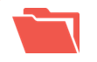






Why shouldn't all important decision making process be managed as a case?
Advanced Case Management
Case Design
Case Runtime
Case Analytics
Models Templates Solutions
Context 360º View History
Structured Unstructured
Real time Persisted
Case Infrastructure
Case Object Models
Case APIs
Solution Constructs
Task Object Model
Case Analytics Data Store
Content
Collaboration
& Social SW
Workflow
Rules
Events
Integration
Monitoring & Analytics
people s process s information
11
Notes:
11
11
11
IBM is building an advanced case management platform that unites content, process and people
Customers can start from investments in any of these capabilities and expand into advanced case management
IBM is delivering optimized case outcomes through analytics, rules, collaboration and social computing
Advanced case management supports work management of structured and unstructured activities
Advanced case management delivers trusted information to the case – both content and structured data
Advanced case management can uniquely manage the entire case lifecycle including retention and governance requirements
IBM has the broadest portfolio of case management capabilities and the most extensive ecosystem of case management solutions

Slide 13

As powerful analytics tools uncover a bounty of new insight - decision making and investigations are growing in complexity
We began to look for processes that required:
Assimilate large and growing volumes of information
    Access information trapped in content
    Monitor internal and external information feeds
    Monitor and capture content from social networks
    Understanding sentiment and tangible data
    Collaborate internally and externally
    Analyze patterns and trends to support process improvement
    Analyze customer information in real time to support customer-facing personnel

Slide 14
What concerns you most?
Cross channel fraud
Insider fraud
Money laundering schemes
Malware and phishing on fixed and mobile networks
Credit card fraud / white plastic / ATM & POS skimming
ACH and wire transfer fraud
Securities and stock fraud
Compliance issues
Acquire and analyze data from social networks
Access intelligence on individuals and groups that may pose a threat to your facilities or personnel
Notes:
Here are a few use cases that have successfully deployed i2 solutions to counter threat. As you can see – the usage of the solution is VERY broad

Slide 15
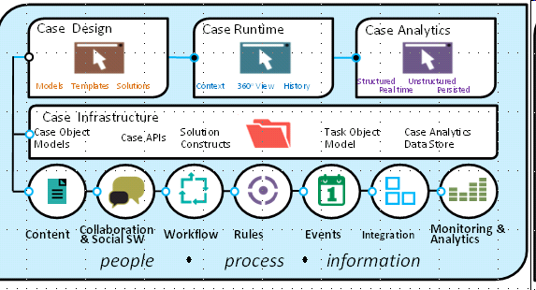
We Are Seeing A New Solutions Approach Trend
Solutions addressing applications involving complex decision making
AML
Card
Investigations
Fraud
Investigation.
Wealth
management
Commercial
lending
Account
Opening

