Slide 1
Program Management Portal (PgMP): What’s New in Release 16.1
Program Management Practice
© 2016 IBM Corporation
Notes:
1
Welcome to the web lecture on the Program Management Portal (PgMP): What’s New in Release 16.1. This module is intended for existing users of PgMP. If you are new to the tool, instead of completing this module, please proceed to the Overview Basics module of the PgMP Client Education Suite. You can find a link to this suite on slide 3 of this presentation.

Slide 2
Learning Objectives
Understand the changes made to PgMP Functionality in 16.1:
Attachments
Fields
New roles
Proposal Rejection options
Notes:
In this module you will learn about the updates made to PgMP in Release 16.1. With the deployment of this release, users retain their existing functionality but have access to additional capabilities in the tool. Enhancements and fixes have been made to make it easier to use as well as respond to user feedback. Changes have been made to Attachments, fields, roles, and Proposal Rejection options. We will address each of these changes at a high level in the coming slides.

Slide 3
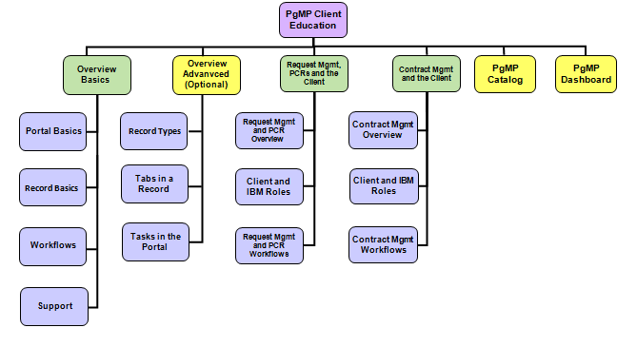
PgMP Client Education Suite
PgMP Education Suite Link
*
* Recommended Education Module
Main Education Suite
PgMP Client Education Index
Notes:
Pictured here is the overall PgMP Education Suite for the Client. There are six education modules on PgMP. The boxes in the top of the graphic indicate the topics covered and the boxes beneath list the elements within them. The Overview Basics module, denoted by a red asterisk, is recommended for all users of PgMP. The Overview Advanced module is optional and intended for those users who seek additional details on the tool. Request Management, PCRs and the Client and Contract Management and the Client modules are available if required by your account or your job role. Additionally there is a Catalog and PgMP Dashboard module for accounts and users who utilize these optional functionalities. Users can click in the lower right hand corner of the screen to view or download the PgMP Client Education Index to find more information on the contents of each module. Click the hyperlink in the upper left hand corner of the screen to go to the PgMP Education Suite located at the end of the PgMP Client User Guide.

Slide 4
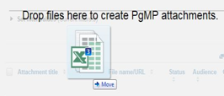
Changes to Fields and Attachments
Changes to Fields
Make the height of all multi-line fields self-adjusting
Consistent look for all large and small text fields that can contain multiple lines
Upload Multiple Attachments
Use the Drag and Drop method to add many attachments at once
Upload via the Attachments list in a record or the Organization Attachments
Users can use the Drag and Drop method to drop new version attachments
IBM and Client users can add a single version attachment at a time to Draft attachment records
Notes:
All multi-line fields in PgMP are now self-adjusting to make for a more consistent look for all large and small text fields. Time saving changes have been made to attachments in PgMP. Users can now Drag and Drop multiple attachments into a record’s or Organizations’ attachment list. Some information is copied from the file and information entered in for the first attachment is copied for the subsequent attachments. Another convenient change is the ability to Drag and Drop a new version of a draft attachment into PgMP.

Slide 5
Roles and Record Updates
New roles
Requirements Team Lead (RTL)
New IBM role for Requirements Definition in PCR and Request record types
4 new client roles to work in the optional Catalog Only workflow:
Client Catalog Only Requestor, Client Catalog Only Approver, Client Catalog Only Focal Point, Client Catalog Only Budget Approver
All client roles have been migrated to new roles
Record Select List updates
Addendum (Custom) Pricing added to the Price type select list
Hold and Withdraw reason code updates to select list
Notes:
5 new roles have been added to PgMP in Release 16.1. The first we will cover is Requirements Team Lead or (RTL). It is a new IBM role for Requirements Definition PCR and Request record types. Accounts utilizing the optional Catalog functionality will find 4 new client roles have been created for the Catalog Only workflow: Client Catalog Only Requestor, Client Catalog Only Approver, Client Catalog Only Focal Point, and Client Catalog Only Budget Approver. All client roles have been migrated to new roles (Client Requestor to Client Catalog Only Requestor for example.)
Additions and improvements have been made to some record select lists in PgMP. Addendum (Custom) Pricing has been added to the price type select list. Hold and Withdraw reason codes have been reworded and new choices have been added to better serve our users.

Slide 6
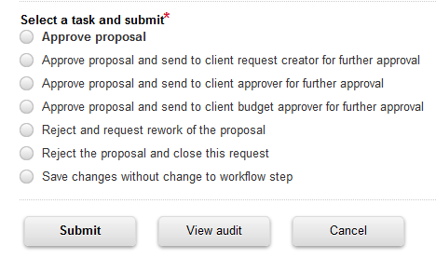
Proposal Reject Update
Rejecting a Proposal
"Reject and request rework of the proposal“
“Reject the proposal and close this request"
Notes:
Clients now have the ability to Reject a proposal and ask for the Proposal to be reworked or Reject the proposal and close out the RFS. If clients wish to have the proposal reworked a “revised proposal requested date” must be entered into the tool.

Slide 7
Next Steps …
Additional education
Complete any other PgMP modules that fit your job role if you haven’t done so already:
Overview Basics for the Client
Overview Advanced for the Client
Request Management, PCRs and the Client
Contract Management and the Client (Covers Issues, Deliverables, Contract Change and Risk Management)
PgMP Client Catalog
PgMP Client Dashboard
Additional information
For additional information on PgMP view the Client User Guide
Account specific information (See IBM Account Focal Point)
Notes:
Please take advantage of the education and additional resources available to you on PgMP. Complete the appropriate education for your job role and your account if you have not done so already. You can review the PgMP Client User Guide for more information about PgMP including links to additional Client education. The guide has been updated to reflect the changes made in Release 16.1. Additionally your IBM Account Focal Point is an invaluable resource on PgMP, don’t hesitate to contact him or her with questions or to resolve issues. This concludes What’s New in Release 16.1 module of the Program Management Portal. Thank you for your time and attention.

