Slide 1
IBM z14 / Pervasive Encryption
Michael Jordan
IBM Distinguished Engineer, IBM Z Security
Nick Sardino
IBM Z Offering Management

Slide 2
Trademarks
* Registered trademarks of IBM Corporation
CICS*
DB2*
DFSMS
DS8000*
Guardium
IBM*
IBM (logo)*
IBM Z
IMS
Qradr*
RACF*
z13*
z14
zSecure
z/OS*
z/VM*
Adobe, the Adobe logo, PostScript, and the PostScript logo are either registered trademarks or trademarks of Adobe Systems Incorporated in the United States, and/or other countries.
IT Infrastructure Library is a Registered Trade Mark of AXELOS Limited.
ITIL is a Registered Trade Mark of AXELOS Limited.
Linear Tape-Open, LTO, the LTO Logo, Ultrium, and the Ultrium logo are trademarks of HP, IBM Corp. and Quantum in the U.S. and other countries.
Intel, Intel logo, Intel Inside, Intel Inside logo, Intel Centrino, Intel Centrino logo, Celeron, Intel Xeon, Intel SpeedStep, Itanium, and Pentium are trademarks or registered trademarks of Intel Corporation or its subsidiaries in the United States and other countries.
Linux is a registered trademark of Linus Torvalds in the United States, other countries, or both.
Microsoft, Windows, Windows NT, and the Windows logo are trademarks of Microsoft Corporation in the United States, other countries, or both.
Java and all Java-based trademarks and logos are trademarks or registered trademarks of Oracle and/or its affiliates.
Cell Broadband Engine is a trademark of Sony Computer Entertainment, Inc. in the United States, other countries, or both and is used under license therefrom.
UNIX is a registered trademark of The Open Group in the United States and other countries.
VMware, the VMware logo, VMware Cloud Foundation, VMware Cloud Foundation Service, VMware vCenter Server, and VMware vSphere are registered trademarks or trademarks of VMware, Inc. or its subsidiaries in the United States and/or other jurisdictions.
Other product and service names might be trademarks of IBM or other companies.
The following are trademarks of the International Business Machines Corporation in the United States and/or other countries.
Notes:
Performance is in Internal Throughput Rate (ITR) ratio based on measurements and projections using standard IBM benchmarks in a controlled environment. The actual throughput that any user will experience will vary depending upon considerations such as the amount of multiprogramming in the user's job stream, the I/O configuration, the storage configuration, and the workload processed. Therefore, no assurance can be given that an individual user will achieve throughput improvements equivalent to the performance ratios stated here.
IBM hardware products are manufactured from new parts, or new and serviceable used parts. Regardless, our warranty terms apply.
All customer examples cited or described in this presentation are presented as illustrations of the manner in which some customers have used IBM products and the results they may have achieved. Actual environmental costs and performance characteristics will vary depending on individual customer configurations and conditions.
This publication was produced in the United States. IBM may not offer the products, services or features discussed in this document in other countries, and the information may be subject to change without notice. Consult your local IBM business contact for information on the product or services available in your area.
All statements regarding IBM's future direction and intent are subject to change or withdrawal without notice, and represent goals and objectives only.
Information about non-IBM products is obtained from the manufacturers of those products or their published announcements. IBM has not tested those products and cannot confirm the performance, compatibility, or any other claims related to non-IBM products. Questions on the capabilities of non-IBM products should be addressed to the suppliers of those products.
Prices subject to change without notice. Contact your IBM representative or Business Partner for the most current pricing in your geography.
This information provides only general descriptions of the types and portions of workloads that are eligible for execution on Specialty Engines (e.g, zIIPs, zAAPs, and IFLs) ("SEs"). IBM authorizes customers to use IBM SE only to execute the processing of Eligible Workloads of specific Programs expressly authorized by IBM as specified in the “Authorized Use Table for IBM Machines” provided at www.ibm.com/systems/support/machine_warranties/machine_code/aut.html (“AUT”). No other workload processing is authorized for execution on an SE. IBM offers SE at a lower price than General Processors/Central Processors because customers are authorized to use SEs only to process certain types and/or amounts of workloads as specified by IBM in the AUT.

Slide 3

IBM Z: Designed for Trusted Digital Experiences
Pervasive
Encryption is the
New Standard
Analytics & Machine Learning for Continuous Intelligence Across
the Enterprise
Open Enterprise Cloud to Extend, Connect
and Innovate
Encrypt all data for applications & databases
Zero application changes
Zero impact to service levels
Protect client and corporate from internal and external threats
Anticipate customer needs and embed insight in every business transaction
Dramatically faster lifecycle management of behavioral models with more memory and greater processing capacity
Derive impactful insights by combining
z Systems data with other structured and unstructured external data sources
Cut new service build time by 90% using secure APIs on IBM z and advanced DevOps
Seamlessly connect any service from public and private cloud with transactions and data on IBM Z
Accelerate innovation with an ecosystem of partners to develop and manage enterprise wide applications leveraging 1000’s open source software packages
Container Pricing For IBM Z provides new flexibility for modern digital workloads.

Slide 4


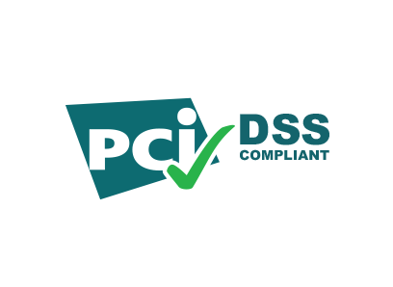



Data protection and compliance are business imperatives
European Union General Data Protection Regulation (GDPR)
“It’s no longer
a matter of if,
but when …”
26%
Likelihood of an organization having a data breach in the next 24 months ¹
Payment Card Industry Data Security Standard (PCI-DSS)
9 Billion
Of the
records
$4M
breached since 2013
Health Insurance Portability and Accountability
Act (HIPAA)
4%
only
were encrypted ³
Average cost of a data breach in 2016 ²
1, 2 Source: 2016 Ponemon Cost of Data Breach Study: Global Analysis -- http://www.ibm.com/security/data-breach/
3 Source: Breach Level Index -- http://breachlevelindex.com/

Slide 5
A Paradigm Shift
From selective encryption to pervasive encryption
Encrypting only the data required to achieve compliance should be viewed as a minimum threshold, not a best practice.
The practice of pervasive encryption can:
Decouple encryption from classification
Reduce risk associated with undiscovered or misclassified sensitive data
Make it more difficult for attackers to identify sensitive data
Help protect all of an organization’s digital assets
Significantly reduce the cost of compliance
Pervasive
encryption
is the new
standard

Slide 6
IBM z14
Encrypt IBM Z® data in-flight and at-rest with new capabilities in hardware, OS, and middleware.
The world’s premier
system for enabling
Data as the new perimeter
No Application Changes
No Impact to SLAs

Slide 7
IBM z14
Protect all application and database data according to enterprise security policy using encryption without application changes and no impact to SLAs.
Blazing fast hardware-accelerated encryption on every core is up to 7x faster than IBM z13® and 2.5x faster than x86.
Bulk encryption enabled in the Operating System for:
Simple implementation Transparent exploitation
Optimized performance
All application and
database data
Secure Service Container delivers tamper-resistant installation and runtime, restricted administrator access, encryption of data and code.

Slide 8
IBM z14
Encrypt all incoming and outgoing network connections for true end-to-end data protection.
Secure the cloud by encrypting APIs 2-3x faster than x86 systems.
All in-flight network
data and APIs
Integrate any z/OS® subsystem through API’s with transactions that have occurred in the Blockchain High Security Business Network.

Slide 9
IBM z14
Safeguard encrypted data by protecting encryption keys with tamper-responding cryptographic hardware, designed to meet the certification requirements for FIPS 140-2 Level 4.
Industry-exclusive protected key encryption delivers both high-performance and high-security.
All encryption
keys protected
Ensure the availability and security of encrypted data with robust, centralized full-lifecycle encryption key management.

Slide 10
IBM z14
Pervasive encryption on IBM Z significantly reduces the time and effort required to meet compliance obligations and complete audits.
Remove entire classes of data and users from compliance scope.
All compliance
Real-time, self-service audit verification that IBM Z data and infrastructure is protected and encrypted.

Slide 11
IBM Z pervasive encryption Technical Foundation

Slide 12






Pervasive Encryption with IBM z Systems
Enabled through full-stack platform integration
Integrated Crypto Hardware
Hardware accelerated encryption on every core – CPACF performance improvements of up to 7x
Next Gen Crypto Express6S – up to 2x faster than prior generation
Data at Rest
Broadly protect Linux® file systems and z/OS data sets¹ using policy controlled encryption that is transparent to applications and databases
Clustering
Protect z/OS Coupling Facility² data end-to-end, using encryption that’s transparent to applications
Network
Protect network traffic using standards based encryption from end to end, including encryption readiness technology² to ensure that z/OS systems meet approved encryption criteria
Secure Service Container
Secure deployment of software appliances including tamper protection during installation and runtime, restricted administrator access, and encryption of data and code in-flight and at-rest
Key Management
The IBM Enterprise Key Management Foundation (EKMF) provides real-time, centralized secure management of keys and certificates with a variety of cryptographic devices and key stores.
Statement of Direction* in the z/OS Announcement Letter (10/4/2016) - http://ibm.co/2ldwKoC
IBM z/OS Version 2 Release 3 Preview Announcement Letter (2/21/2017) - http://ibm.co/2l43ctN
And we’re just getting started …

Slide 13
Pervasive Encryption with IBM z Systems
Technical Foundation
IBM z14™ (z14) -- Designed for Pervasive Encryption
  CPACF – Dramatic advance in bulk symmetric encryption performance
  Crypto Express6s – Doubling of asymmetric encryption performance for TLS handshakes
  CFCC – Designed for CF data encryption (wrapped encryption key stored for recovery scenarios)
z/OS -- New approach to encryption in-flight and at-rest data
  z/OS data set encryption – Transparent encryption of data at-rest
  z/OS CF encryption –Transparent end-to-end encryption of CF data
  z/OS Communication Server - Intelligent Network Security discovery & reporting
Linux on z/LinuxONE -- Full Power of Linux Ecosystem combined with z14 Capabilities
  LUKS dm-crypt – Transparent file and volume encryption using industry unique CPACF protected-keys
  Network Security – Enterprise scale encryption and handshakes using z14 CPACF and SIMD
  Secure Service Container – Automatic protection of data and code for virtual appliance
zVM ®– Encrypted paging support
zTPF - Transparent database encryption (available 8/2016)
  Software-only elements expected on previous generation of z Systems with differentiated value for z14
Notes:
CPACF Acceleration – Expecting 4-6x improvement for selected AES encryption modes:
Galois Counter Mode (GCM)
XEX-based tweaked-codebook mode with ciphertext stealing (XTS)
Cipher Block Chaining (CBC) – ~4x improvement decrypt only
GCM is a stream cipher and its use is defined as part of TLS specifications.
XTS is a block cipher mode typically used for disk encryption.
Programs making use of these encryption modes will realize the performance benefit when running on z14 hardware.
For SSL/TLS workloads it may be necessary to configure cipher suite to prefer GCM mode

Slide 14
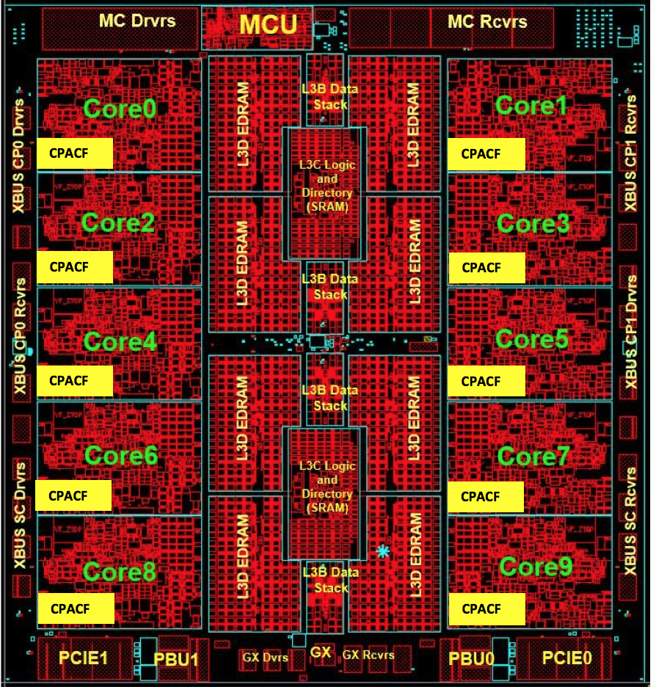
z14 Integrated Cryptographic Hardware
CP Assist for Cryptographic Functions (CPACF)
Hardware accelerated encryption on every microprocessor core
Performance improvements of up to 6x for selective encryption modes
Crypto Express6S
Next generation PCIe Hardware Security Module (HSM)
Performance improvements up to 2x
Industry leading FIPS 140-2 Level 4 Certification Design
Why is it valuable:
More performance = lower latency + less CPU overhead for encryption operations
Highest level of protection available for encryption keys
Industry exclusive “protected key” encryption

Slide 15
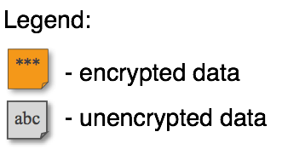


Data Protection // z/OS Dataset Encryption
z/OS 2.2 & 2.3
Protection of data at-rest
z/OS
DB2,IMS, zFS, etc...
abc
CPACF
Storage System
CF
***
SAN
***
Network
z/OS
z/OS
Client Value Proposition:
Reduced cost of encryption along with simple policy controls allows clients to enable extensive encryption to protect data in mission critical databases including DB2®, IMS™ and VSAM
z/OS Dataset Encryption:
Application transparent & enabled by policy
Encryption tied to fine grained access control
Host encryption via CPACF as data written-to or read-from disk.
Supports ext. format sequential & VSAM
Includes HSM & DSS migration/backup of encrypted data sets
Replicated data remains encrypted
Supports: CICS®, DB2, IMS, Logger, & zFS
In-memory system or application data
buffers will not be encrypted
LinuxONE/Linux on z
Notes:
Text from IBM z/OS Version 2 Release 2 enhancements and statements of direction
(IBM United States Software Announcement 216-392, dated October 4, 2016)
IBM plans to deliver application transparent, policy-controlled dataset encryption in IBM zTM/OS. IBM DB2 for z/OS and IBM Information Management System (IMS) intend to exploit z/OS dataset encryption.
As indicated above, IBM plans to support z/OS data set encryption for DB2, IMS and CICS (e.g. CICS VSAM) data, as well as sequential data (BSAM, QSAM) for batch workloads (see page 30 & 31 for more details).
Data sets must be extended format BSAM, QSAM or VSAM.

Slide 16

Data Protection // Coupling Facility Encryption
z/OS 2.3
Protection of data in-flight and in-use (CF)
z/OS
abc
XES
Storage System
CPACF
CPACF
CF
***
Network
SAN
***
CF
Client Value Proposition:
Simplify and reduce cost of compliance by removing CF and CF data from compliance scope (i.e. ability to encrypt all CF data)
CPACF
CPACF
End-to-End encryption of CF Data:
Host Protected key CPACF Encryption
(High Performance / Low Latency)
Data encrypted in the host and remains encrypted until decrypted by host
No application enablement required
List & Cache Structures only – No Lock!
z/OS
z/OS
z/OS Parallel Sysplex Cluster

Slide 17
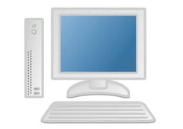
Data Protection // z/OS Network Security
z/OS 2.3
Protection of data in-flight
***
App A
abc
App B
COMM SERVER
abc
COMM SERVER
Storage System
***
CF
Network
SAN
Client Value Proposition:
Not all organizations use host-based network encryption today. Reduced cost of encryption enables broad use of network encryption and enhanced audit simplifies compliance.
z/OS
z/OS
Communication Server
z Encryption Readiness Technology (zERT):
A z/OS administrator can determine when network traffic meets specified policy with new discovery and reporting capabilities
Currently no single method to easily determine which application traffic patterns are protected
LinuxONE/Linux on z

Slide 18
Data Protection // Linux on z File Encryption
Submitted Upstream
Protection of data at-rest
Client Value Proposition:
Integration of hardware accelerated Crypto into standard components for wide reach into solutions
z/OS
z/OS
Storage System
CF
Network
SAN
***
z/OS
z/OS
Linux on z and LinuxONE
Focus on Transparent Enablement:
Transparent data encryption optimized with z14 CPACF hardware performance gains
Leverage industry-unique CPACF encryption which prevents raw key material from being visible to OS and applications.
***
LinuxONE/Linux on z
DB server
block device encryption
abc
CPACF
Status: dm-crypt enhancements for CPACF protected-key submitted upstream

Slide 19
Data Protection // Linux on z Network Security
Submitted Upstream
Protection of data in-flight
z/OS
z/OS
Storage System
***
Network
CF
SAN
z/OS
z/OS
Client Value Proposition:
Not organizations use host-based network encryption today… reduced cost of encryption enables broad use of network encryption
Linux on z and LinuxONE
Focus on Transparent Enablement:
Transparently accelerate TLS & IPSec using CPACF & SIMD to leverage hardware performance gains
LinuxONE/Linux on z
Open SSL,
Java,
or GSKIT
App
***
CPACF
abc
Status: dm-crypt enhancements for CPACF protected-key submitted upstream

Slide 20
Data Protection // Secure Service Container
Extending the value of Z hardware crypto
z/OS
z/OS
Storage System
Client Value Proposition:
Simplified, fast deployment and management of packaged solutions
Tamper protection during Appliance installation and runtime
Confidentiality of data and code running within the Appliance both at flight and at rest
Restricts administrator access to workload and data
Secure Service Container architecture builds on the value z systems hardware crypto using a runtime environment designed to help clients reduce risk.
Network
CF
SAN
LinuxONE / z Systems
z/OS
z/OS
LinuxONE™/ Z
Secure Service Container
Protected-key CPACF – key value not visible to OS or application

Slide 21
Data Protection // z/VM Encrypted Paging
z/VM 6.4
***
***
z/VM
z/VM
xyz
CPACF
def
CPACF
SSI
Encrypted Paging
Threat: access to sensitive data when stored on CP owned disk
Solution: encrypt guest data on page-out.
Notes:
Paging is not SSI-relevant
Paging data does not need to survive an IPL
Ephemeral CPACF protected-key stored in CP (not on disk somewhere)
AES encryption
Very low overhead via CPACF
z/VM
z/VM
abc
CPACF
***
z/VM Single System Image cluster
Client Value Proposition:
Protect guest paging data from administrators and/or users with access to volumes

Slide 22
Data Protection // z/TPF Transparent Database Encryption
z/TPF 1.1.0.13
Technical Foundation
z/TPF at-rest Data Encryption
  Automatic encryption of at-rest data
  No application changes required
  Database level encryption using highly efficient CPACF HW crypto
  Includes data on disk and cached in memory
  Optionally can include data integrity checking to detect accidental or malicious data corruption
Additional Information
  Data encrypted using AES CBC (128 or 256)
  Optional integrity checking uses SHA-256
  Includes tools to migrate an existing DB from unencrypted to encrypted state or change the encryption key/algorithm for a given DB while transactions are flowing (no DB downtime)
Support shipped August 2016
(APAR PI56476)
Client Value Proposition:
Transparent encryption of TPF database data plus reduced cost of encryption allows clients to enable extensive encryption of TPF data.

Slide 23
zSecure 2.3 Pervasive Encryption Support
Command Verifier: Command Verifier policy for DATAKEY
Admin: Easy administration DATAKEY on DFP segment
Audit: Report on non-VSAM and VSAM data sets key labels
  Extend existing report types DSN / SENSDSN
Audit: Report key protection CSFKEYS
  New report types ICSF_SYMKEY, ICSF_PUBKEY
Audit: Report which systems sharing DASD can decrypt ds
Audit: Extend report type SMF
  Type 14/15 non-VSAM and Type 62 VSAM keylabel use
  ICSF
  zERT records to show encryption strengths

Slide 24
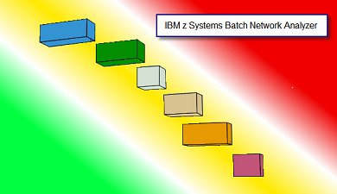
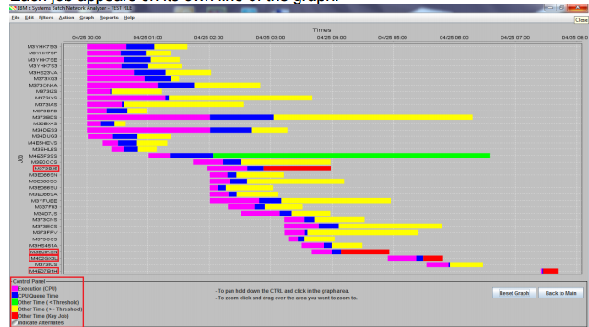
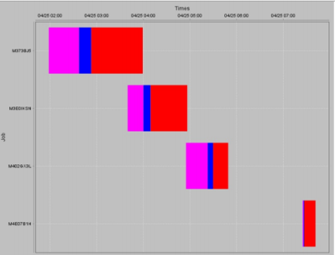
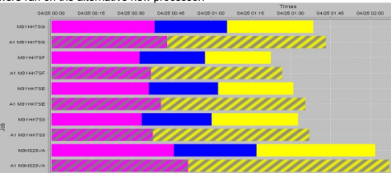
Estimating CPU Cost of Data Protection
z Batch Network Analyzer (zBNA)
Background:
A no charge, “as is” tool originally designed to analyze batch windows
PC based, and provides graphical and text reports
Available on techdocs for customers, business partners, and IBMers
http://www-03.ibm.com/support/techdocs/atsmastr.nsf/WebIndex/PRS5132
Previously enhanced for zEDC to identify & evaluate compression candidates
Encryption Enhancements:
zBNA will be further enhanced to help clients estimate encryption CPU overhead based on actual client workload SMF data
Ability to select z13 or z14 as target machine
Support will be provided for
  z/OS data set encryption
  Coupling Facility encryption

Slide 25
IBM Z pervasive encryption
Considerations

Slide 26
Multiple Layers of Encryption
Robust data protection
z14 CPACF Performance enables encryption at course scale
App
Encryption
hyper-sensitive data
Database Encryption
Provide protection for very sensitive in-use (DB level), in-flight & at-rest data
Full Disk and Tape Encryption
Provide 100% coverage for at-rest data with zero host CPU cost
File or Dataset Level Encryption
Provide broad coverage for sensitive data using encryption tied to access control for in-flight & at-rest data protection
Data protection & privacy provided and managed by the application… encryption of sensitive data when lower levels of encryption not available or suitable
Granular protection & privacy managed by database… selective encryption & granular key management control of sensitive data
Complexity & Security Control
Broad protection & privacy managed by OS… ability to eliminate storage admins from compliance scope
Protection against intrusion, tamper or removal of physical infrastructure
Coverage

Slide 27
Data Protection // Existing Disk Encryption
Protection of data at-rest
z/OS
abc
abc
Storage System
CF
Network
SAN
***
z/OS
z/OS
***
DS8000® Disk Encryption
Encrypting disk drives protect data at rest when disk drives are retired, sent for repair or repurposed
Once the key has been served to storage system any system connecting to storage system can retrieve unencrypted data
LinuxONE/Linux on z
xyz
xyz

Slide 28
Multiple layers of encryption for data at-rest
Robust data protection
App
Encryption
hyper-sensitive data
Database Encryption
Provide protection for very sensitive in-use (DB level), in-flight & at-rest data
Full Disk & Tape
Provide 100% coverage for in-flight & at-rest data with zero host CPU cost
File or Data Set Level Encryption
Provide broad coverage for sensitive data using encryption tied to access control for in-flight & at-rest data protection
Data protection & privacy provided and managed by the application… encryption of sensitive data when lower levels of encryption not available or suitable
Full Disk & Tape Encryption
Protects at the DASD subsystem level
All or nothing encryption
Only data at rest is encrypted
Single encryption key for everything
No application overhead
Zero host CPU cost
Prevents exposures on: Disk removal, Box removal, File removal
Granular protection & privacy managed by database… selective encryption & granular key management control of sensitive data
Broad protection & privacy managed by OS… ability to eliminate storage admins from compliance scope
Full Disk and Tape Encryption
Provide 100% coverage for at-rest data with zero host CPU cost
Protection against intrusion, tamper or removal of physical infrastructure
Protection against intrusion, tamper or removal of physical infrastructure
Coverage

Slide 29
Multiple layers of encryption for data at-rest
Robust data protection
App
Encryption
hyper-sensitive data
Database Encryption
Provide protection for very sensitive in-use (DB level), in-flight & at-rest data
Full Disk & Tape
Provide 100% coverage for in-flight & at-rest data with zero host CPU cost
File or Data Set Level Encryption
Provide broad coverage for sensitive data using encryption tied to access control for in-flight & at-rest data protection
Data protection & privacy provided and managed by the application… encryption of sensitive data when lower levels of encryption not available or suitable
z/OS Data Set Encryption
Enabled by policy
Transparent to applications
Tied to access control
Uses protected encryption keys managed by the host
Granular protection & privacy managed by database… selective encryption & granular key management control of sensitive data
Complexity & Security Control
File or Data Set Level Encryption
Provide broad coverage for sensitive data using encryption tied to access control for in-flight & at-rest data protection
Broad protection & privacy managed by OS… ability to eliminate storage admins from compliance scope
Broad protection & privacy managed by OS… ability to eliminate storage admins from compliance scope
Protection against intrusion, tamper or removal of physical infrastructure
Broadly encrypt data at rest
Covers VSAM, DB2, IMS, Middleware, Logs, Batch, & ISV solutions¹
Encrypt in bulk for low-overhead
Utilizes IBM z Systems integrated cryptographic hardware
Applications or middleware making use of VSAM,
QSAM, BSAM access methods. Refer to individual ISV documentation to confirm support of z/OS data set encryption.
Coverage

Slide 30
Multiple layers of encryption for data at-rest
Robust data protection
App
Encryption
hyper-sensitive data
Database Encryption
Provide protection for very sensitive in-use (DB level), in-flight & at-rest data
Full Disk & Tape
Provide 100% coverage for in-flight & at-rest data with zero host CPU cost
File or Dataset Level Encryption
Provide broad coverage for sensitive data using encryption tied to access control for in-flight & at-rest data protection
Data protection & privacy provided and managed by the application… encryption of sensitive data when lower levels of encryption not available or suitable
IBM Security Guardium Data Encryption for DB2 and IMS Databases
Database Encryption
Provide protection for very sensitive in- use (DB level), in-flight & at-rest data
Granular protection & privacy managed by database… selective encryption & granular key management control of sensitive data
Broad protection & privacy managed by OS… ability to eliminate storage admins from compliance scope
Encrypts sensitive data at the DB2 row and column levels and IMS segment level
Transparent to applications
Separation of Duties (SOD) and granular access control
Protects Data-In-Use within memory buffers
Clear text data cannot be accessed outside DBMS access methods
Persists the encrypted sensitive data in logs, image copy data sets, DASD volume backups
Utilizes IBM z Systems integrated cryptographic hardware
Protection against intrusion, tamper or removal of physical infrastructure
Coverage

Slide 31
Multiple layers of encryption for data at-rest
Robust data protection
App
Encryption
hyper-sensitive data
App
Encryption
hyper-sensitive data
Database Encryption
Provide protection for very sensitive in-use (DB level), in-flight & at-rest data
Full Disk & Tape
Provide 100% coverage for in-flight & at-rest data with zero host CPU cost
File or Data Set Level Encryption
Provide broad coverage for sensitive data using encryption tied to access control for in-flight & at-rest data protection
Data protection & privacy provided and managed by the application… encryption of sensitive data when lower levels of encryption not available or suitable
Data protection & privacy provided and managed by the application… encryption of sensitive data when lower levels of encryption not available or suitable
Application Encryption
Granular protection & privacy managed by database… selective encryption & granular key management control of sensitive data
Requires changes to applications to implement and maintain
Highly granular
Protect data right up to the point where it will be used
Applications must be responsible for key management
Appropriate for selective encryption of hyper-sensitive data
Broad protection & privacy managed by OS… ability to eliminate storage admins from compliance scope
Protection against intrusion, tamper or removal of physical infrastructure
Coverage

Slide 32
Compression and Encryption
+
Encrypted data does not compress!
Any compression downstream from encryption
will be ineffective
Where possible compress first, and then encrypt
z/OS data set encryption
DFSMS™ will compress first (generic, tailored, enhanced, and zEDC) then encrypt
Data sets will remain encrypted during HSM and DSS migration and backup processing
Data sets will remain encrypted during hardware based data replication services
zEDC is expected to significantly reduce the CPU cost of encryption
Great compression ratios (5X or more for most files)
Less data to encrypt means lower encryption costs
Compressed data sets use large block size for IO (57K)
Applicable to QSAM, and BSAM access methods

Slide 33
z/OS data set encryption – High Level Steps
1
2
3
4
Generate an encryption key and key label, store it in the CKDS .
Setup for use of key label in RACF®.
Associate the key label with the desired data set(s).
Migrate to encrypted data
Allow secure key to be used as protected key
via ICSF segment
SYMCPACFWRAP
SYMCPACFRET
DB2:
Online Reorg
In RACF, alter DFP segment in data set profile - DATAKEY()
Non-disruptive
IMS HA Database:
Online Reorg
Non-disruptive
– OR –
– AND –
zFS Container:
zfsadmin encrypt
In DFSMS, assign to data class
Non-disruptive
Grant access to key label
VSAM or Seq data set:
Stop application
Copy data
Restart application

Slide 34
CF Data Encryption – High Level Steps
Run the policy utility (IXCMIAPU) to define a CFRM policy and specify ENCRYPT(YES) for the structures to be encrypted
SETXCF START the policy
SETXCF REALLOCATE to get structures encrypted
D XCF,STR to see current encryption state of a structure
SETXCF MODIFY,STRNAME=strname,ENCRYPTKEY to change encryption key for selected structure(s) defined in the active CFRM policy

Slide 35
Naming Conventions & Granular Access Control
Leveraging naming conventions & z Security to enforce separation across application instances
Naming conventions can be used to segment applications, data, and keys, e.g.
  Environment: PROD, QA, TEST, DEV
  Application: App1, App2,…, AppN
  Data-Type: Account, Payroll, Log
Recommend use of version # to support key rotation
  Version: Ver1, Ver2,…,VerX
Application resources (data sets, encryption keys) can be assigned names based on naming conventions, e.g.
  PROD.APP2.LOG.VER10
  PROD.APP1.PAYROLL.KEY.VER7
Security rules can be used to enforce separation with granular access control for application resources and encryption keys
PROD
MK_{PROD}
App1
AppN
Data1
PROD.App1.Data1.VerX
DataN
PROD.AppN.DataN.VerX
Data2
App2
PROD.App2.Data2.VerX
PROD CKDS
PROD.App1.Data1.VerX
PROD.App2.Data2.VerX
PROD.AppN.DataN.VerX
***
***
***

Slide 36
Enterprise Key Management Considerations
Encryption of data at enterprise scale requires robust key management
The current key management landscape can be characterized by clients who have …
… already deployed an enterprise key management solution
… developed a self-built key management solution
… not deployed an enterprise key management solution
Key management for pervasive encryption must provide …
Policy based key generation
Policy based key rotation
Key usage tracking
Key backup & recovery
The IBM Enterprise Key Management Foundation (EKMF) provides real-time, centralized secure management of keys and certificates in an enterprise with a variety of cryptographic devices and key stores.
EKMF

Slide 37

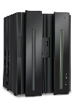
IBM Key Management Landscape…
ICSF
Provides secure key storage with HSM protected keys (CKDS, PKDS, TKDS)
Integrated with High Availability and Disaster Recovery Solutions
Basic key administration primitives
New ICSF CKDS Browser (HCR77C1)
ISKLM - IBM Security Key Lifecycle Manager
Primarily used for serving keys to storage devices (e.g. disk, tape)
Supports IBM Proprietary Protocol (IPP) and OASIS Key
Management Interoperability Protocol (KMIP)
Available on z and distributed platforms
Limited ability to manage keys in z Systems hardware key stores
EKMF – IBM Enterprise Key Management Foundation
Geared toward Banks, payment processors and other financial services
Provides Multi-platform, multi-site & multivendor support key management
Rich integration with Z hardware cryptography and key stores
Robust backup and recovery capabilities
Supports proprietary protocol for key distribution
Delivered as a services offering

Slide 38

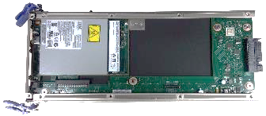
High Availability Key Management Considerations
ICSF Parallel Sysplex Enablement
EP-11 MK
EP-11 MK
z/OS ICSF can provide a Single System Image view by allowing key stores to be shared by all members of the sysplex.
Enabled via SYSPLEXCKDS(YES), SYSPLEXPKDS, SYSPLEXTKDS
Wrapped keys cached in-memory for fast access.
Updates are automatically propagated across the sysplex (via signaling) to maintain cache coherency.
Key store management operations are coordinated across the sysplex
Same Master Key must be loaded into all HSMs
HSM
Master Key
HSM
Master Key
EP-11 MK
EP-11 MK
HSM
Master Key
HSM
Master Key
Shared ICSF Key Store
MK VP
  DES
  AES
  RSA
  ECC
Record
  Label
  Token

Slide 39
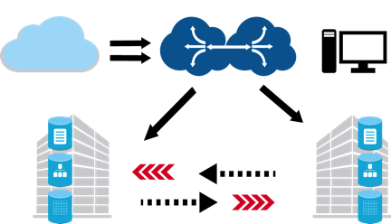

Disaster Recovery Key Management Considerations
Replication of Cryptographic Key Material for Multi-Site DR Solutions
Configure and maintain both sites to run the same cryptographic workload
Replicated copies of encrypted z/OS data sets will also be encrypted/protected.
Replicate cryptographic coprocessor configurations across both sites:
  Master Keys, access control points, etc…
  Done at initial setup & periodic MK change
  Can be simplified with TKE domain groups
Replicate cryptographic key material across both sites:
  Define ICSF Key Store datasets on replicated volumes
CKDS
PKDS
TKDS
CKDS
PKDS
TKDS
Supports Multi-site Disaster Recovery Solutions. e.g. GDPS PPRC, XRC, GM, MGM, etc...

Slide 40
Protecting data at the core of the enterprise
Encryption is the solid foundation of a layered cybersecurity strategy
Privileged Identity Management
Traditional workloads and APIs:
DB2
IMS
CICS / VSAM
MQ
Access Management
Multi-factor Authentication
Federated Identity
Identity Governance
Sensitive
Data Protection
Integrated Security Intelligence
Key Security Solutions:
IBM Security zSecure™ Suite
IBM Security Qradar®
IBM Security Guardium® Family
IBM Multi-factor Authentication
IBM Security Identity Governance
Enterprise Key Management
Encryption
Data Activity Monitoring
Access Management
Key Management
SIEM
Security Intelligence
User Behavior Analytics
Audit and Reporting

Slide 41
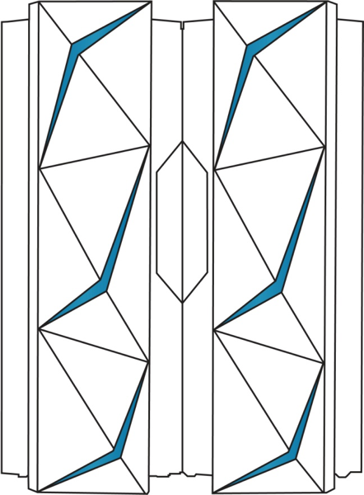
IBM z14: Designed for Trusted Digital Experiences
Pervasive Encryption is the new standard
Analytics & Machine Learning for Continuous Intelligence Across the Enterprise
Open Enterprise Cloud to Extend, Connect
and Innovate
Container Pricing For IBM Z provides new flexibility for modern digital workloads

Slide 42
IBM Z pervasive encryption
Backup - Use Cases

Slide 43

Encrypt data in core business applications
582.9M
Ensure that sensitive customer data in more than CICS / VSAM applications processing thousands of transactions per second is protected in order to meet compliance requirements.
Data records were compromised in 2015, including nearly 20M financial records.
TODAY
Organizations in this situation must implement encryption within their applications
Application changes are costly, complex, and require significant ongoing maintenance
WITH z14
Encrypt application data without making any application changes and no impact to SLAs
Implement a defense-in -depth encryption strategy for a multi-layered threat defense
“We know we need to encrypt this,
…but we can’t.”
“We don’t want to do this,
…but don’t have a choice”
“Can you get it to us sooner? Can you make it happen sooner?”
“As soon as the code is available, we want it”
User
Feedback

Slide 44
Protect unstructured data objects
4%
Large unstructured data objects that are stored in databases, such as policy documents, billing statements, and medical records in PDF or image format, contain sensitive data.
Out of the 9 billion records breached since 2013, only 4% were encrypted.
TODAY
The company is held responsible for protecting ALL customer data
There are many documents with sensitive customer data that reside as objects within the database and there is no way to encrypt them today.
WITH z14
Binary large objects can be protected through full database encryption, without any application changes or add-on products
Easy to set up and maintain
“We recognize this is sensitive, but there are limitations to our technology…”
“We’re excited to finally be reducing this risk.”
User
Feedback

Slide 45


Protect Archived Transactional Logs
Historical financial transactional logs contain sensitive information that must be protected, and must be retained for long periods of time for research and compliance purposes.
48%
of financial institutions are putting more sensitive data in the cloud
TODAY
Historical logs are accessed infrequently and should reside on lower cost cloud storage
Gaps in current encryption via cloud storage solutions has gaps, does not protect data end-to-end, and introduces additional complexities with management of encryption keys
WITH z14
z/OS data set encryption, z/OS storage automation, and Transparent Cloud Tiering provide the ability to automatically transfer and encrypt data end-to-end in the cloud
Encryption is centrally managed and controlled by the z Systems host, reducing the risk
“We generate a lot of log files that we have to store each year…”
“That would be perfect. That’s what we would like to be able to do.”
User
Feedback

Slide 46
Reduce the threat from within
58%
Ensure that that only the people with a need-to-know within the organization have access to data in the clear, while still allowing those who don’t to do their jobs efficiently and effectively.
Of security attacks on financial institutions in 2016 were insider attacks.
TODAY
Organizations have a priority to limit the number of users with access to data in the clear
The fear of insider threat, either malicious or inadvertent, is a driving force and so is the need to simplify compliance.
WITH z14
z14 enables encryption by policy tied to access control
Separate access control to data sets and encryption keys providing separation of duties — eliminate entire classes of users from compliance scope
“We have to track all our DBA activity to make sure they’re not doing what they don’t need to be doing.”
“You covered my storage guys—that was important.”
User
Feedback

Slide 47

Meet audit and compliance obligations
$4M
Comply with numerous Financial Services Sector regulations and endure relentless inspection and audit from internal auditors, external auditors, and clients.
Average cost of a data breach in 2016
TODAY
Organizations are faced with multiple audits per year - internal, external, client…a state of near continuous audit
WITH z14
With Pervasive Encryption, organizations no longer have to encrypt only data for compliance, and can encrypt all application/database data
z14 provides solutions for both application teams and auditors to verify up-to-date compliance stats in near real-time
“Increasing rules from inside and outside is our biggest security concern for the next 5 years.”
User
Feedback
“It’s simple to demonstrate compliance, and we know what’s coming well before the audit happens.”

Slide 48
IBM Z pervasive encryption
Backup - Software Rollout

Slide 49
z/OS Data Set Encryption
Hardware and Operating System Support
Product/Feature | Required Level | Description
Hardware
Minimum HW | z196 CPACF | Minimum HW for AES-XTS (MSA-4)
 | Crypto Express3 | Minimum HW for Secure-key/Protected-key CPACF¹
Recommended HW | z14 CPACF | AES-XTS CPACF performance improvements
 | z14 Crypto Express6s | Crypto express performance improvements
Operating System – Base Support
DFSMS | z/OS 2.3 | Full support
 | z/OS 2.2 + OA50569 PTFs
 | z/OS 2.1 + OA50569 PTFs | Toleration only –read/write, cannot create encrypted data sets.
RACF | z/OS 2.3 | DFP segment key label and conditional access checking
 | z/OS 2.1, 2.2 + OA50512 PTFs
ICSF | HCR77C0 or HCR77C1 | Protected-Key Read
 | HCR77A0–B1 + OA50450 PTFs
¹ – Secure-key is STRONGLY RECOMMENDED for production environments. Clear-key may be used for dev/test.

Slide 50
z/OS Data Set Encryption
Exploitation
Product/Feature | Required Level | Description
Software Exploitation
DB2 | DB2 v12 + PTFs | Base exploitation + user interface enablement
 | DB2 v11 + PTFs | Base exploitation
IMS | IMS v14 | FF VSAM DB & OLDS - test only no code changes expected
 | IMS v15 | FP DEDB VSAM & WADS enablement support
CICS | Supported CICS versions | Test-only for user, CICS TS, and TD data sets
MQ | NA | Recommendation for MQ - Advanced Message Security
zSecure | zSecure 2.3 | zSecure Audit & Admin support for z/OS data set encryption
zBNA | zBNA x.y.z | zBatch Network Analyzer support for z/OS data set encryption
z/OS Exploitation
zFS | z/OS 2.1 & 2.2 | Toleration support
 | z/OS 2.3 | User Interface & data conversion support
System Logger | z/OS 2.3 w/RB 2.2 & 2.1 | Media Manager enablement for logger data sets

Slide 51
CF Encryption
Hardware and Operating System Support
Product/Feature | Required Level | Description
Hardware
z/OS: Minimum HW | zEC12 | Minimum supported for z/OS 2.3
 | Crypto Express3 | Required for Protected-key CPACF
z/OS: Recommended HW | z14 CPACF | AES-CBC CPACF performance improvements
CF: Recommended HW | z14 CF | Simplified recovery for specific sysplex-wide recovery scenarios
Operating System – Base Support
z/OS | z/OS 2.3 | z/OS support for CF encryption
Exploitation
zSecure | zSecure 2.3 | zSecure Audit support for CF encryption
zBNA | zBNA x.y.z | zBatch Network Analyzer support for CF encryption

Slide 52
z/OS Communications Server
Hardware and Operating System Support
Product/Feature | Required Level | Description
Hardware
Recommended HW | z14 CPACF | AES-GCM CPACF performance improvements
Operating System – Base Support
z/OS Comm Server | z/OS 2.3 | Provides zERT function
z/OS Exploitation
System SSL | z/OS 2.3 | zERT-enabled cryptographic protocol provider
OpenSSH | z/OS 2.3 | zERT-enabled cryptographic protocol provider
Software Exploitation
Connect:Direct | z/OS 2.3 + PTFs | Exploits SIOCSHSNOTIFY ioctl
zSecure | TBD | Working with zSecure to be a consumer of zERT SMF records
ISV Support
ISVs | As required by ISV | ISV enablement/compatibility support

Slide 53
Thank you
Nick Sardino
IBM Z Offering Management
Michael Jordan
IBM Distinguished Engineer, IBM Z Security
ZSP04731USEN-00

