Slide 1

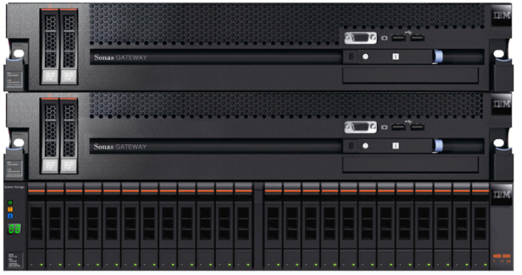

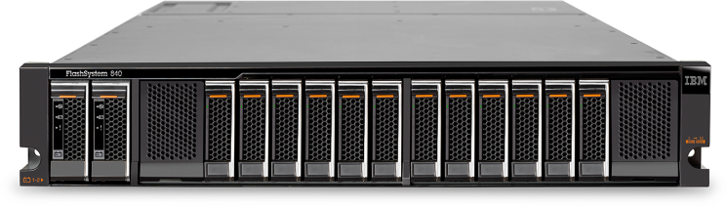
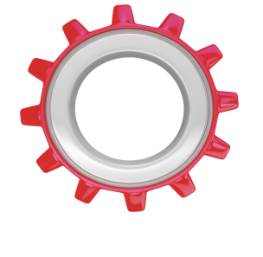
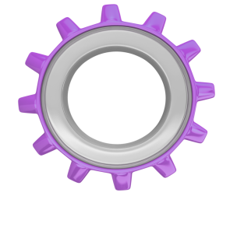

Effective file management with IBM® FlashSystem™ and IBM® Storwize® V7000 Unified
Extreme Performance
with
Unified File & Block Access
Why IBM FlashSystem with IBM Storwize V7000U
Provides greater flexibility for provisioning of storage resources and improves overall capacity utilization
Unified console simplifies storage administration with a single user interface and common CLI
Enables deployment of a broad set of applications from within a single storage system, especially in shared storage environments
Performance Acceleration of Major File Applications
IBM Storwize V7000U
V7000 Unified
V7000 Unified
IBM Storwize V7000U
IBM FlashSystem 840
IBM Storwize V7000U is an enterprise-class storage systems that provides the foundation for implementing an effective storage infrastructure.
Fully integrated user interface for block & file data simplifies management
Enterprise feature capabilities such as Thin Provisioning, Easy Tier®, and Real-time Compression™
                Active Cloud Engine - technology delivers automated storage efficiency capabilities
                Built-in IBM Tivoli Storage Manager client simplifies backup to TSM server
EFFICIENT
Maximize
Data Storage
EASY
NOW File protocol (NFS/CIFS) Access for FlashSystem Storage
IT Admin
Optimized
DEPENDABLE
24x7
Delivery
          IBM FlashSystem adds Extreme Performance with IBM MicroLatency™, Macro Efficiency, and Enterprise Reliability to your File System infrastructure through IBM Storewize V7000 Unified
For more information visit http://www-03.ibm.com/systems/storage/flash/840/ or http://www-03.ibm.com/systems/storage/flash/ecosystem/

