Slide 1
IBM X-Force Red security testing services
Boost your offense with a global team of security testing specialists
November 7, 2016
Notes:
Author notes: <please delete these instructions before presenting>
This is the IBM Security Default Template for both internal and external use. It’s aspect ratio is 4:3 and measures 10 x 7.5”. This template was created in Microsoft PowerPoint 365 Pro Plus 2016.
Template files (saved with the file extension .potx) contain slide designs and customized layouts and are stored in your Microsoft templates folder*
To save your new template as your default template for future use:
Click “File / Save as” and choose “PowerPoint template (.potx) from the pull down menu”
Rename file to, “Blank.potx” and click “Save” (file will then be stored to the default template location)
Themes provide a complete slide design that can be applied to your existing presentation, including background designs, font styles, colors, and layouts
To save your new template’s theme file; click “View / Slide Master / Themes”
On the Themes pull down menu, select, “Save Current Theme”
This new Theme file is how you apply the new template design to your existing presentations
For more information, visit: Office.com / PowerPoint / Support
Copy your existing source slides in slide sorter view
Paste special by right-clicking in slide sorter view of destination file or template
Select “Keep source formatting”
This helps to ensure your slides retain their existing styles
Each slide needs to be adjusted by doing the following in “Normal view”
Select body content except title and footer by (Control “A”; then select title and footers while holding shift key)
Cut remaining selected body content (Control “X”)
Reset slide layout using new template layouts
Paste slide content back onto slide (Control “V”)
Learn more about using templates, visit: Office.com / PowerPoint / Support

Slide 2
Multiple drivers increase the need for security
Advanced attacks
Innovation
Skills gap
Human error
Compliance
Notes:
Advanced Attacks – more advanced than ever, >80% in cyber gangs, global business that accounts for $400B+ a year.
Source: http://www.mcafee.com/us/resources/reports/rp-economic-impact-cybercrime2.pdf
Human error – More than half of data breaches are caused by insiders, including employees, third-party contractors and partners. Source: http://www-03.ibm.com/security/data-breach/2015-cyber-security-index.html?ce=ISM0484&ct=SWG&cmp=IBMSocial&cm=h&cr=Security&ccy=US
Innovation – cloud, mobile, and IOT create unprecedented risks to organizations. 44% of security leaders expect a major cloud provider to suffer a significant security breach in the future. 33% of organizations don’t even test their mobile apps. CISCO estimates that by 2020, there’ll be 50 billion devices connected.
Sources: https://www-03.ibm.com/press/us/en/pressrelease/45326.wss; https://securityintelligence.com/mobile-insecurity/; http://blogs.cisco.com/diversity/the-internet-of-things-infographic
Compliance – adapting to a threat-aware, risk based approach vs. compliance based, box checking approach. In August 2015 a federal court ruled that the Federal Trade Commission (FTC) has the authority to take action against organizations that fail to protect consumer information against cyber attacks. The court’s ruling should lead to greater scrutiny of corporate cyber security following a breach of personal privileged information.
Source: http://www.pcworld.com/article/2974771/appeals-court-denies-challenge-to-ftcs-cybersecurity-enforcement.html
The Federal Communications Commission (FCC) reached a $25 million settlement with AT&T Services over allegations the phone carrier failed to protect the personal data of hundreds of thousands of customers whose personal information was compromised in a data breach that occurred between November 2013 and April 2014. Source: http://topclassactions.com/lawsuit-settlements/lawsuit-news/53582-att-to-pay-25m-in-data-breach-settlement-with-fcc/
Skills gap - experts predict a shortage of 1.5 million open and unfilled security positions by 2020. Source: Frost & Sullivan Report, 2015
More than 209,000 cybersecurity jobs in the U.S. are unfilled, and postings are up 74% over the past five years, according to a 2015 analysis of numbers from the Bureau of Labor Statistics by Peninsula Press, a project of the Stanford University Journalism Program.
Source: http://www.forbes.com/sites/stevemorgan/2016/01/02/one-million-cybersecurity-job-openings-in-2016/#683b25157d27

Slide 3
The impact of attacks is big—and getting bigger
The latest research shows that:
Malicious attacks against corporate assets are on the rise
64 percent more security incidents were reported in 2015 than in 2014¹
Computer crime will become a 2.1 trillion dollar problem by 2019²
It takes companies an average of 229 days to detect advanced persistent threats³
1 IBM Security, “2016 Cyber Security Intelligence Index,” 2016.
2 James Moar, “The Future of Cybercrime & Security,” Juniper, December 5, 2015.
3 Ponemon Institute, “2016 Cost of Data Breach Study: Global Analysis,” June 2016.
Notes:
1 http://www-03.ibm.com/security/data-breach/cyber-security-index.html
2 https://www.juniperresearch.com/researchstore/strategy-competition/cybercrime-security/financial-corporate-threats-mitigation
3 https://www-01.ibm.com/marketing/iwm/dre/signup?source=mrs-form-1995&S_PKG=ov49542

Slide 4
The need for new approaches is undeniable
85
45
1.5
¹
MILLION unfilled security positions by 2020²
security tools from
vendors – hard to
manage effectively
68
PERCENT of CEOs are reluctant to share incident information externally³
1 IBM customer experience.
2 Michael Suby et al, “The 2015 (ISC)2 Global Information Security Workforce Study,” Frost & Sullivan, April 2015.
3 IBM Institute for Business Value, “Securing the C-suite Cybersecurity perspectives from the boardroom and C-suite,” IBM Corp., February 2016.
Notes:
1 IBM customer experience.
2 Michael Suby et al, “The 2015 (ISC)2 Global Information Security Workforce Study,” Frost & Sullivan, April 2015. https://www.isc2cares.org/uploadedFiles/wwwisc2caresorg/Content/GISWS/FrostSullivan-(ISC)²-Global-Information-Security-Workforce-Study-2015.pdf
3 IBM Institute for Business Value, “Securing the C-suite Cybersecurity perspectives from the boardroom and C-suite,” IBM Corp., February 2016. https://www-01.ibm.com/marketing/iwm/dre/signup?source=ibm-WW_Security_Services&S_PKG=ov43890&S_TACT=000000NJ&S_OFF_CD=10000252&ce=ISM0484&ct=SWG&cmp=IBMSocial&cm=h&cr=Security&ccy=US

Slide 5
Penetration testing is a key tool for improving security
An effective penetration testing program:
Is robust enough to test any technology, anywhere, at any time
Utilizes expert-level manual testing and automated, tools-based testing in the proper combination
Leverages vulnerability analytics to help isolate risks
Is agile enough to meet on-demand testing requirements
Provides an alternative to time-intensive and error-prone scoping activities

Slide 6
Introducing comprehensive testing services: IBM X-Force Red
Announced at Black Hat 2016, IBM® X-Force® Red is:
A global organization of elite security testing specialists
A purpose-built provider of flexible, agile and proactive security testing services
A team of industry leaders equipped to help uncover vulnerabilities before criminals do

Slide 7
IBM X-Force Red Security testing across four disciplines
Application testing, including:
Manual penetration testing
Code review and vulnerability assessments of all platforms:
Web
Mobile
Client-server
Terminal
Mainframe
Middleware
Network testing, including:
Manual penetration tests
Vulnerability assessments of all networks:
Internal
External
Wi-Fi and other radio frequencies
Supervisory control and data acquisition (SCADA)
Hardware testing, including:
Internet of Things (IoT)
Wearable devices
Point-of-sale (POS) and self-checkout
Self-service banking (ATMs)
Automotive, video, other systems
Human testing, including
simulations of:
Phishing campaigns
Social engineering
Ransomware
Physical security violations

Slide 8
Taming huge volumes of vulnerability data
Vulnerability analytics can improve the efficiency and impact of security testing by:
Extracting value from otherwise overwhelming volumes of vulnerability data
Analyzing all types of vulnerability data, regardless of the source
Helping identify and map risks
Prioritizing and tracking testing efforts

Slide 9
Providing flexible consumption models
Project services, allowing organizations to:
Purchase tests individually
Meet isolated or “one-off” testing requirements
Subscription services, allowing organizations to:
Dedicate a set of funds for testing over a period of 12 to 36 months, or longer
Enable on-demand security testing by eliminating administrative overhead
Pre-allocate testing funds without first having to define test targets or even test types
Meet dynamic testing requirements
Call on IBM X-Force Red expertise as needed, without the cost of keeping a team on staff
Managed services, allowing organizations to:
Have a dedicated IBM X-Force Red consultant execute your security testing program
Leverage that consultant for decision-making and governance
Get expert help in identifying test targets, prioritizing tests and selecting the appropriate testing level
Ensure tracking and coordination of remediation efforts
Better enforce security policies
For all services, simple scoping allows organizations to:
Replace cumbersome input questionnaires with standardized scoping
Accelerate the engagement process
Better predict security testing costs

Slide 10
Why IBM X-Force Red?
IBM X-Force Red provides:
A flexible, customizable security testing program
Global security specialists
The industry-leading ability to test any technology
A combination of economic, tools-based scanning with essential manual testing
Rapid test scheduling
More control over security spending
An agile testing methodology to complement today’s agile development environments

Slide 11
Why IBM Security?

Slide 12
An integrated and intelligent security immune system
Indicators of compromise
Security Ecosystem
IP reputation
Threat sharing
Endpoint patching and management
Threat Intelligence
Incident and threat management
Firewalls
Antivirus
Endpoint
Network
Sandboxing
Malware protection
Virtual patching
Network visibility
Log, flow, data analysis
Anomaly detection
Transaction protection
Vulnerability management
Incident response
Fraud protection
Device Management
Mobile
Security Analytics
Advanced Fraud
Criminal detection
Content security
Data monitoring
Data and Apps
Identity and Access
Privileged identity management
Data access control
Entitlements and roles
Application scanning
Cloud
Access management
Application security management
Cloud access security broker
Workload protection
Identity management
Notes:
Let’s think about a security portfolio in a more organized fashion, structured around domains, with core discipline of security intelligence in the middle to make sense of threats using logs, data, threats, flows, packets, etc.
It’s not integrated until they start talking to each, sending the important info across the environment to make sense of threats. And you start to see the Immune system metaphor. Different organs as your layers of defense, working together, interconnected points to automate policies and block threats. When you get a cold or virus, these are the organs that understand the virus and send data up through your central nervous system (security intelligence) to create white blood cells / antibodies to gather info, prioritize and take actions. This is what’s called the “Immune Response”.
And it’s not fully integrated until you sit on top of a partner ecosystem that allows collaboration across companies and competitors, to understand global threats and data, and adapt to new threats.
Integration can help increase visibility. Notice how capabilities organize around their domains. You’ll start to get an idea of how this immune system works. Like a body fighting a virus, there are different parts of a security portfolio working at once…
And it’s not a complete immune system until these domain capabilities can interact, communicate, and integrate with one another across your hybrid IT environments; Extending beyond your organizations walls across your entire ecosystem.

Slide 13
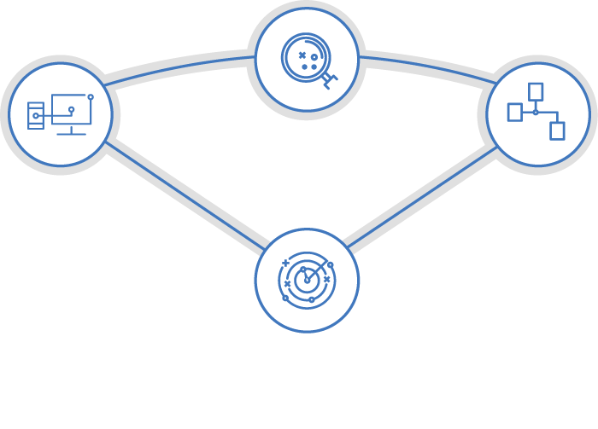
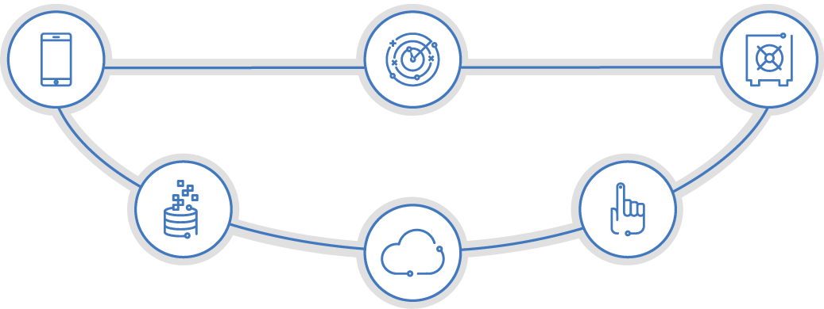
A portfolio designed to meet customer needs
X-Force Exchange
Security Ecosystem
Threat Intelligence
BigFix
Network Protection XGS
App Exchange
Endpoint
Network
QRadar Incident Forensics
SECURITY OPERATIONS AND RESPONSE
QRadar SIEM
QRadar Risk Manager
QRadar Vulnerability Manager
Resilient Incident Response
Trusteer Pinpoint
MaaS360
Mobile
Security Analytics
Advanced Fraud
Trusteer Mobile
Trusteer Rapport
INFORMATION RISK AND PROTECTION
Guardium
Data and Apps
Identity and Access
Identity Governance and Access
Key Manager
Privileged Identity Manager
AppScan
Cloud
Cloud Identity Service
Cloud Security Enforcer
zSecure
SECURITY TRANSFORMATION SERVICES
Management consulting | Systems integration | Managed security
Notes:
IBM offers a rich portfolio of products and services that are organized into three domains that uniquely address client needs. First is the Security Operations and Response domain that helps organizations orchestrate their defenses throughout the attack lifecycle, The second is the Information Risk and Protection domain that helps organizations protect their most critical information and risks. And the third is the Security Transformation Services which help organizations transform their security program. All of the IBM Security offerings are backed by an extensive business partner ecosystem which consists of industry-leading technology, sales and service partners.
Security Operations and Response:
IBM BigFix: Find, fix, and secure endpoint threats and vulnerabilities
IBM Security Network Protection: Prevent network exploits and limit malware communications
IBM QRadar Security Intelligence: Use advanced analytics to discover and eliminate threats
IBM Resilient Incident Response Platform: Generate response playbooks and coordinate activity
IBM X-Force Exchange: Automatically update incident artifacts with threat intelligence
IBM Security Services: Deliver operations consulting to help implement processes and response experts when something goes wrong
Information Risk and Protection:
IBM Cloud Security: Deliver visibility, control and protection of cloud apps
IBM MaaS360: Mobile productivity and enterprise security without compromise
IBM Identity Governance and Access Management: Govern and enforce context-based access to critical assets
IBM Guardium: Protect crown jewels across the enterprise and cloud
IBM AppScan: Scan and remediate vulnerabilities in modern applications
IBM Trusteer: Stop financial and phishing fraud, and account takeovers
IBM Security Services: Deliver governance, risk and compliance consulting, systems integration and managed security services
Security Transformation Services:
Security Strategy, Risk and Compliance: Automate governance, risk and compliance programs
Security Intelligence and Operations: Build security operations and security fusion centers
Cyber Security Assessment and Response: Establish robust security testing and incident management programs
Identity Governance and Management: Modernize identity and access management for the cloud and mobile era
Data and Application Security: Deploy robust critical data protection programs
Infrastructure and Endpoint Security: Redefine infrastructure and endpoint solutions with secure software-defined networks

Slide 14
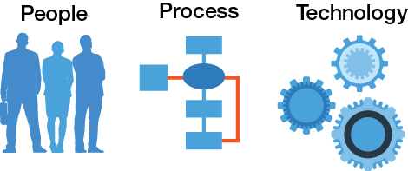
IBM Security Transformation Services
Unparalleled expertise
Best-in-class managed security services
Integrated approach
Access to a global network of skilled industry experts
Deep industry service delivery experience across numerous types of operations
Ability to lead and execute large, transformational projects
IBM X-Force Exchange and Threat Research teams providing zero-day threat alerts to clients
More than 1,400 employees serving 130+ countries, with a 95 percent retention rate
35 billion security events analyzed daily across 4,500+ global clients
Integrated portfolio of security services and technology
Open ecosystem with 100+ technology partners and 30+ services partners
800+ technical vendor and 150+ professional security certifications

Slide 15
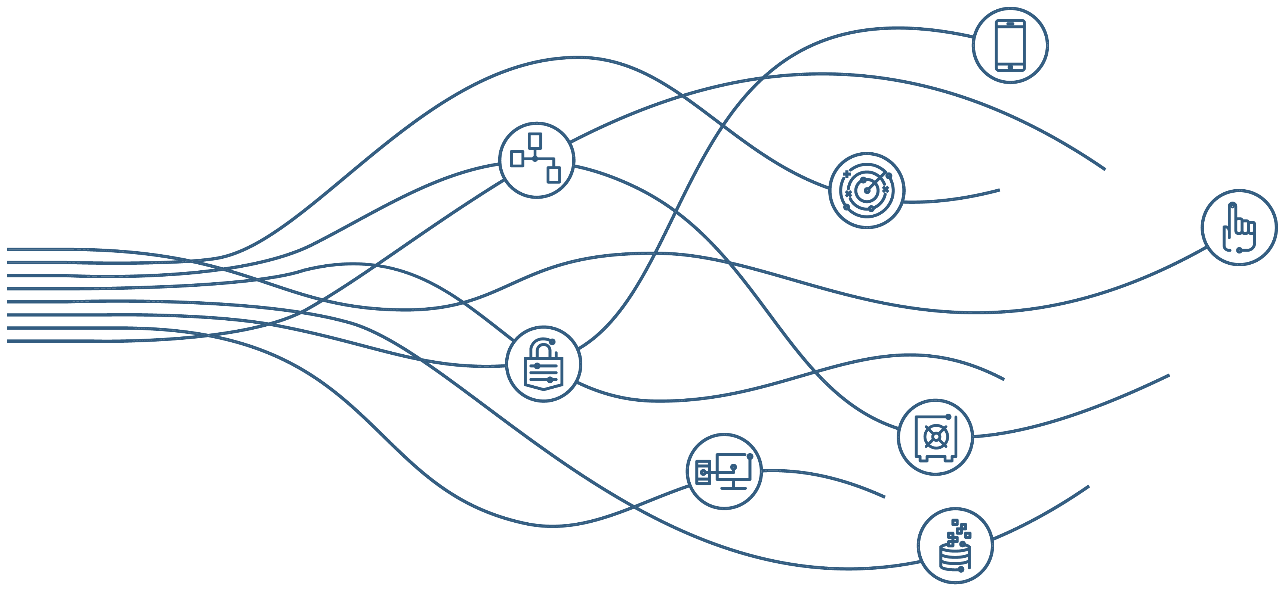
A Global Leader in network innovation
#1 in enterprise security software and services¹
7,500+ people
12,000+ customers
133 countries
3,500+ security patents
15 acquisitions since 2005
1 According to “Enterprise Security Market Forecast 2015-2020,” Technology Business Research, March 2016.

Slide 16
SEP03419-USEN-00

